Slide 1
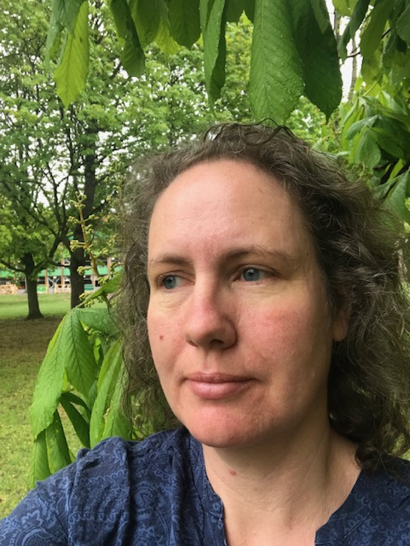
LIFE Coast Benefit
Visitor experiences
Project manager
Anneli Lundgren
anneli.lundgren@lansstyrelsen.se

Slide 2
Ecosystem services
Ecosystem services divided in four categories:
- Providing food from farm animals and cultured crops, as well as wild berries and mushroom
-Regulating and maintenance purifying of water and air by biological processes, regulating local climate, pollination, seed dispersal.
- Cultural attractive environments for recreation, estetic values, values linked to historical scenarios and spiritual reasons.
-Supporting interactions between trophy levels, decomposition, providing habitats for all development stages for species.
Notes:
There are guidelins in the SEPA web-page how to categorize ecosystem services:
http://www.naturvardsverket.se/Stod-i-miljoarbetet/Vagledningar/Samhallsplanering/Integrera-ekosystemtjanster-i-myndigheters-verksamhet/
The excel book you can download from this page has been used for the mapping of ecosystem services produced by the LIFE Coast Benefit project.
Ecosystem services are divided in four categories:
- Providing services food from farm animals and cultured crops, as well as wild berries and mushroom
-Regulating and maintenance purifying of water and air by biological processes, regulating local climate, pollination, seed dispersal.
- Cultural attractive environments for recreation, estetic values, values linked to historical scenarios and spiritual reasons
-Supporting interactions between trophy levels, decomposition, providing habitats for all development stages for species

Slide 3
Visit survey
Visitor survey at Herrborum nature reserve
Notes:
We used paper questionnaire an put them in mailboxes at 6 of our project sites.
We did not get plenty of anwers. BUT there is a lot to learn from this study!
One thing is that its difficult to se information material, those who filled in the questionnair in this point didn´t know there was signs in the other side of the Notice board, even tho they passed it on their way to the table.
The visitor seldom saw our leaflest – even when sitting next to the box containing leaflets.

Slide 4
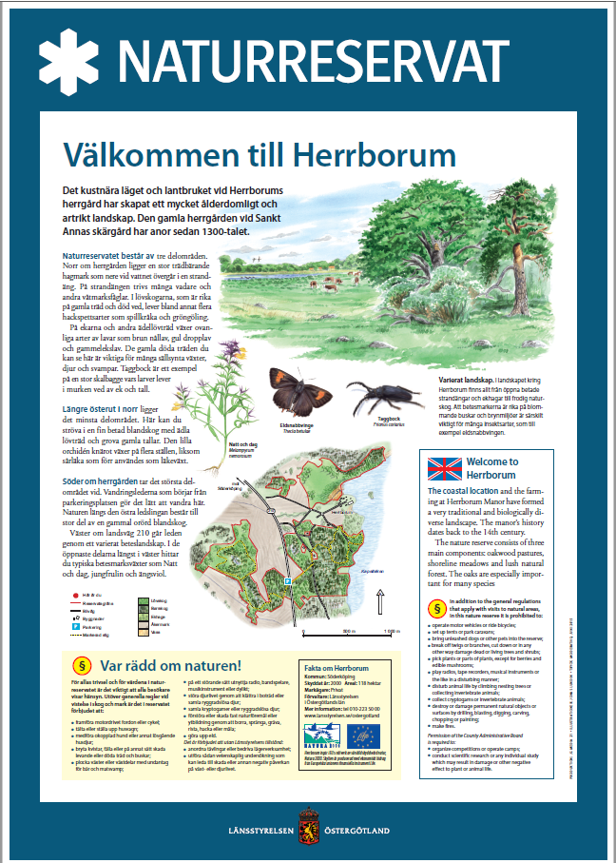
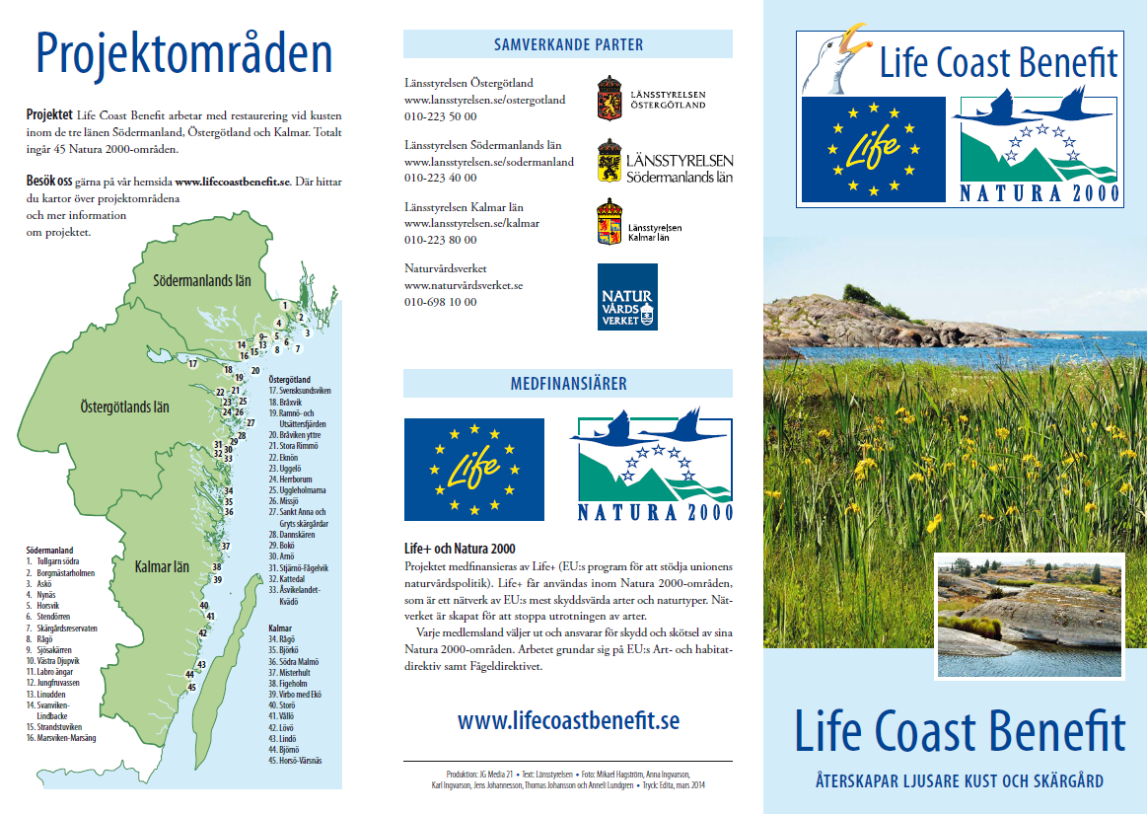
Signs and leaflets
Notes:
At Herrborum Naturereserv there were signs in place att one side of the noticeboard – visitor had to pass them on their way in, but still they missed them! Focused on parking lot?
Over all in the survey signs and leaflets some times had been noticed by visitor though. Facebook and webpage almost no one had visit.
Conclusion – there is still need for the old kind of information – leaflets and signs to reach persons visiting our project areas. Social media and websites reach more people but not visitors.
When prepaering a project there should be som analysis where and how to inform about the project measures.

Slide 5
Grass and paths
Hiking path through a grazed pasture.
But the cows had not eat all grass yet.
Troblesome for visitors.
Notes:
Most visitors in the reservs in our survey comes for taking a walk in beautiful nature, often with their family.
Quite often they return many times.
But in the case of Herrborum the parking lot was built in the project and for the first time visitor get to know how to enter the reserv! And they vere pleased with that. But anoyed that the trail was not totally obvious. Some parts had high grass.
This is grazed pasture and the cows had not been in all parts of the reserve.
Here we has to notice that we have different views! Working with grassland this is a natural thing, we don´t think much about it. But visitors not from the countryside experience that this is not available for walking – we should do somthing about it!

Slide 6
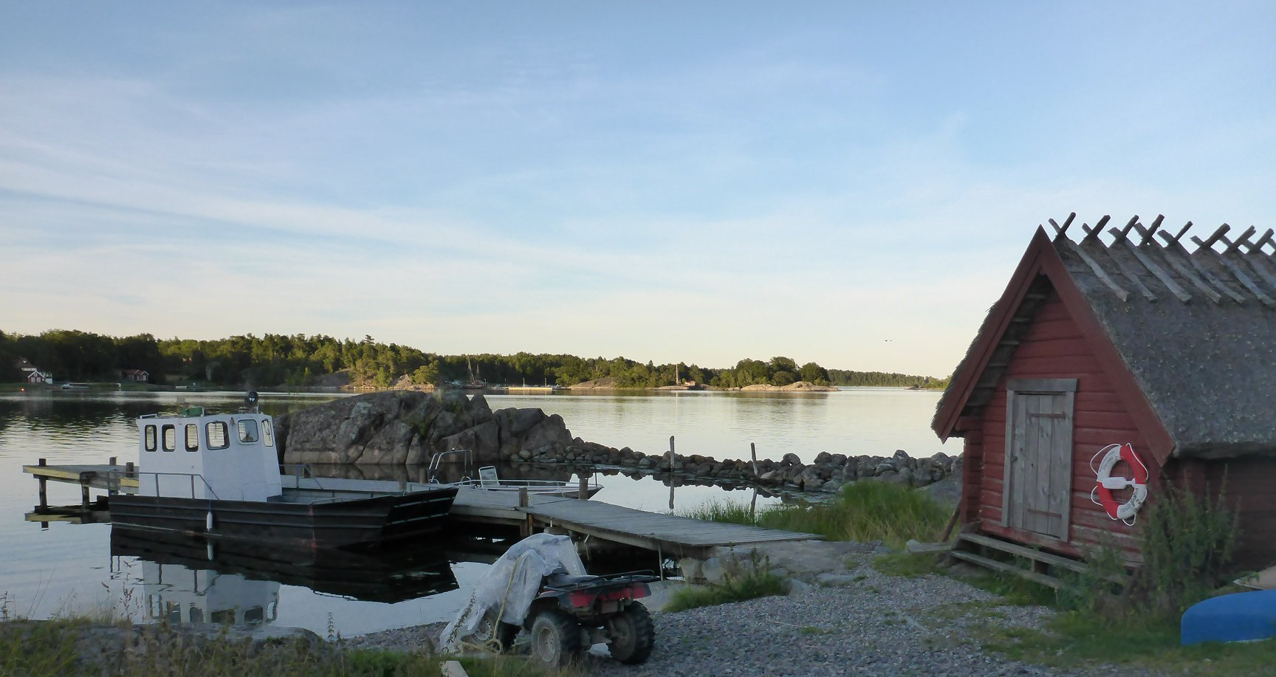
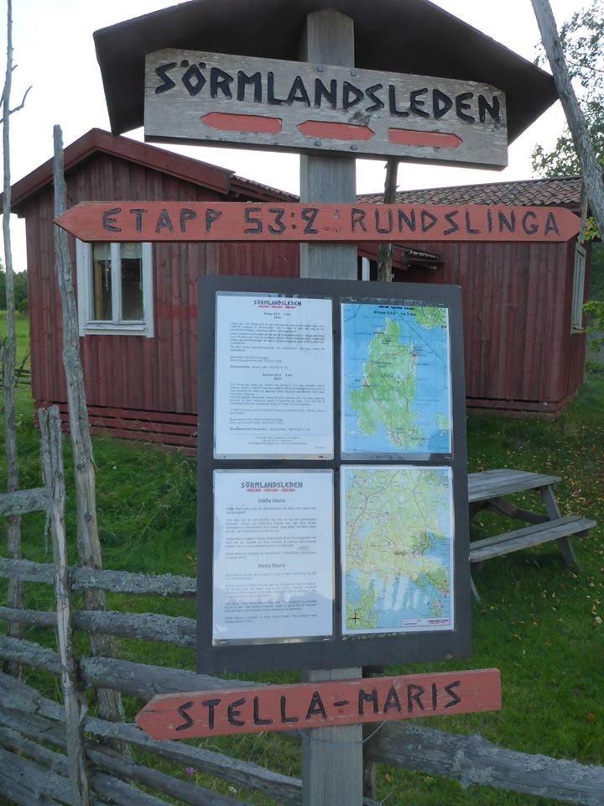
Sävö
Notes:
Visitor at Sävö in Södermanland archipelago are very satisfied with their visits!
In the project we didn´t any actions for visitors but it seems that this enchanting place and everything that is in place here make people happy.
Public transport to the island is one strong wish and some visitors also would like to buy something to eat.
There is a hostel in the island and actually You can buy some food there. Information in place?
There is a nature –school in the island, school-classes from grade 4 and older are welcome to make an reservation. And all kids from the municipality Nyköping comes here.
The visitors participating in the survey seems well educated, they praise the ongoing nature conservetion management and its clear that they know that farming with animals in the pastures are essential for the experience of the island.

Slide 7
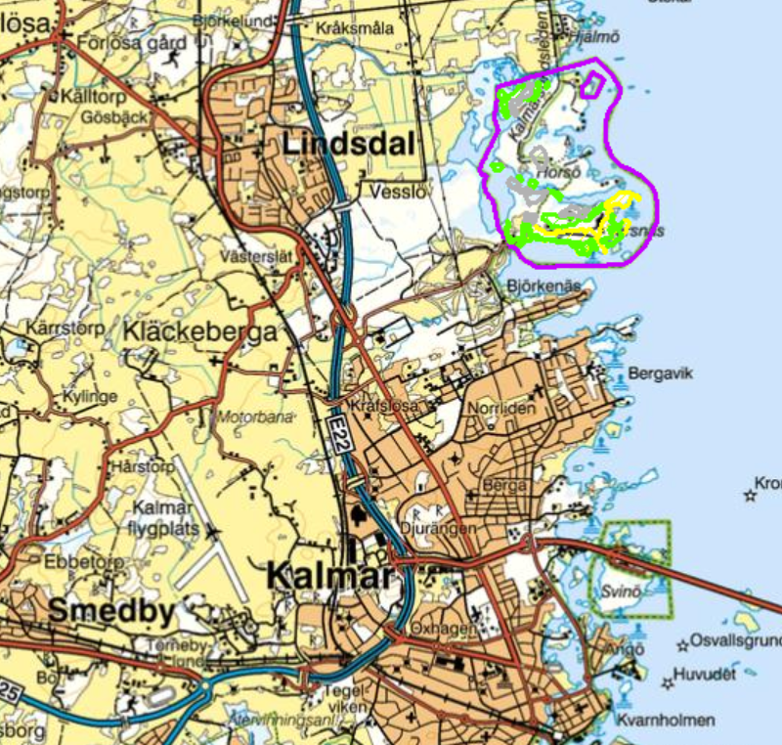
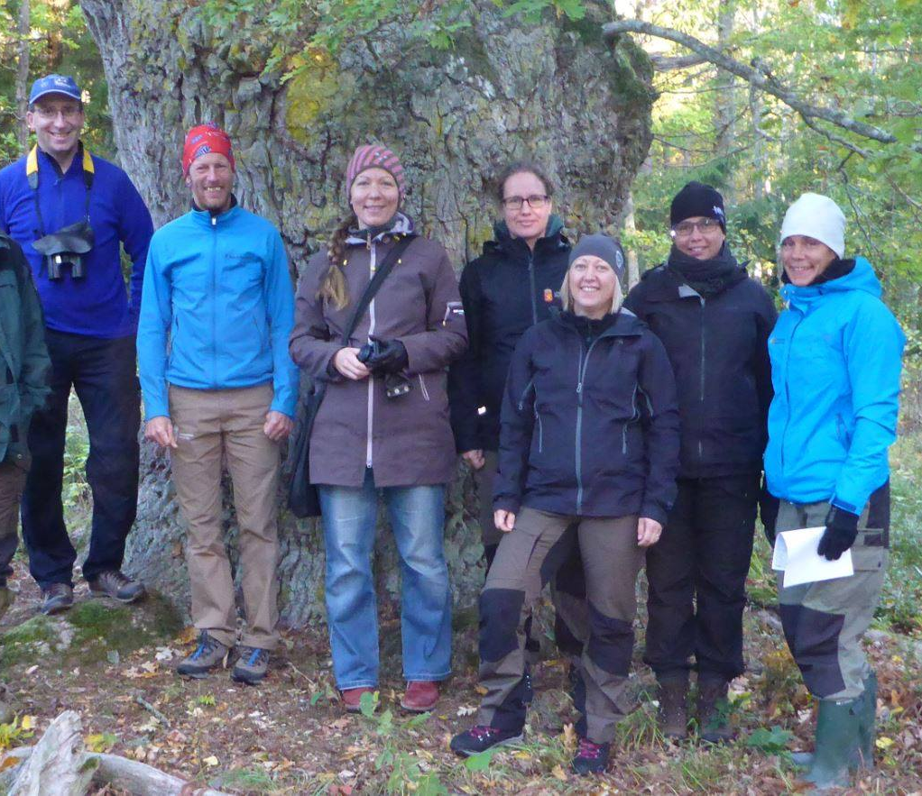
Horsö-Värsnäs
Notes:
The project site Horsö-Värsnäs
The project area is very close to the city of Kalmar. The citizens use the nature reserv for their recreation, trails are used for running and excercising. Dog owners return to the area freakvently for walks. And the visitors in general come from the neigborhood.
People seems to look at this nature reserv as if it was a city park.
There is some worries in the comments about reintroducing animals – will the dog walking now be restricted? Will we not be alowed to pass through the fences to the sea?
When asked what they wish for its comments about toilets, running tracks, mountin bike tracks.
Visitors like the oaks but it seems to bee a significant group that rather not have tha animals here.

Slide 8
Conclusions
The project sites are attractive for visitors and generate ecosystem services
The visitors are of different categories in different project sites. The information about nature and the activities in the project should have been more efficient if we had had an anlysis of this in advance and had information activities due to the target group.
It would be a good idea to seek collaboration with other actors in the project site. Visitors don´t sort out who´s responsilbe for different part of the maintainance.
Notes:
The project site Horsö-Värsnäs
The project area is very close to the city of Kalmar. The citizens use the nature reserv for their recreation, trails are used for running and excercising. Dog owners return to the area freakvently for walks. And the visitors in general come from the neigborhood.
People seems to look at this nature reserv as if it was a city park.
There is some worries in the comments about reintroducing animals – will the dog walking now be restricted? Will we not be alowed to pass through the fences to the sea?
When asked what they wish for its comments about toilets, running tracks, mountin bike tracks.
Visitors like the oaks but it seems to bee a significant group that rather not have tha animals here.

