Slide 1
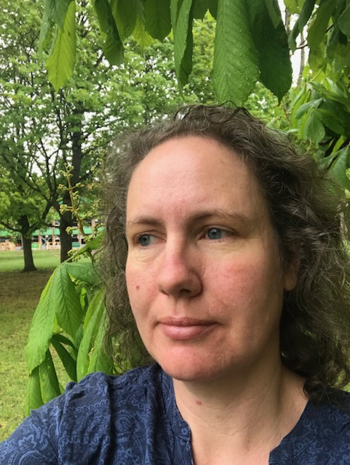
LIFE Coast Benefit
Socio economic study
Anneli Lundgren
anneli.lundgren@lansstyrelsen.se
Notes:
Socio-economic means
– does anyone gain money from the project?
-Who earn money?
-where from comes the money?
-Is it money that comes one time during the project, or is it an income that will keep coming even in the future?

Slide 2
Ecosystem services
Ecosystem services divided in four categories:
- Providing food from farm animals and cultured crops, as well as wild berries and mushroom
-Regulating and maintenance purifying of water and air by biological processes, regulating local climate, pollination, seed dispersal.
- Cultural attractive environments for recreation, estetic values, values linked to historical scenarios and spiritual reasons.
-Supporting interactions between trophy levels, decomposition, providing habitats for all development stages for species.
Notes:
There are guidelins in the SEPA web-page how to categorize ecosystem services:
http://www.naturvardsverket.se/Stod-i-miljoarbetet/Vagledningar/Samhallsplanering/Integrera-ekosystemtjanster-i-myndigheters-verksamhet/
The excel book you can download from this page has been used for the mapping of ecosystem services produced by the LIFE Coast Benefit project.
Ecosystem services are divided in four categories:
- Providing services food from farm animals and cultured crops, as well as wild berries and mushroom
-Regulating and maintenance purifying of water and air by biological processes, regulating local climate, pollination, seed dispersal.
- Cultural attractive environments for recreation, estetic values, values linked to historical scenarios and spiritual reasons
-Supporting interactions between trophy levels, decomposition, providing habitats for all development stages for species

Slide 3
Providing
We have restored 300 ha open semi-natural grasslands
Ca 1 livestock unit per hectare (one grown up cow)
The cow gain 800-1000g every day and 150 days in the grasslands (May-Sept)
Farmers get approx 3 Euro per kilogram meat
That give us 121 500 Euro per year from open grasslands
Notes:
Cows grazing at the island Hartsö SE0220129 (photo Anna Ingvarson), one of the island in the project area.
In the project we have restored 300 hectares of semi natural grasslands like this one. We usually count one livestock unit (for example one cow) per hectare.
So in cvantitative numbers we support about 300 cows (or 300 livestock units of any kind)
In monetary the price for meat from cows (beef) are slowly declining. In 2016 it was about 3 Euro/kg.
https://www.luke.fi/sv/nyheter/producentpriserna-for-kott-och-spannmal-sjonk-for-tredje-aret-i-rad/
The cows gain between 800 g and 1000 g every day. In 150 days per season the 405 Euro/livestock unit.
http://www2.jordbruksverket.se/webdav/files/SJV/trycksaker/Pdf_jo/jo06_11.pdf

Slide 4
Providing services in total
Open semi-natural grasslands 300 hectares (1 livestock units/hectare) 121 500 €/year
Coastal meadows 230 hectares (1,5 livestock units/hectare) 139 725 €/year
Woded meadows 370 hectares (0,5 livestock units/hectare) 83 250 €/year
Altogether : 344 475 €/year

Slide 5
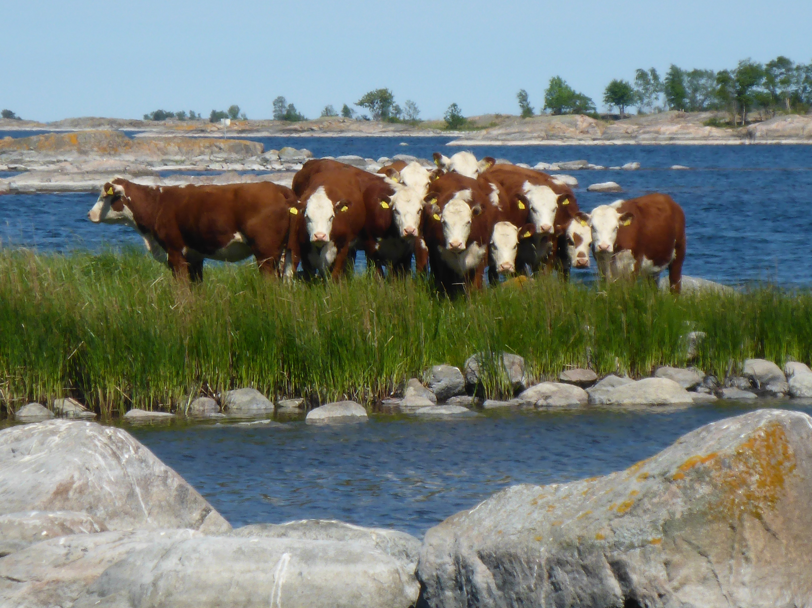
RDP
Rural Development Program (RDP)
We assume the same 900 hectares will gain subsidies from the RDP after the project
Calculation 3 different subsidies ”gårdsstöd + miljöersättning”
-Open semi-natural grasslands 300 ha:
131 €/ha + 280 €/ha = 123 300 €/year
-Coastal meadows 230 ha:
131 €/ha + 280 €/ha = 94 530 €/ha
-Grazed forest 370 ha:
350 € = 95€/h4 530
In total 217 830 €/year
Notes:
Subsidies from RDP
http://www.jordbruksverket.se/amnesomraden/stod/jordbrukarstod/stodochersattningar/miljoersattningar/betesmarkerochslatterangar/utbetalning.4.4dfd5d3a1526082877c7e470.html

Slide 6
Complement
Inaccessible land 100 €/ha/year, estimated 286 ha in 2018 and may increase now 2019
=28 600 €/ha/year
Harvesting leafs as fodder from pollards 10 €/tree /year
We have restored more than 1300 ancient pollarded trees.
We have created new ones as well.
Lets make a rough estimate, 700 pollards will be eligible for the subsidy
=7 000 €/year
Notes:
We have restored more than 1300 ancient pollarded trees, but not all them so much that they can be used for harvesting fodder. We have created new ones as well. Lets make a rough estimate, 700 pollards will be eligible for the subsidy

Slide 7
Money for contractors
In february 2019 we had payed 5,5 miljon € to contractors.
25% of the money went to the project area (archipelago and coast, max 1 km from the sea)
Thats 1.4 milj or 13 milj SEK
100 different contractors within the project area!
39 % of the money went to the region (Södermanland, Östergötland and Kalmar)

