Slide 1
LIFE Coast Benefit
Björkö Tjust archipelago

Slide 2
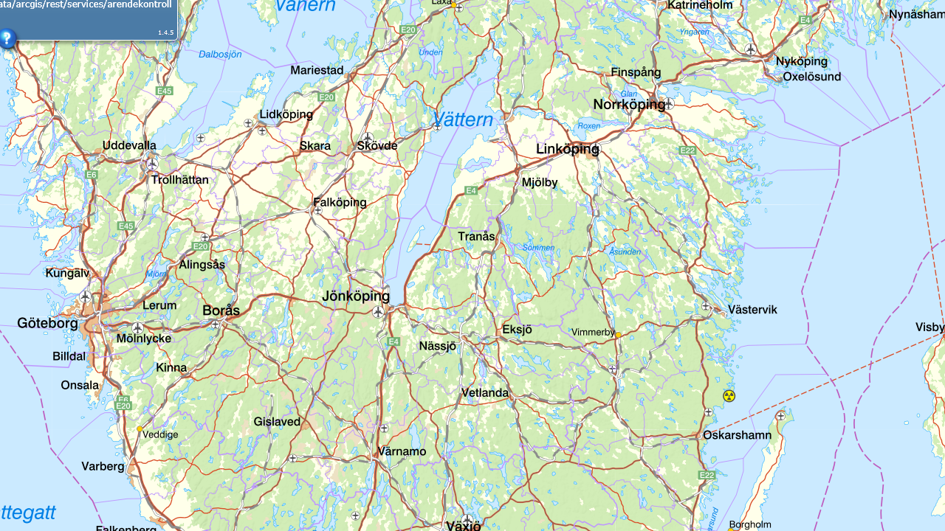
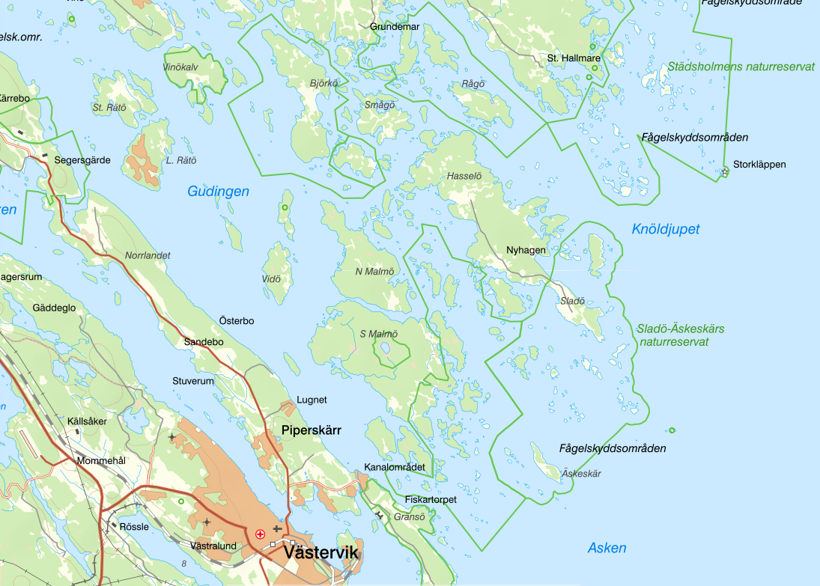
Notes:
Map of Björkö in Tjust archipelago

Slide 3
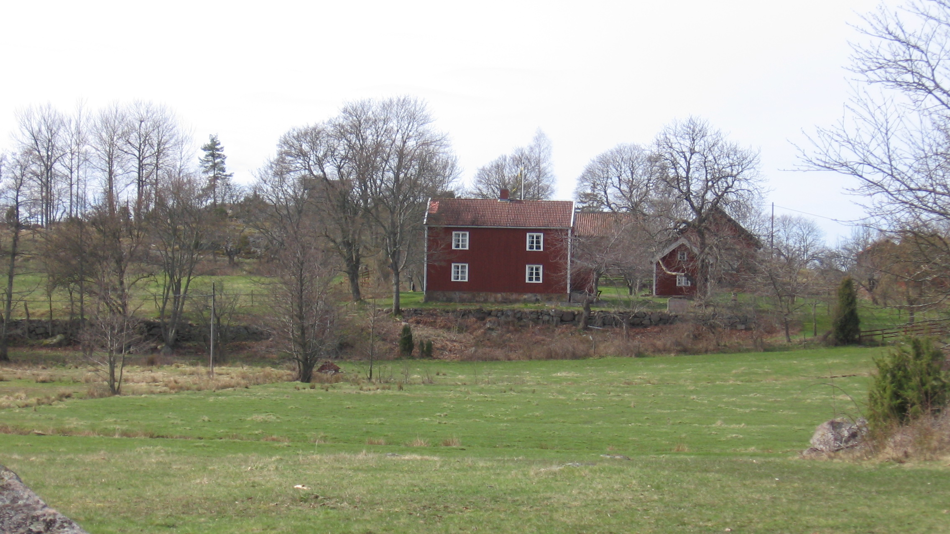

Slide 4
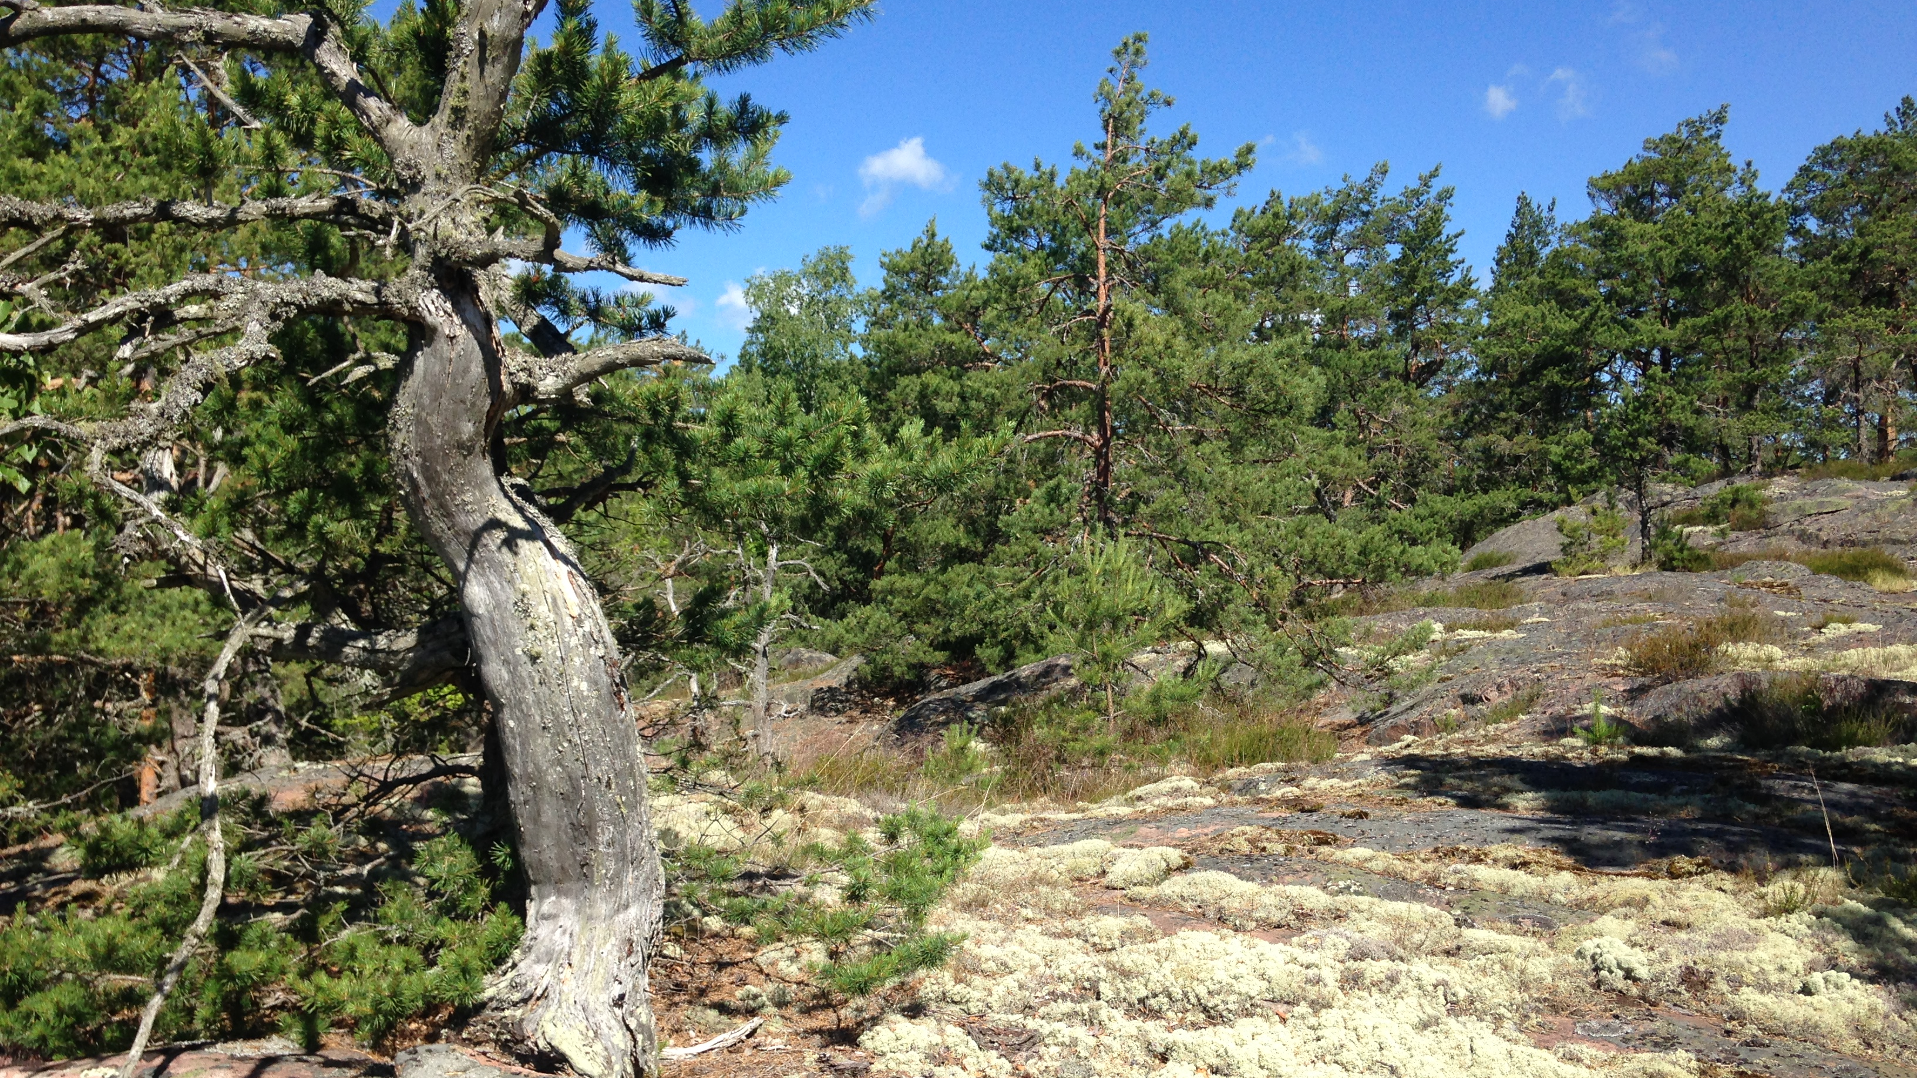

Slide 5
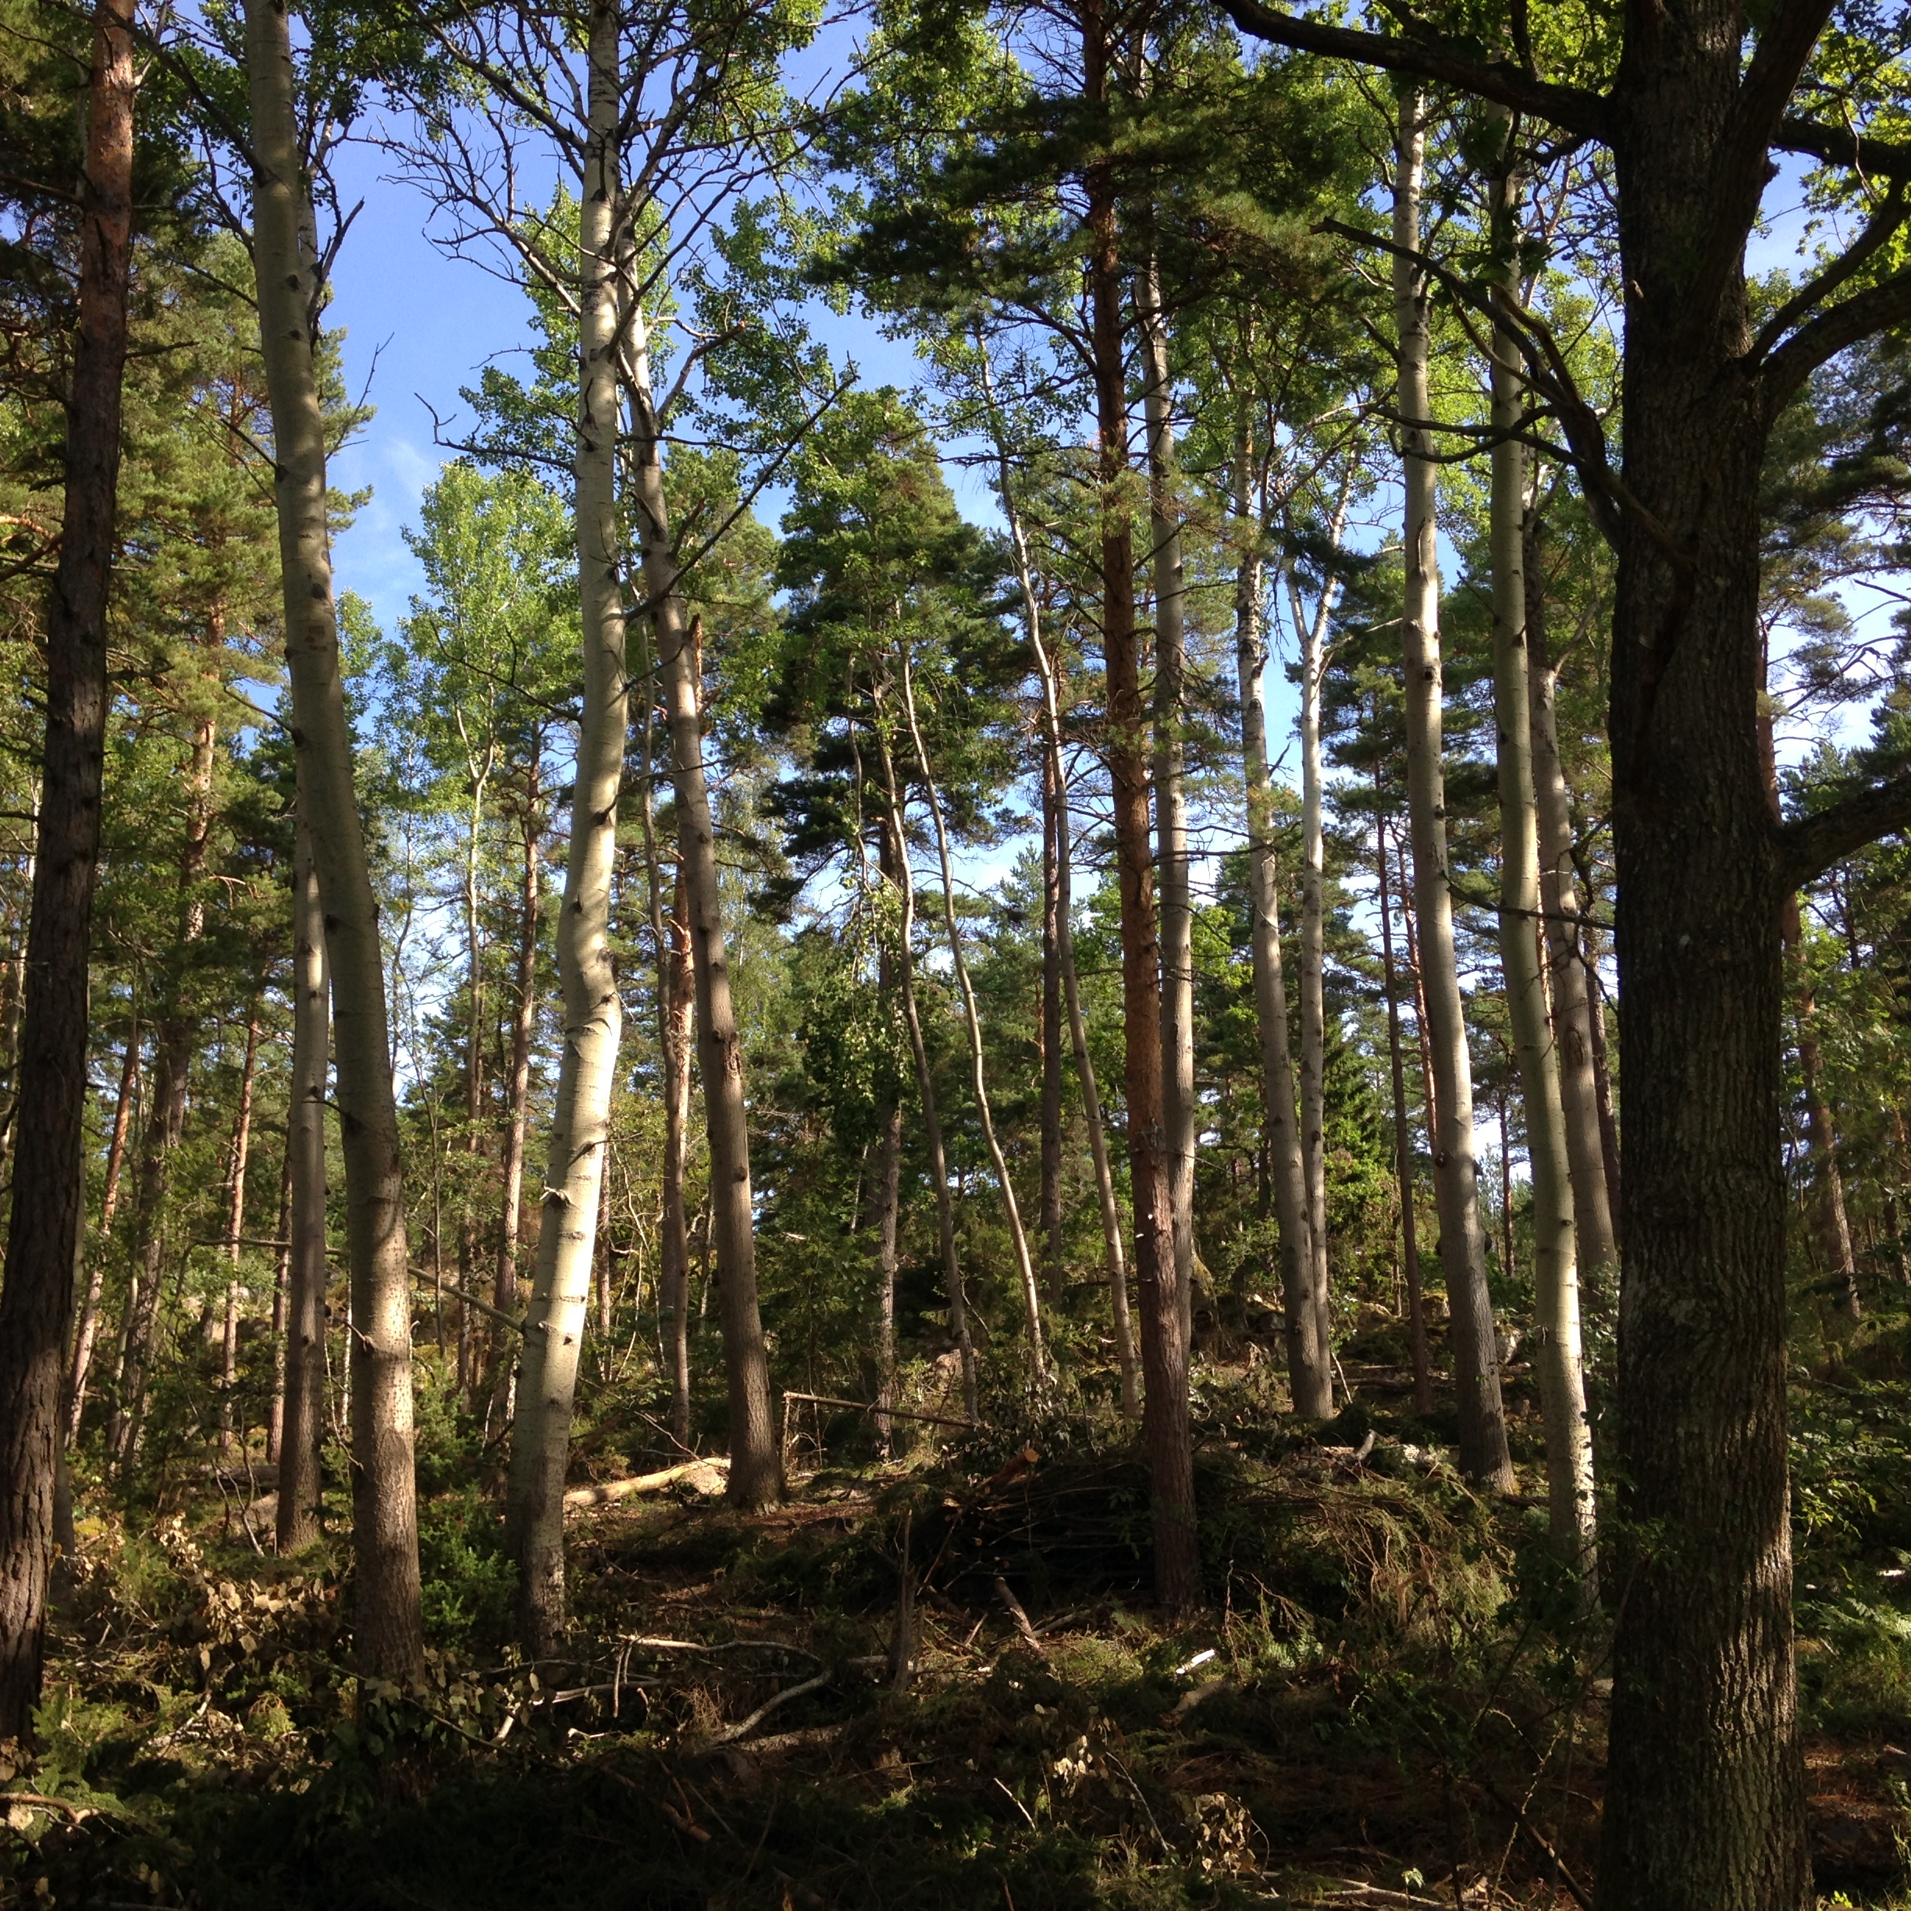

Slide 6
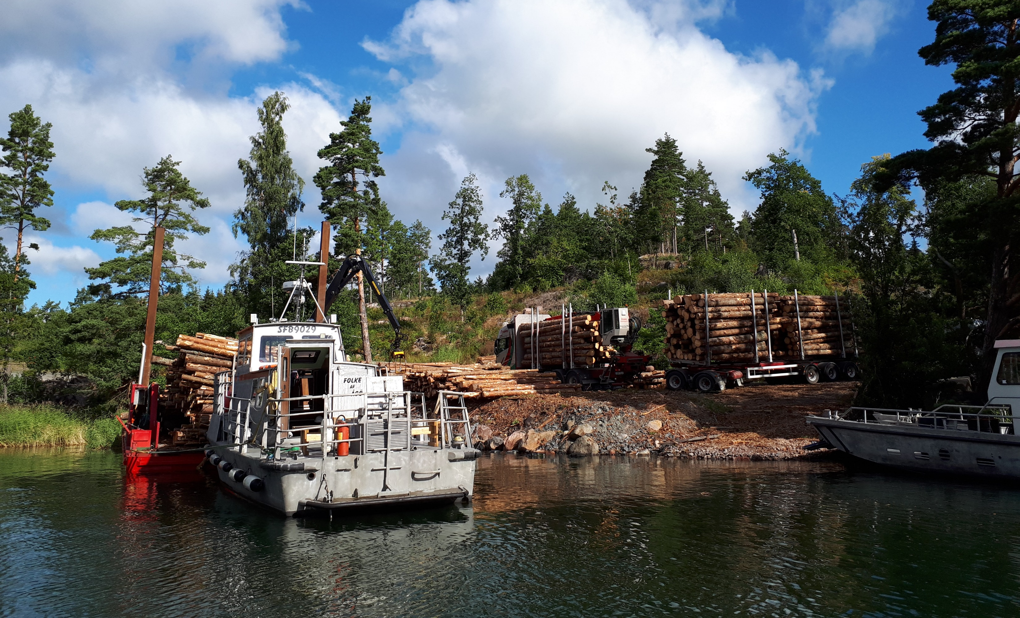
Notes:
Forestry in the archepilago

Slide 7
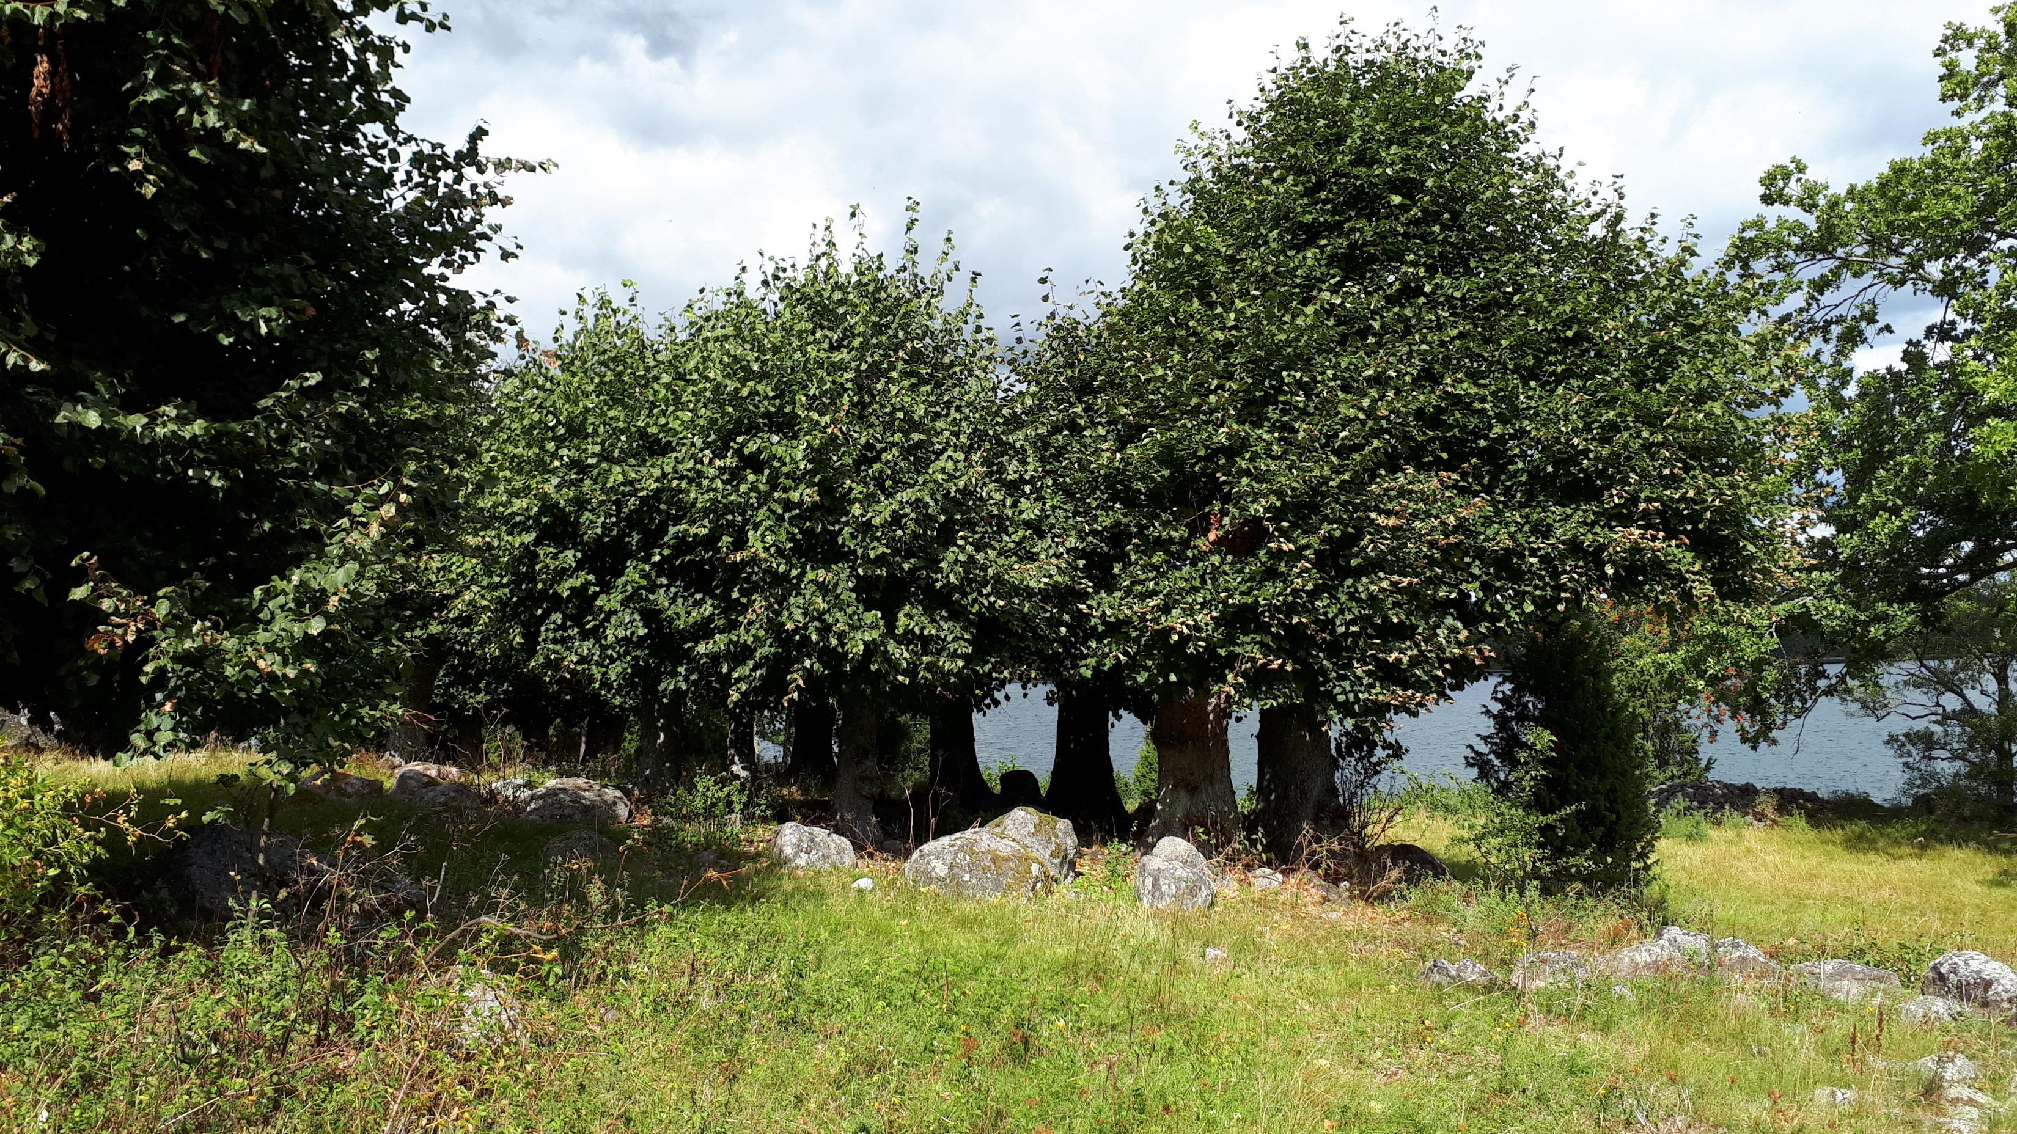
Notes:
lindholmen

Slide 8
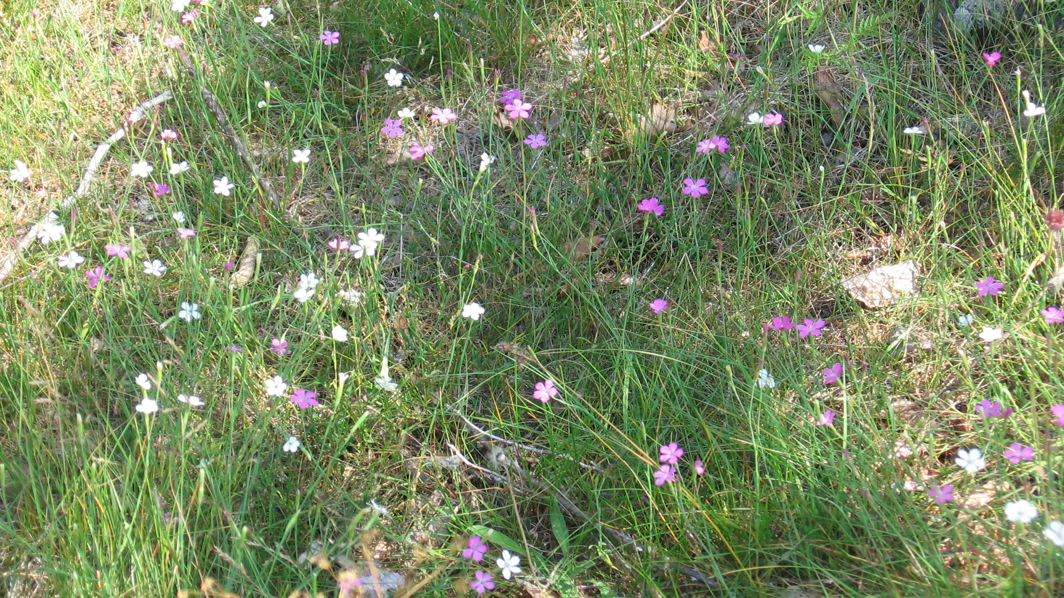
Notes:
lindholmen

Slide 9
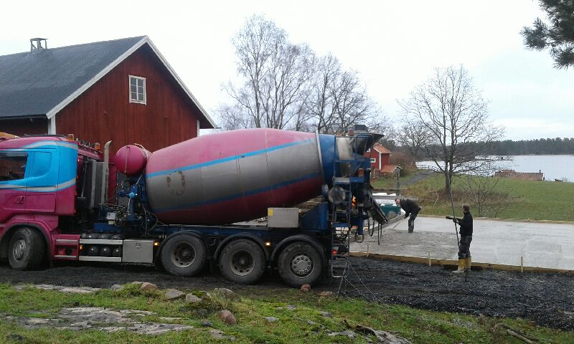
Notes:
Construction of ground floor for extension of the stable

Slide 10
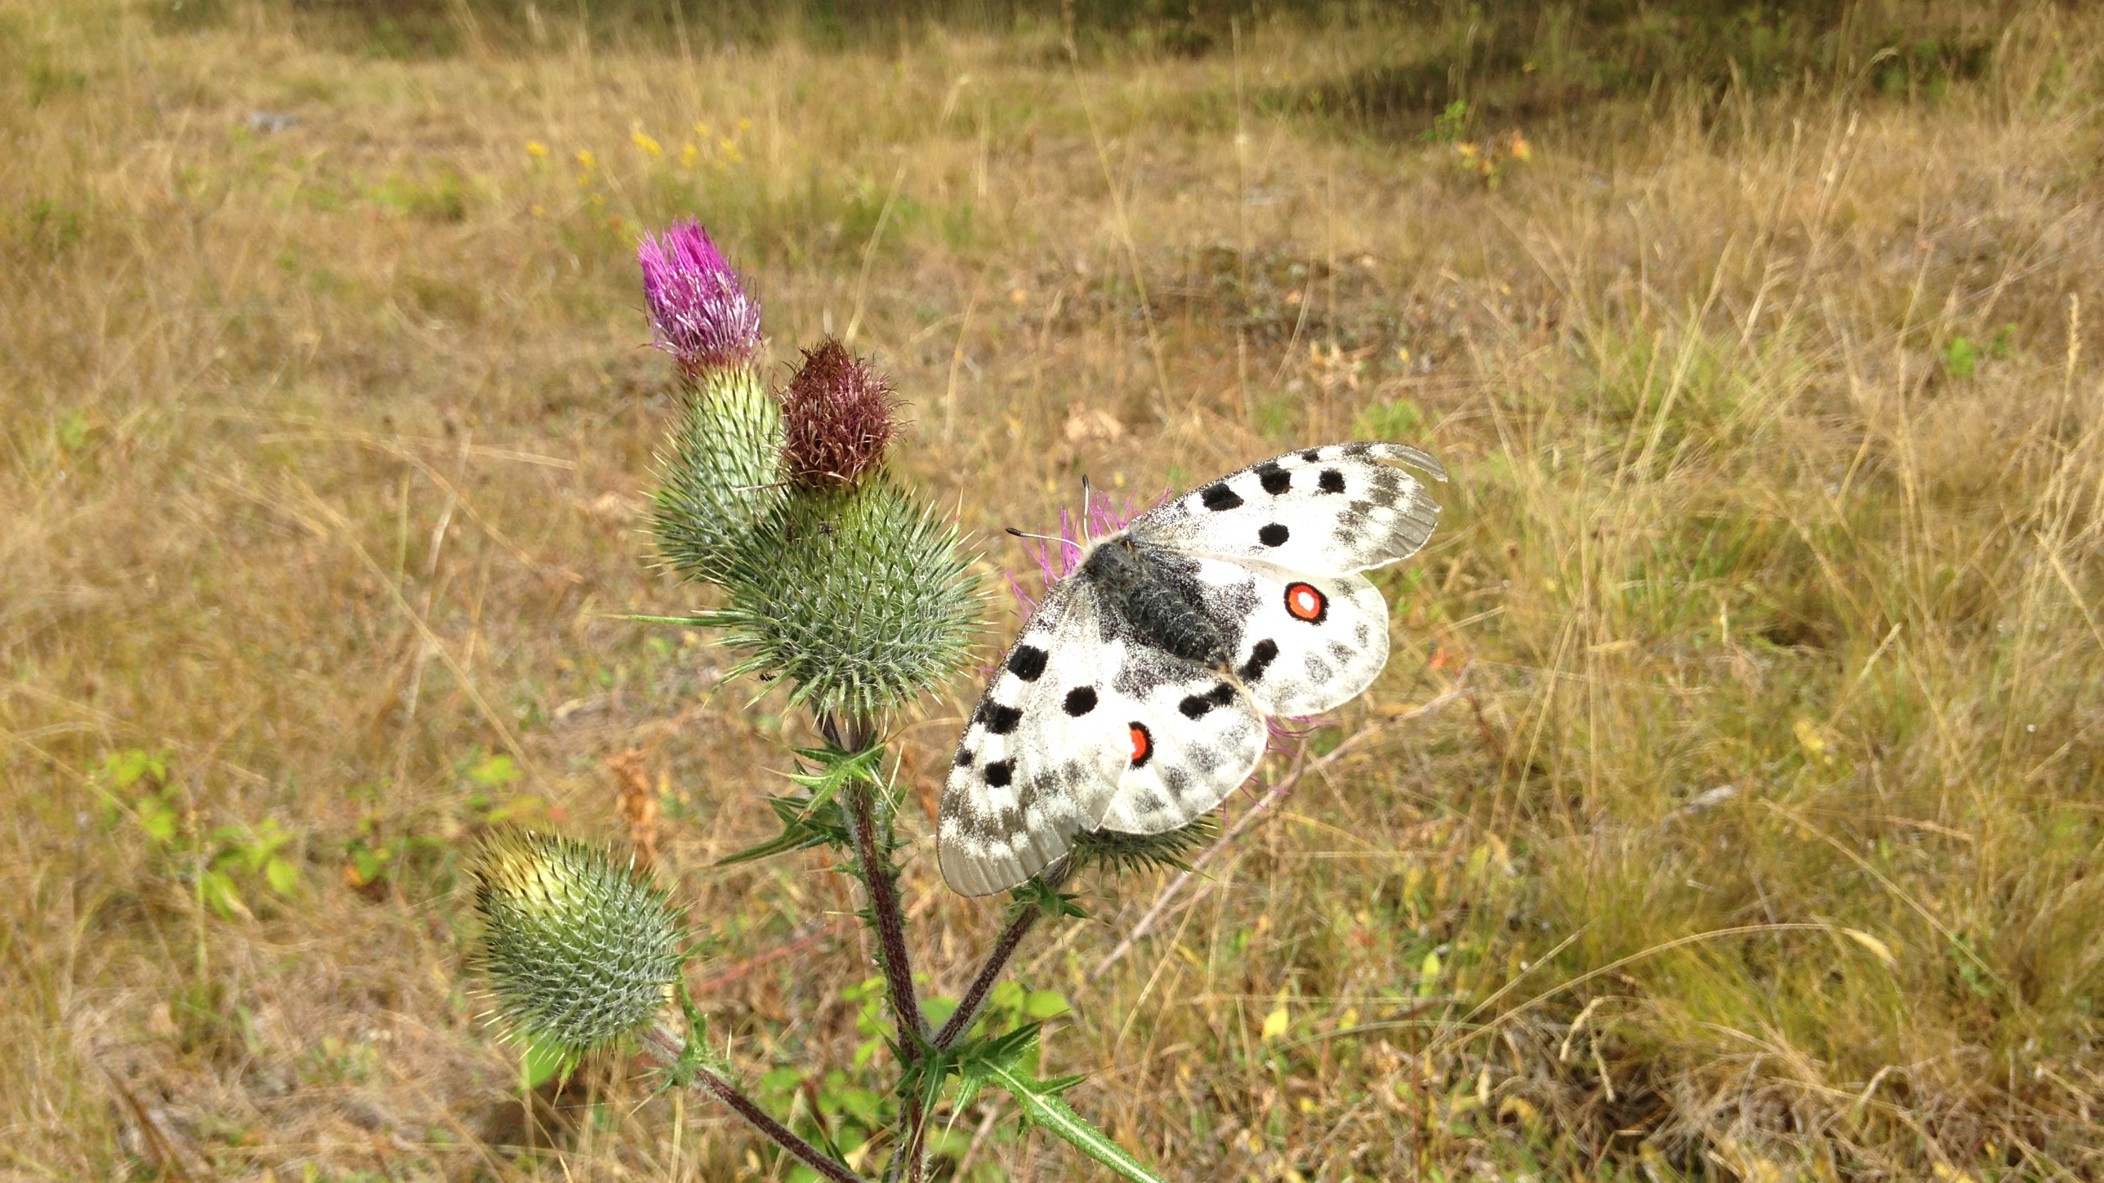
Notes:
Parnassius apollo

Slide 11
Notes:
Magnus Alvarsson (Landowner)

