Slide 1
Nynäs nature reserve Lotta Lindberg-Thompson 2019-05-16

Slide 2
Nynäs nature reserve
Total area of 3800 ha
770 ha of lakes, streams and coastal areas
2400 ha of forested area
280 ha of natural grazing areas
380 ha of arable land

Slide 3
Nynäs nature reserve
Governing body – Region of Sörmland (County council)
Our mission:
To enable our citizens to take part in cultural activities, offer education and outdoor activities
To increase environmental awareness
To increase biological diversity

Slide 4
Life Coast Benefit 2013-2019 Actions
Restauration of 103 ha natural pastures
Controlled conservation burning 8 ha
Fencing 1500 km
Cattle grids
Building a sheep barn
Aerial photography
Monitoring and inventory of bird species and vascular plants before projekt start
Revision of management plan
Information and communication to visitors and tenants

Slide 5
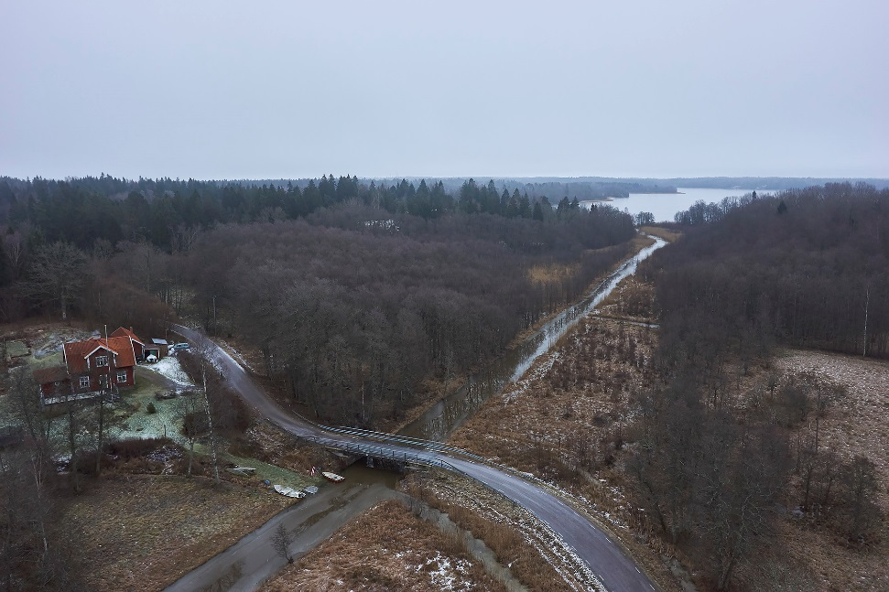
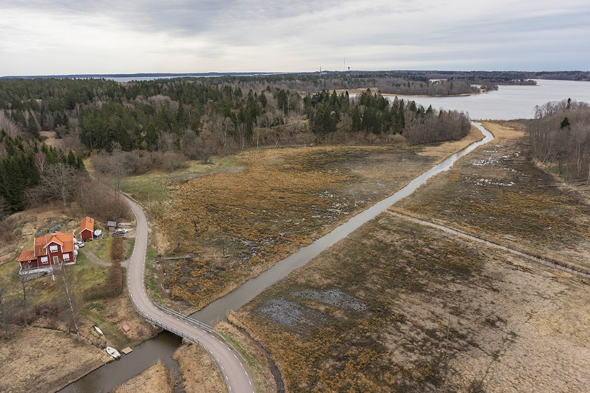
Life Coast Benefit 2013-2019 Actions Pasture restoration
Before
After

Slide 6
Life Coast Benefit 2013-2019 Actions Sheep barn

Slide 7
Life Coast Benefits 2013-2019 Actions Conservation burning

Slide 8
Summary
Dare to make restorations even though it looks very overgrown!
Use historical maps and materials
Important with good cooperation and communication between the different participants
Do not underestimate the power of information and communication with stakeholders
Assume that everything takes longer time than what you have accounted for

