Slide 1
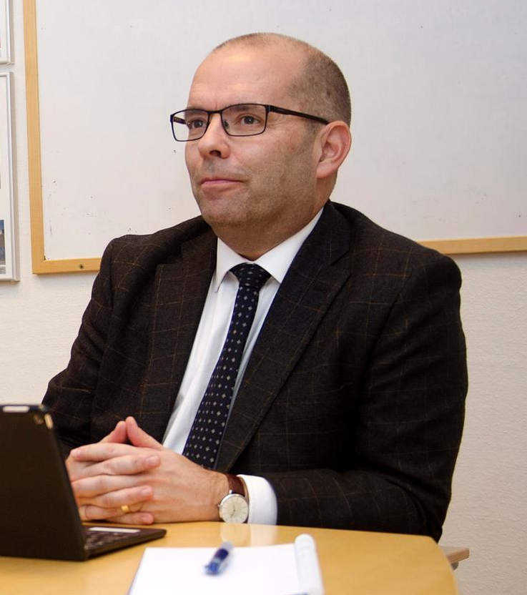
LIFE Coast Benefit
Head of the County Administrative Board of Östergötland
Carl Fredrik Graf

Slide 3
LIFE Coast Benefit
Brighter coast and archipelago

Slide 4
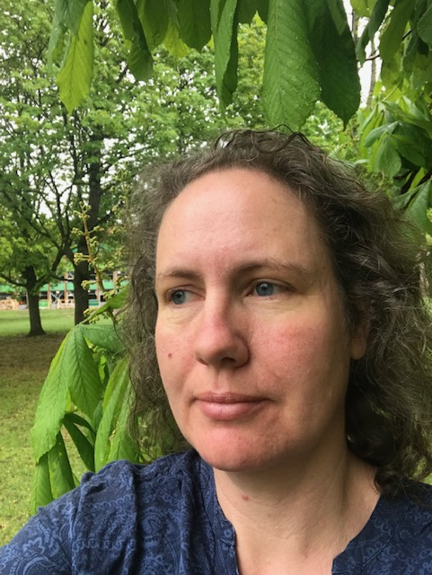
Project management
Finacial manager
Therese Åneklint
therese.aneklint@lansstyrelsen.se
Project manager
Anneli Lundgren
anneli.lundgren@lansstyrelsen.se
Notes:
Anneli Lundgren Project Manager (full time)
Therese Åneklint Financial manager (part time, about 30%)
We keep the project administration and financial reports in good order.
Monthly project group meetings to follow up and monitor activities as well as financial reporting (time sheets, accounting contra the financial statement document).

Slide 5
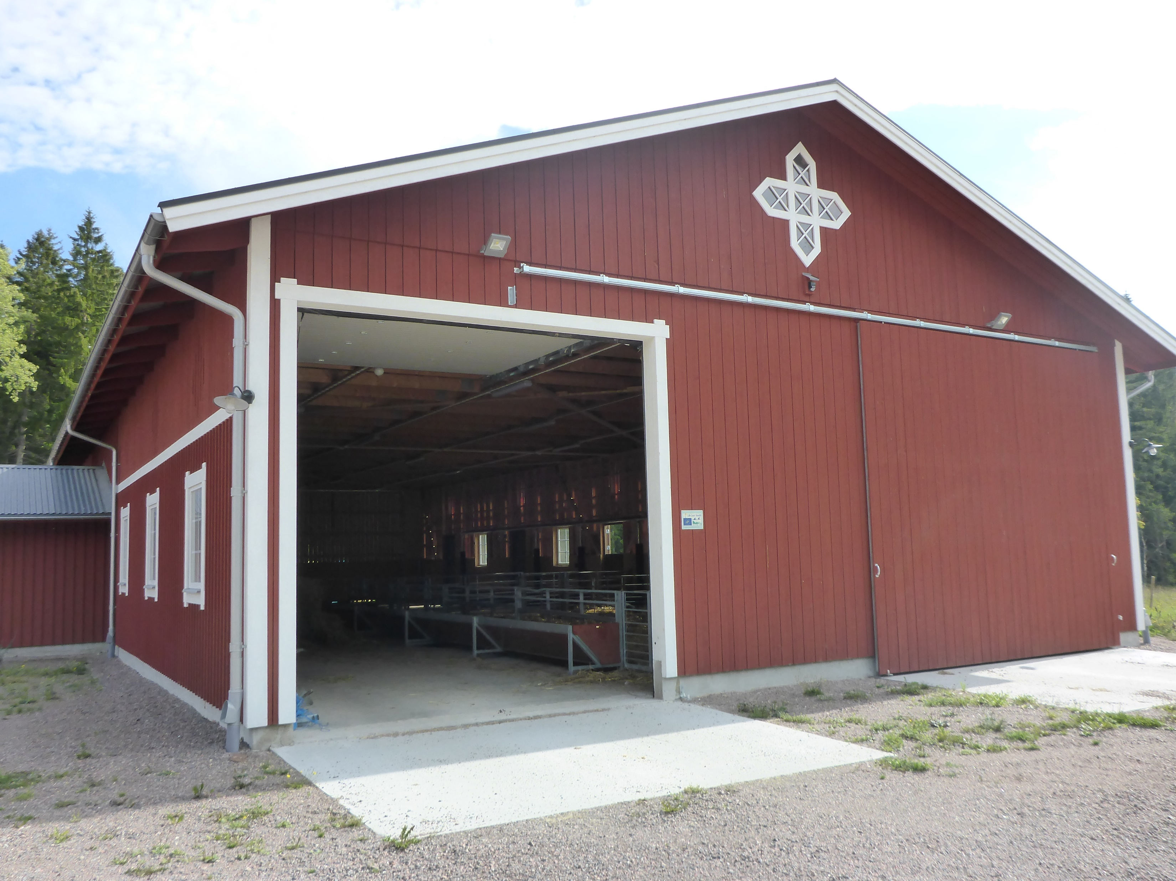
Challenges
Notes:
One of our biggest challenges has been the exchange rate. The Swedish crown has become very week against the euro which is the currency for the project.
We calculated the project at an exchange rate at 8,6 and now we have 10.5 – more than 22% change over the project period.
We will finalize the project with some underspending (in Swedish crowns, quite close to the original calculated budget).
One effect linked to the week currency is that the project will end up with a currency loss. Partners co-financing will therefore increase to cover the currency loss. This has been a challenge to visualize for the project group how this affects our co-financing.
The infrastructure investments in barns and roads have become much more expensive than expected therefore we have had to request a budget change in December 2018. This is due to the market demand which changed during the project.

Slide 6
Successes
Notes:
Regular follow ups have led to good administration - we have a good routine for monitoring both implemented actions and finances. We have used a geodatabase - a map tool where you can record surfaces, lines and dots for each action. The measures are linked to the right area - good overview of what remains to be done through regular monitoring of each action. Swedish platform meetings have given us an exchange of experience and provided support for developing the working methods. The steering group has consisted of operational managers who handle the staffing of each partner. The fact that the head of units who have been part of the steering group are those who actually have the mandate to change the activities of their respective partners has been a part of our success. We have been able to talk about the current situation in the project and directly adapt the workforce and activities. It has also worked well to implement budget changes and the transfer of money between partners. The Swedish Environmental Protection Agency is a partner in our project, it has helped us a lot to keep track of the most complicated administrative rule the so-called 2% rule so carefully.

