Slide 1
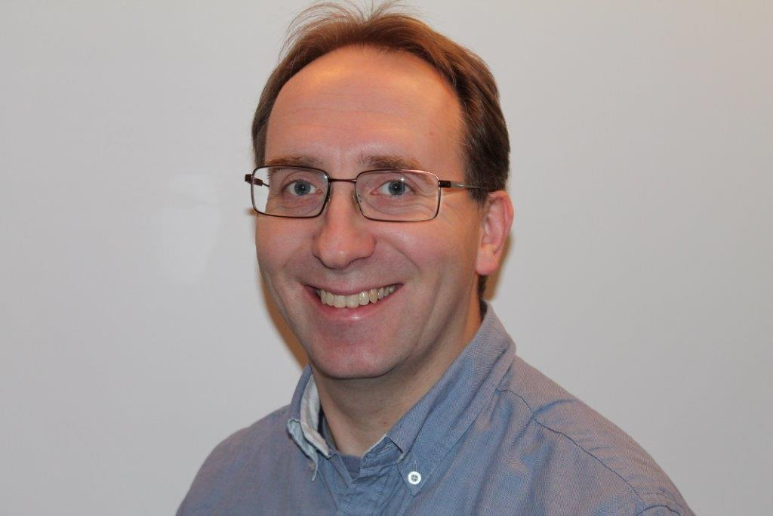
LIFE Coast Benefit
Lighter forests on the coast
Martin Larsson
County Administrative Board Östergötland

Slide 2
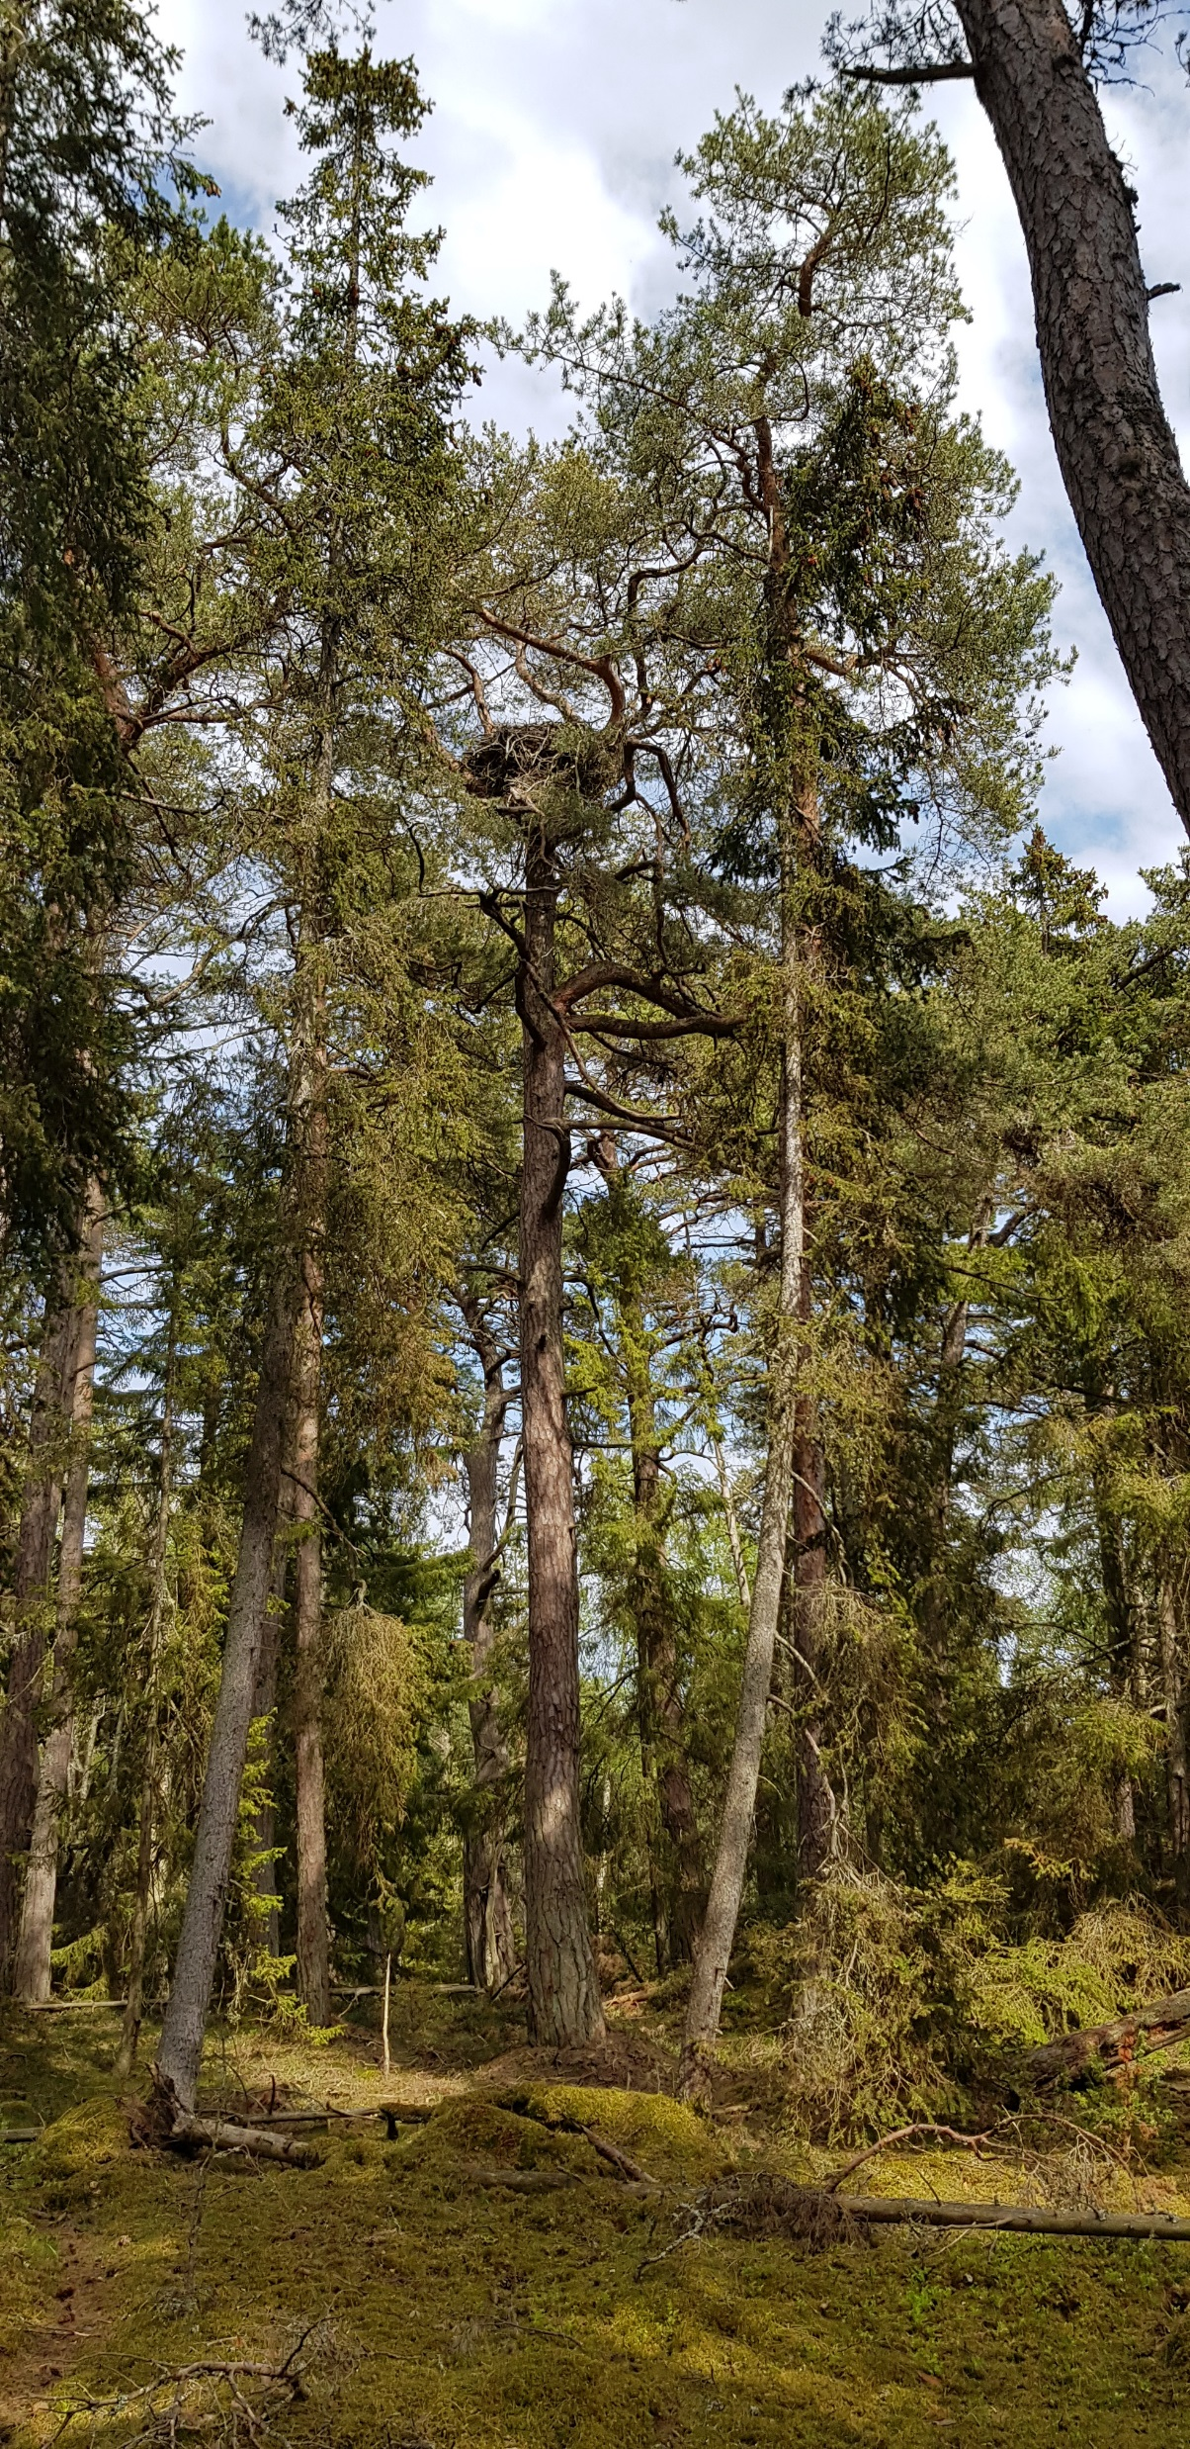
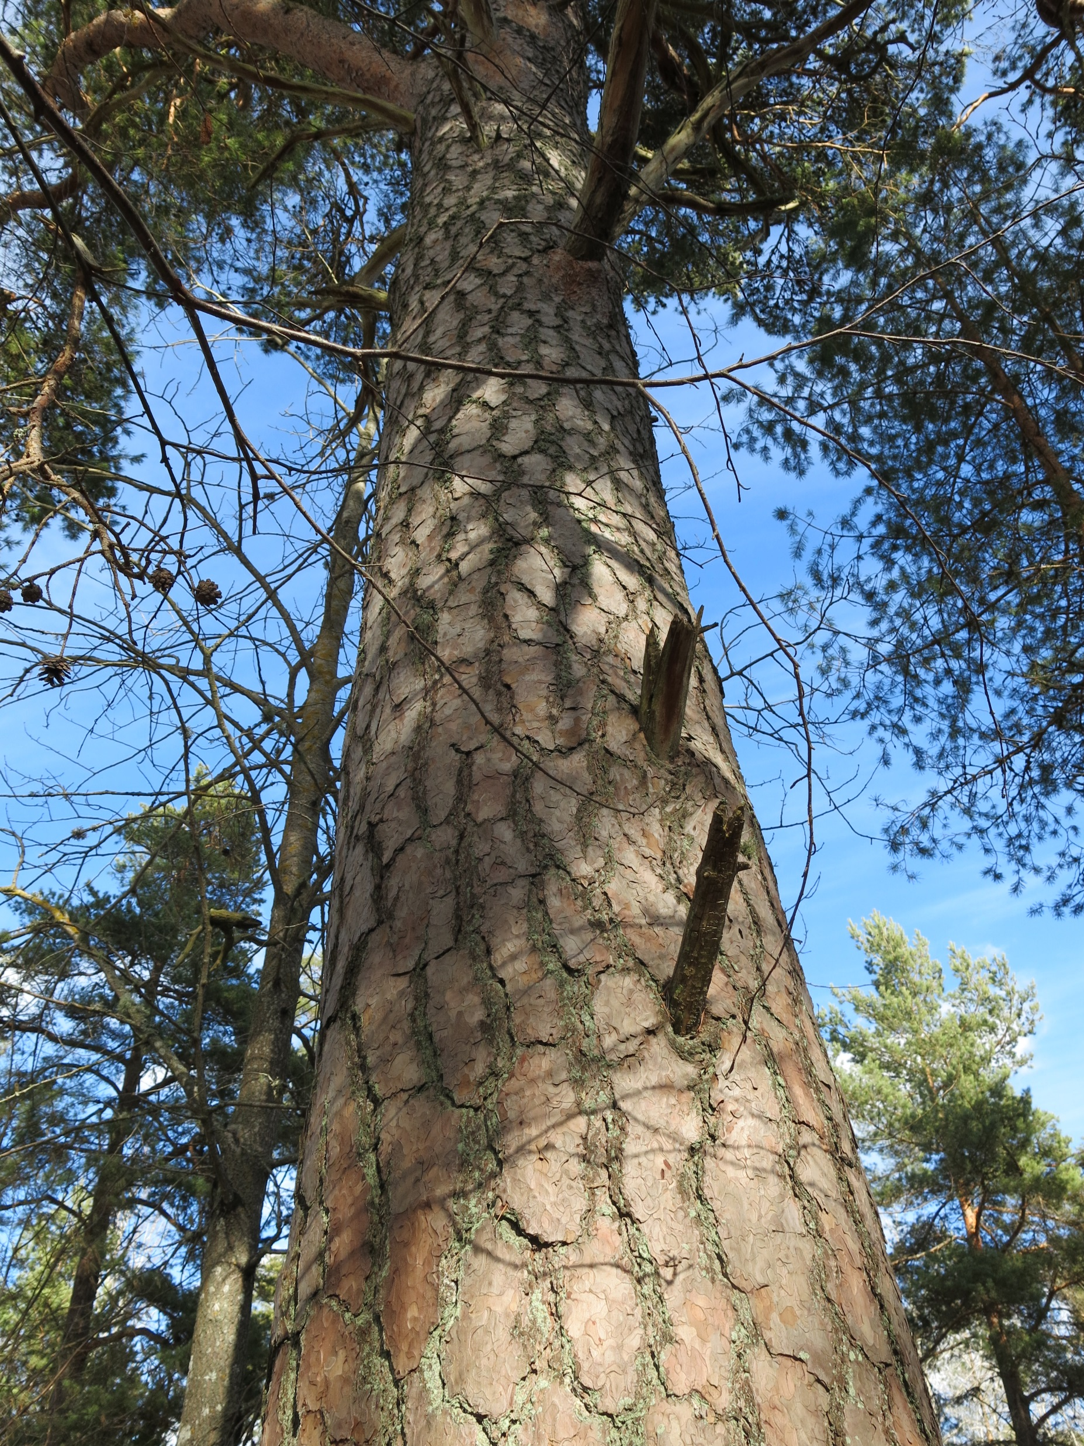
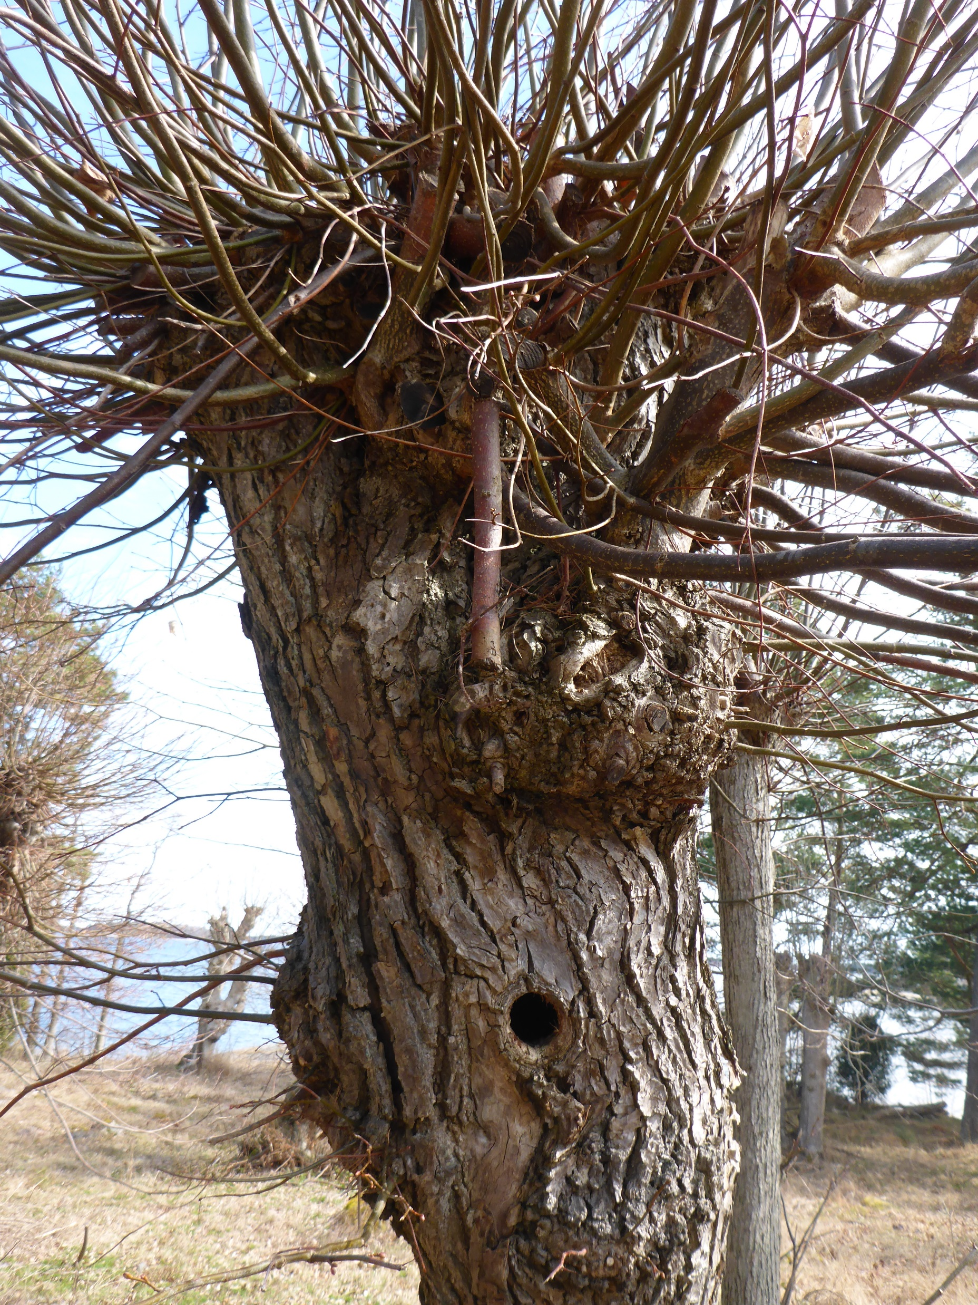
A landscape with high tree values
Nest of Sea Eagle (Haliaeetus albicilla)
Notes:
High nature conservation values are adapted to trees in the coastal landscape of southeastern Sweden (in the counties of Södermanland, Östergötland and Kalmar) where we have run the LIFE Coast Benefit project since 2013.
Here you will find old and mature trees, veteran and ancient trees as well as a cultural landscape with many connections to trees.
I will now tell you about this landscape, our tree related measures in the project and some of the inhabitants and of course all the trees we hope to have appreciated our work.
Feel free to ask your questions and contribute with your knowledge and opinions today and during the conference.

Slide 3
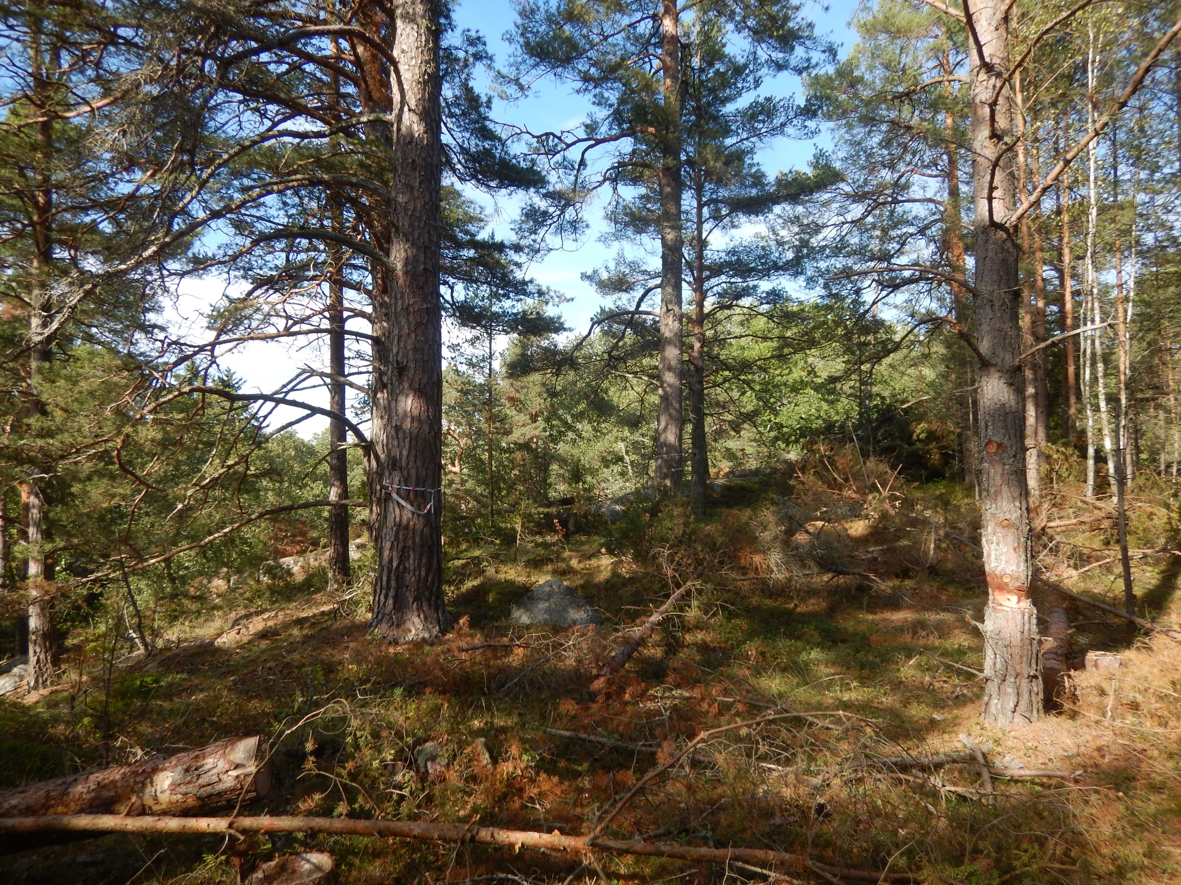
Coastal forests in Eastern Sweden
Notes:
A thin soil layer on bedrock is dominating along the coast and on islands in the region. The proportion of bare rocks are usually high.
There are deeper clayey soils in valleys and other lower areas, locally it also occurs sandy soil.
In some areas there are presence of lime in the soil.
The annual average temperature is high (compared to many other parts of Sweden) and the region have by the lowest annual average precipitation in the country.
The climate on the coast is characterized by a cold spring, warm and dry summer and a longer warm autumn than the surrounding areas depending on the heating and cooling of the sea.
The ongoing climate change might further strengthen this with more extreme weather situations and shift of seasons.
Pine (Pinus sylvestris) is the dominant tree species of many wooded habitats along the coast.
Old and very old (mature) pine trees are widespread in the region and will be found in both pine dominated old forests (Habitat 9010 Western taiga) and scattered in younger forests as well as in grazed areas with various tree composition (Habitat 9070 Fennoscandian wooded pastures).
The forests on the coast are less influenced by modern forestry than in many other areas, important for the biodiversity and for possibilities for dispersion of species!

Slide 4
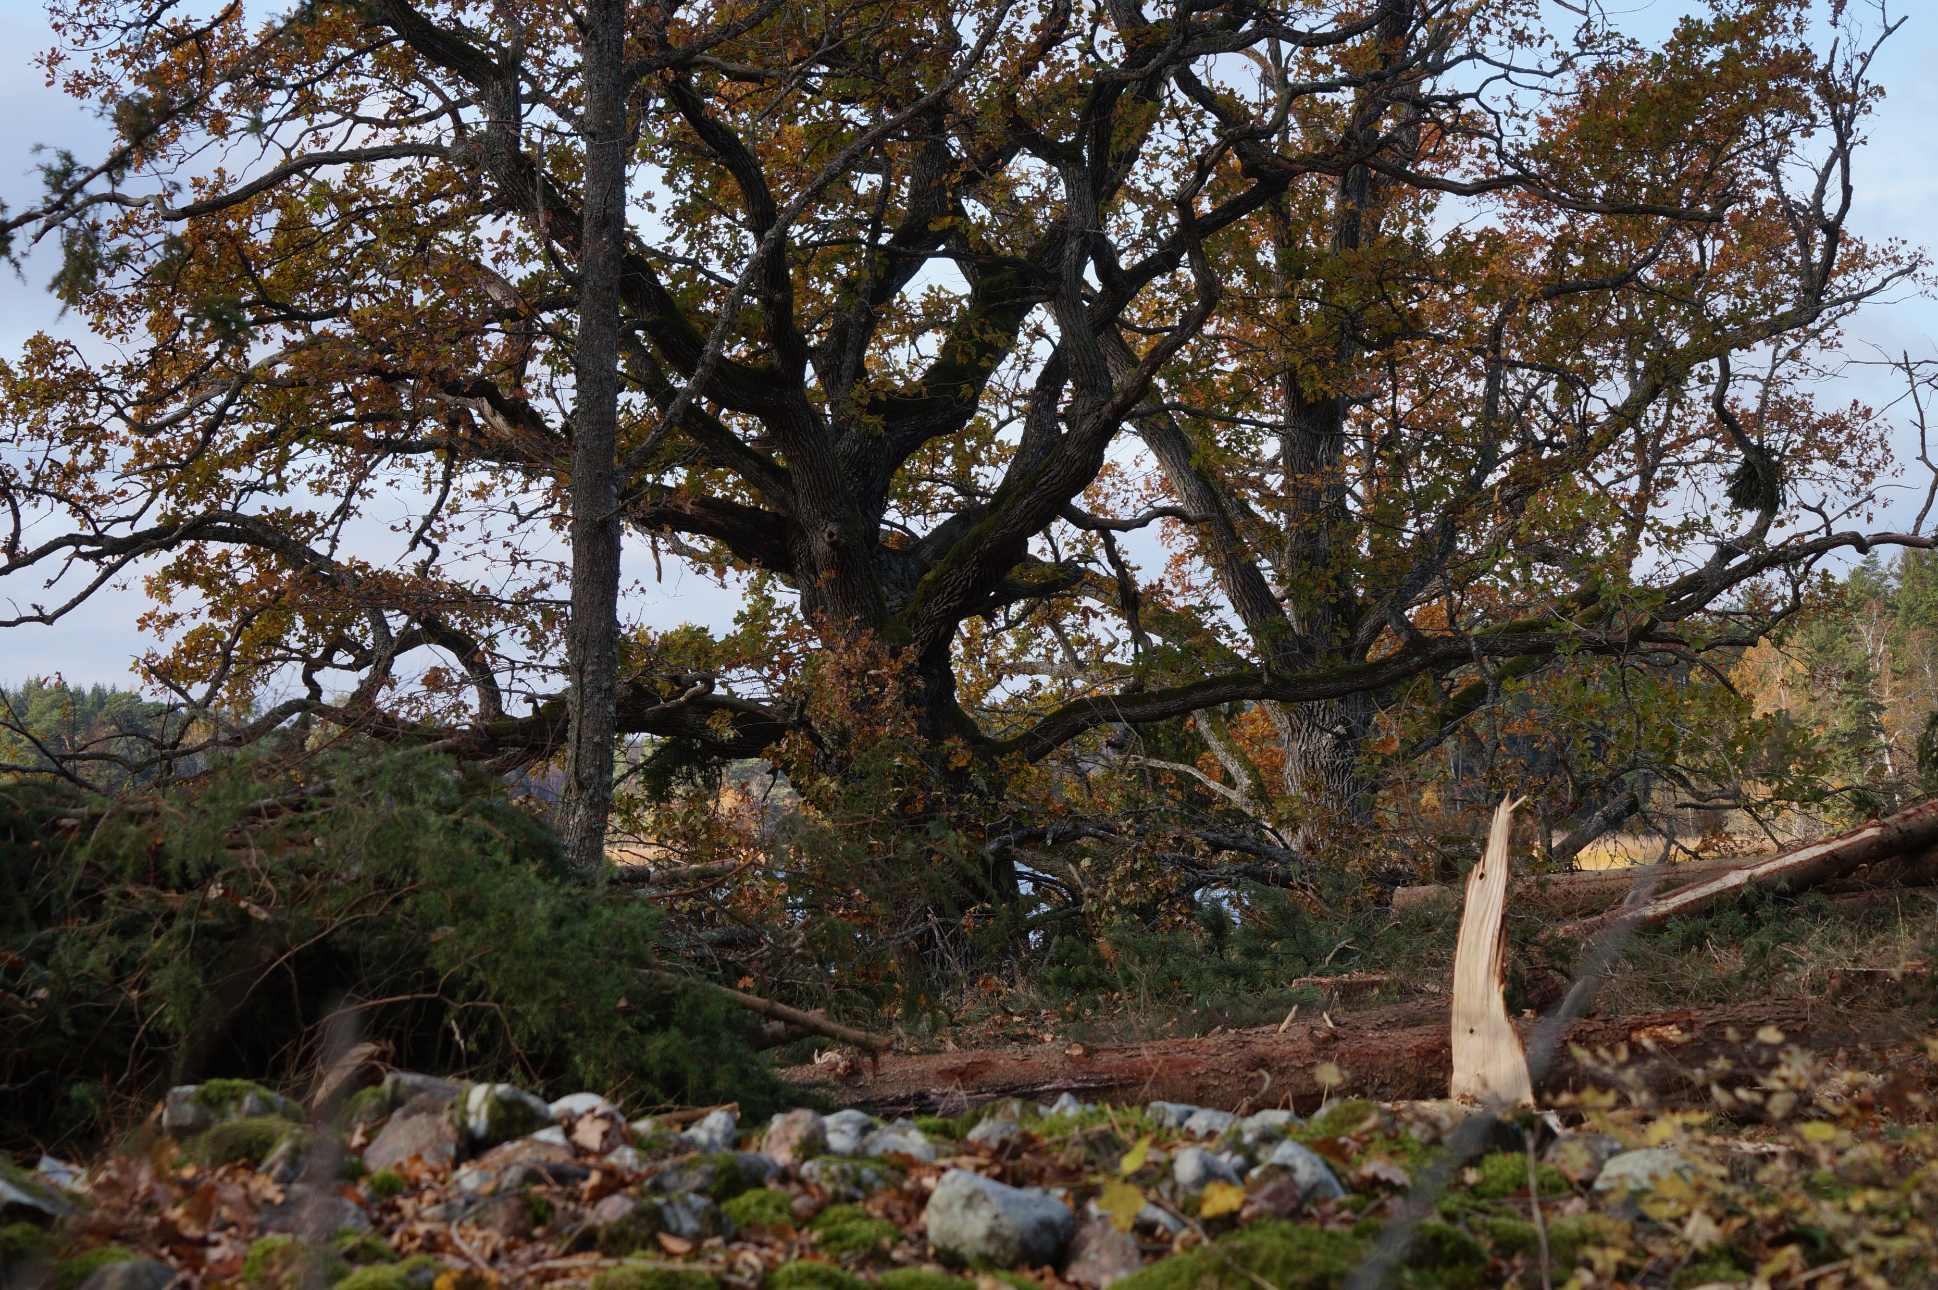
Coastal forests in Eastern Sweden
Notes:
High biodiversity is also connected to broadleaved trees along the coast, particularly Oak (Quercus robur) and Lime-tree (Tilia cordata).
The Oak is found in mixt forests with pine in rocky slopes and together with other broadleaved trees on deeper soil (Habitat 9020 Fennoscandian hemiboreal natural old broad-leaved deciduous forests (Quercus, Tilia, Acer, Fraxinus or Ulmus) rich in epiphytes).
The biggest oaks are often found in areas that are or have been pastures for long time (Habitat 9070 Fennoscandian wooded pastures).
In some regions of the coast the Lime-tree is common and many of the older ones have an origin from pollarding (hamling) in a more light open agricultural landscape.

Slide 5
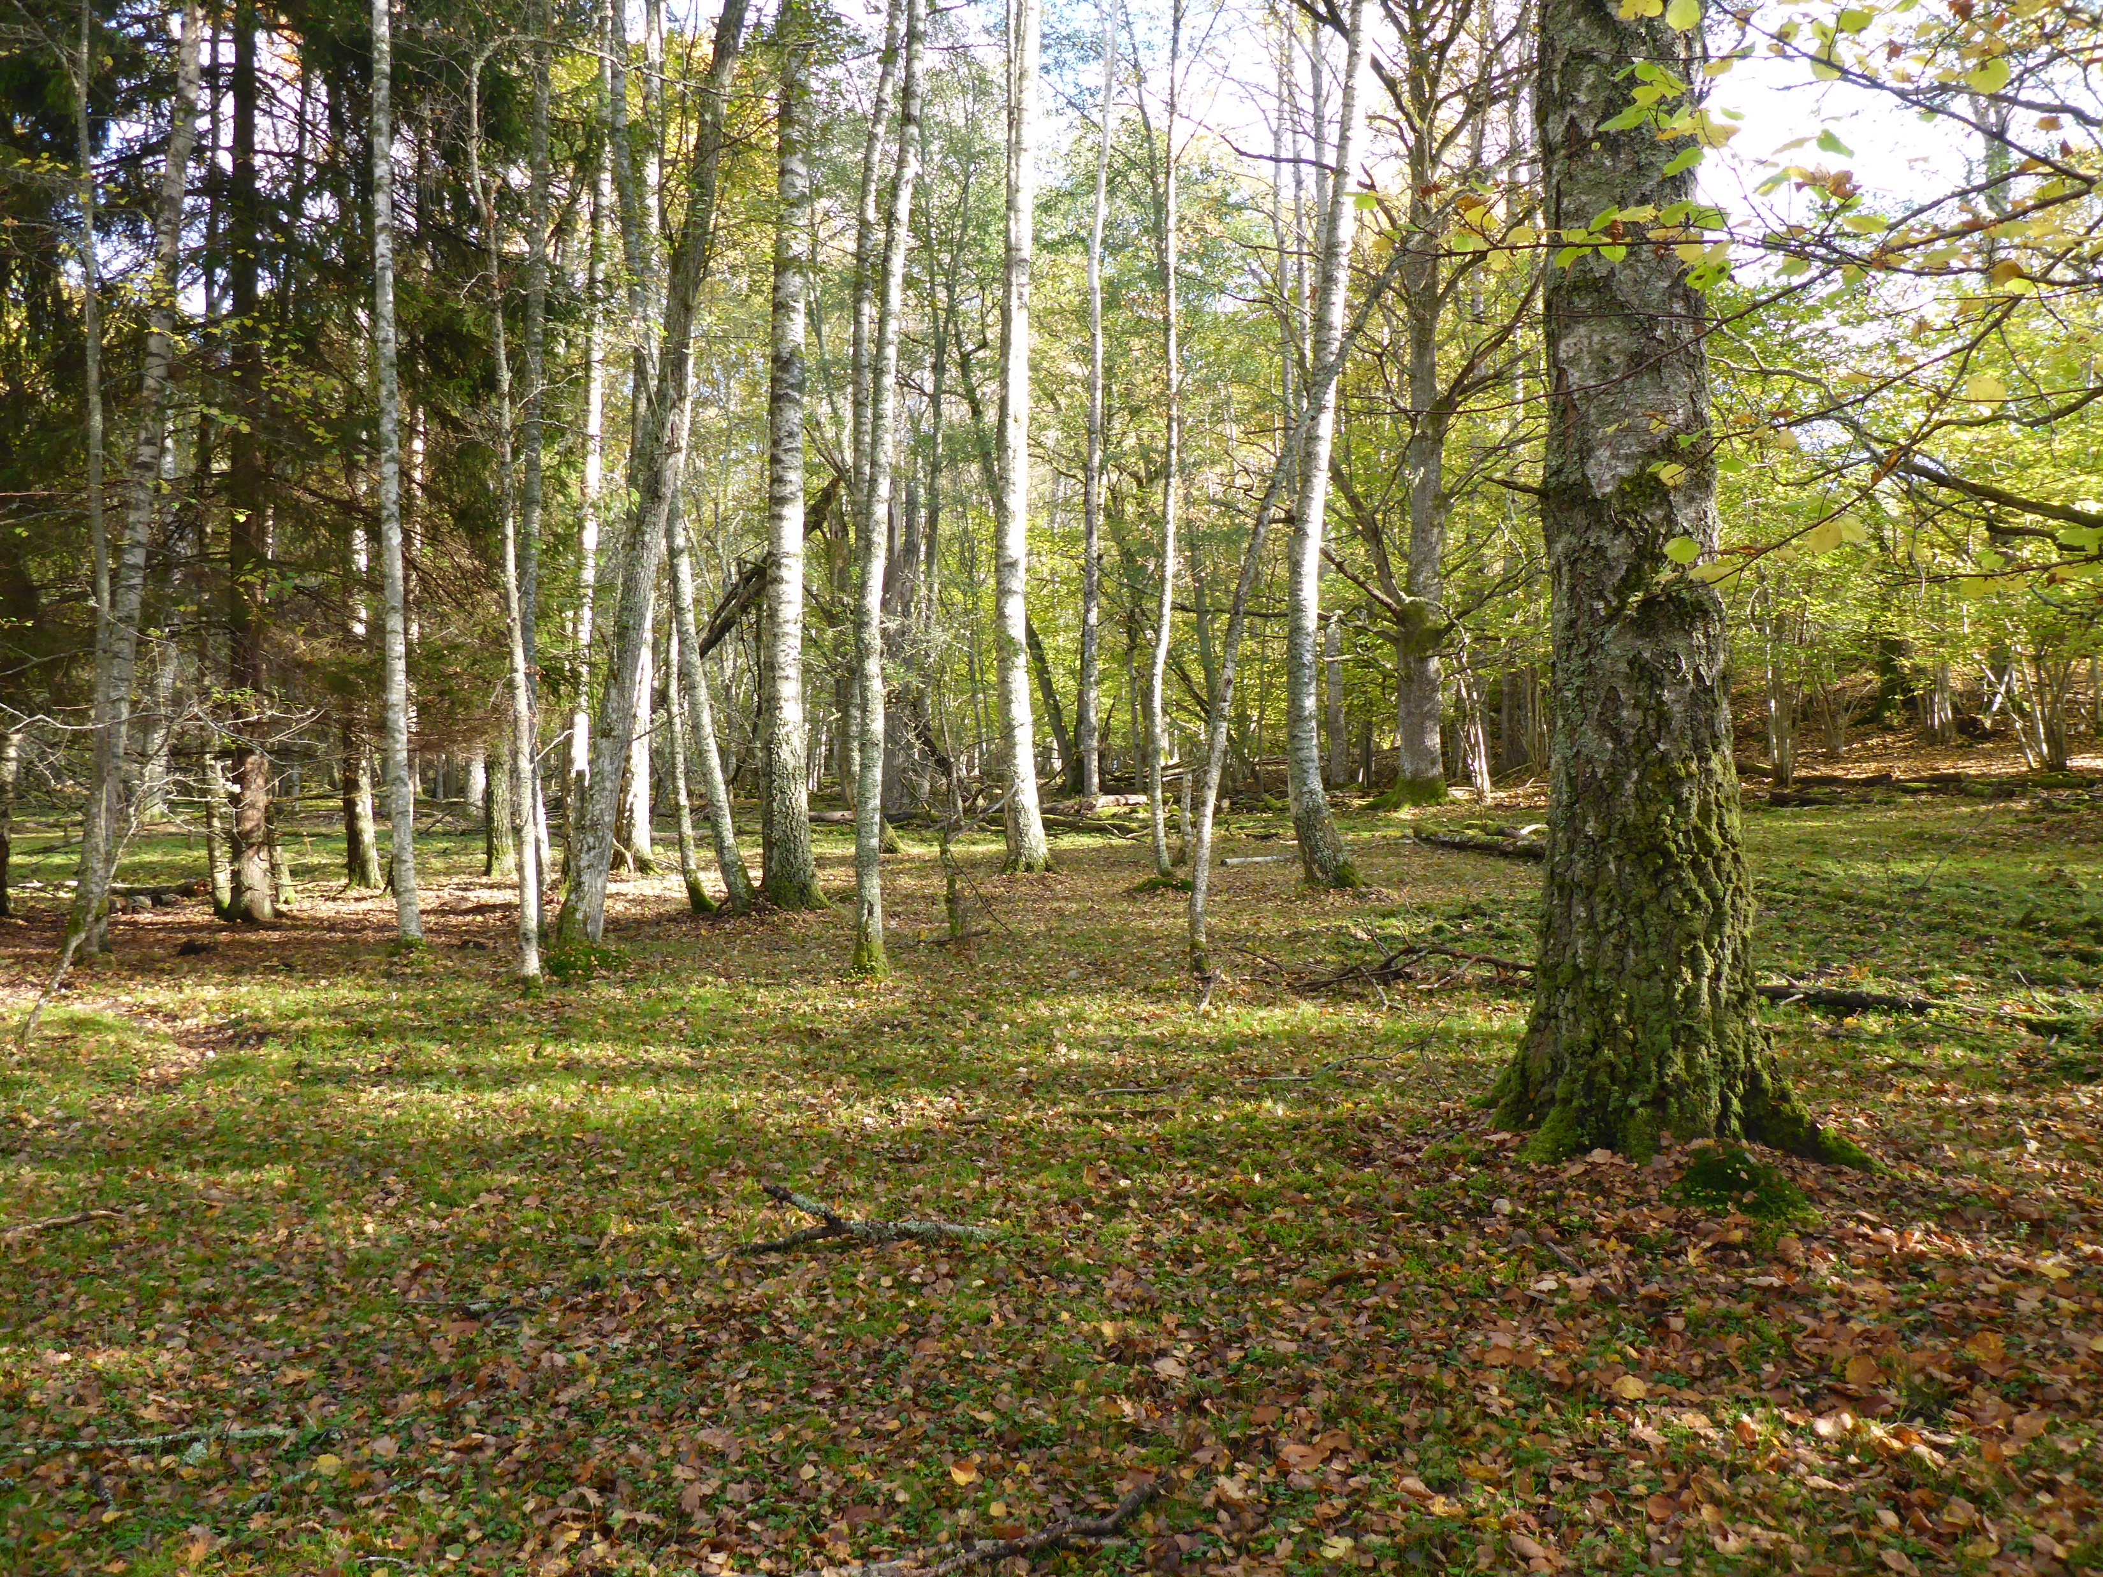
Coastal forests in Eastern Sweden
Notes:
The favorable climate and continuity of trees on the coast is also valuable for the biodiversity associated with other species of trees.
For example birch (Betula pubescens) and alder (Alnus glutinosa) has been shown to have a variety of insect fauna, with some redlisted species, for example the hermit beetle (Osmoderma eremita) is found in old alder on the coast.
Ancient trees and continuity of dead wood of all species of trees are important and a prioritized substrate for the conservation of biodiversity!
Maybe a management that ensures high amount and continuity of old trees and dead wood of common deciduous trees as birch, alder and aspen (Populus tremula) can help us too bridging periods of shortage of substrate for some threatened species.

Slide 6
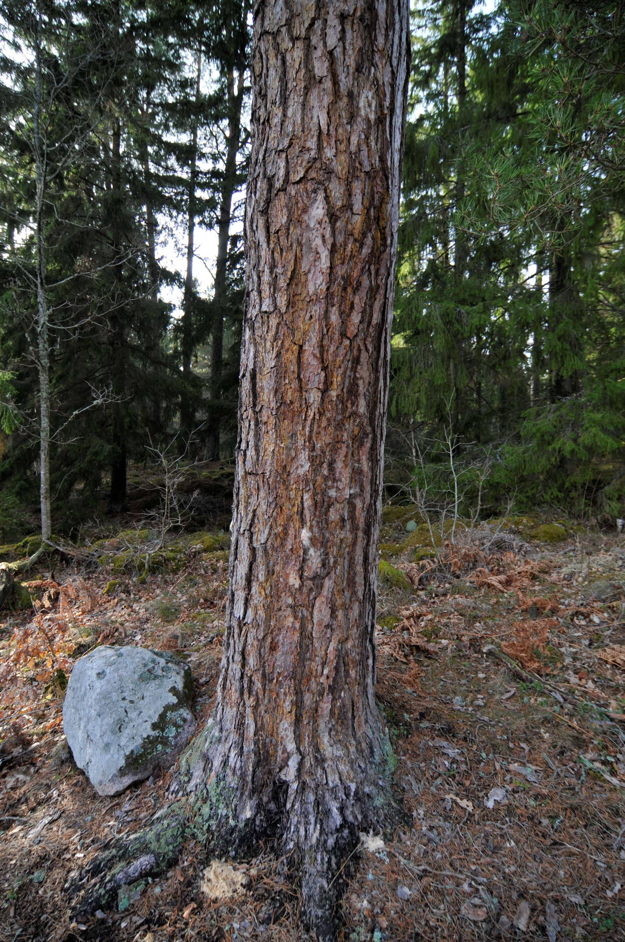
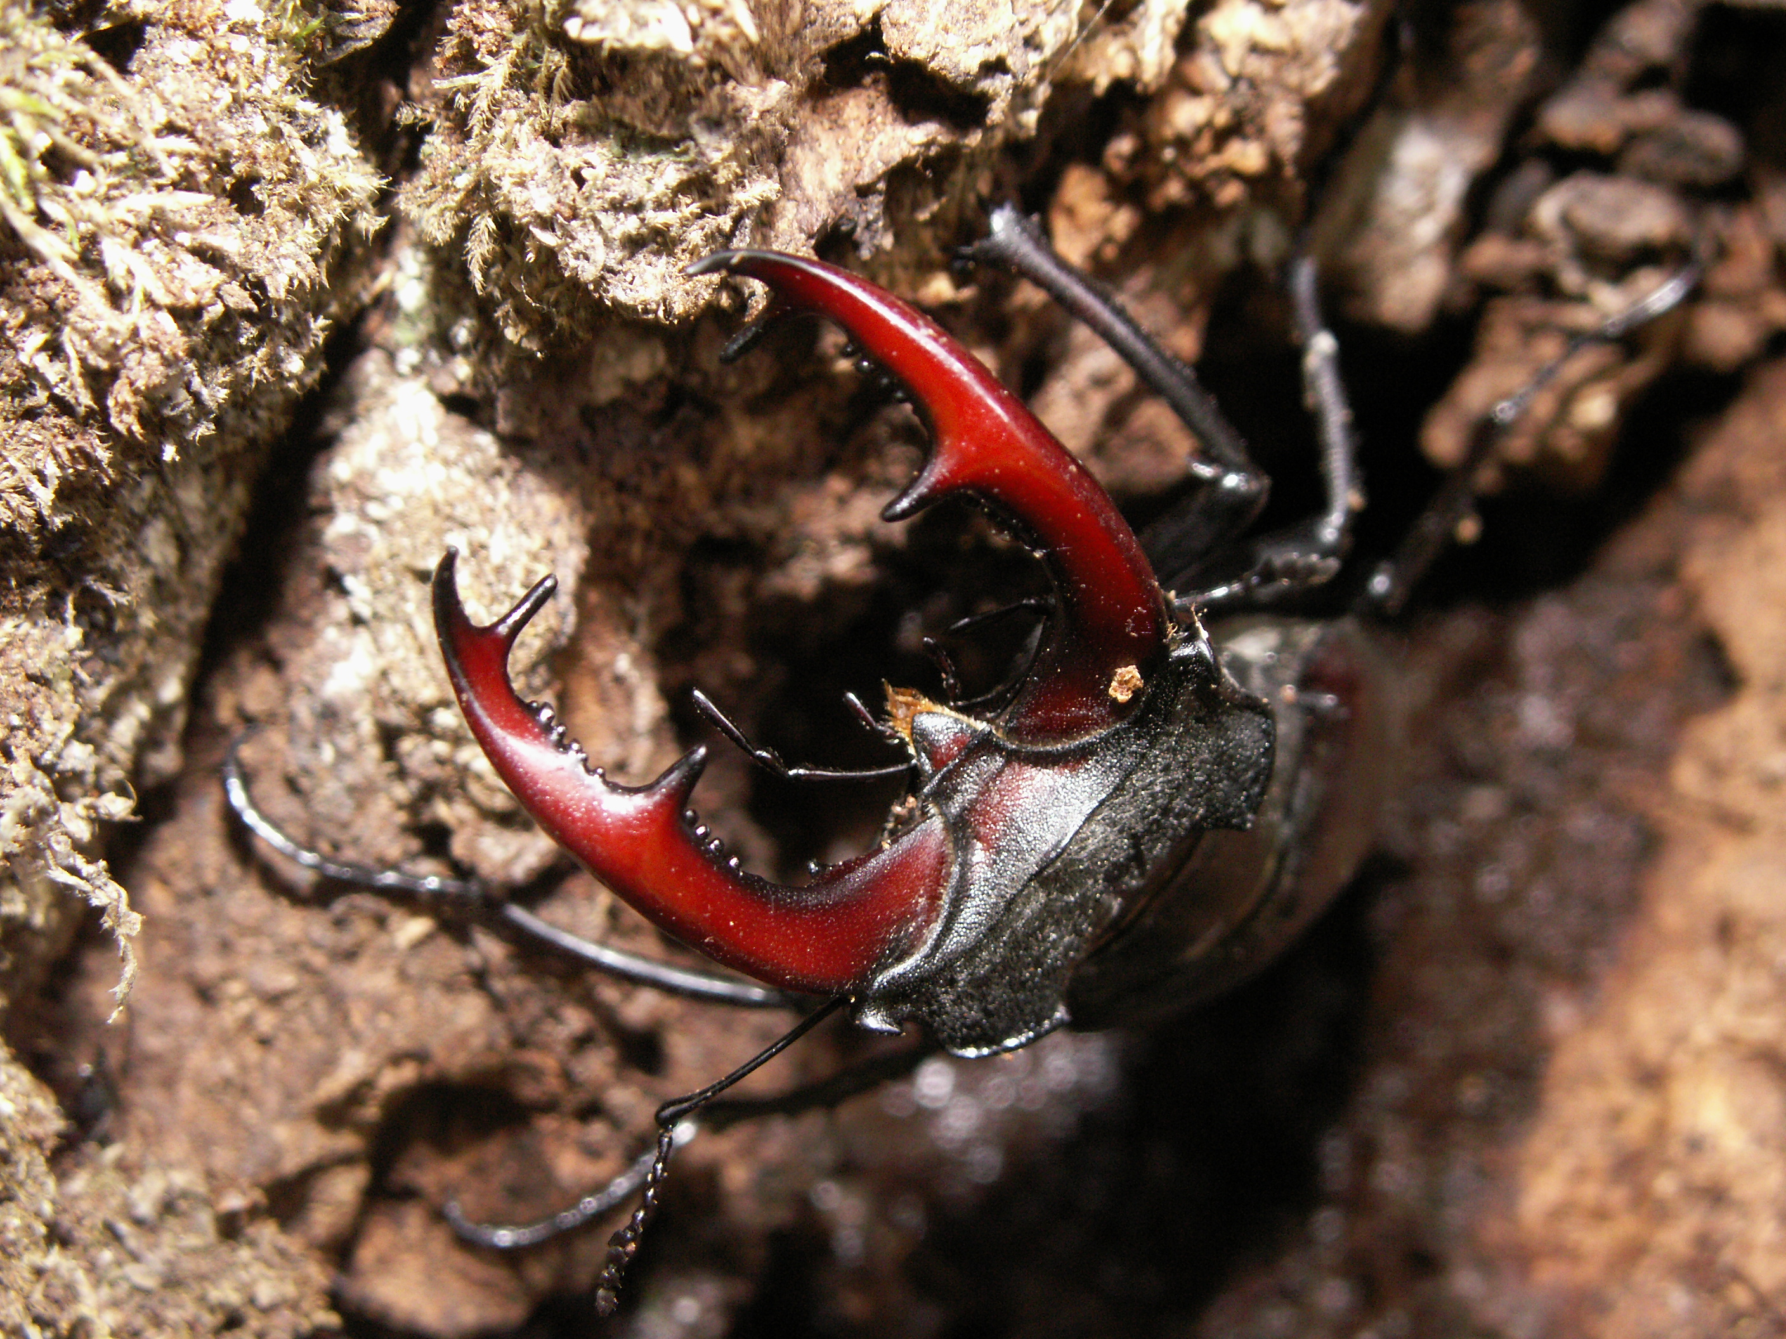
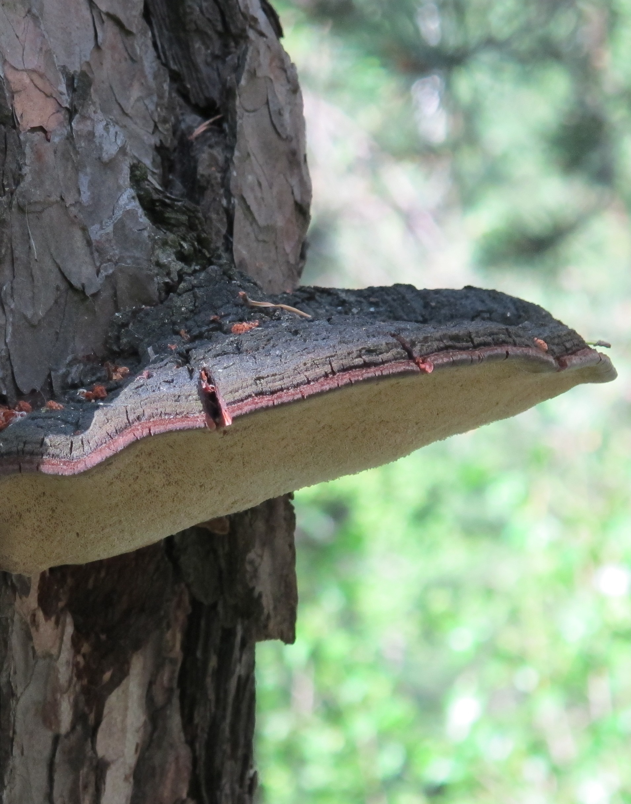
Why the landscape in the past benefited certain species?
Notes:
Coastal forests is a primary landscape but influenced and used by humans since it rose from the sea.
Almost all forests in the region have been used for grazing, wood for construction, tools etc. and for firewood.
In some areas, especially on islands clearcuttings have never occurred.
By that it have benefited species attached to warm, bright conditions and continuity of trees.
The bright and semi-open landscape have contributed to the habitat connection and spread of species in the landscape, although the water have been a strong barrier for some species.

Slide 7
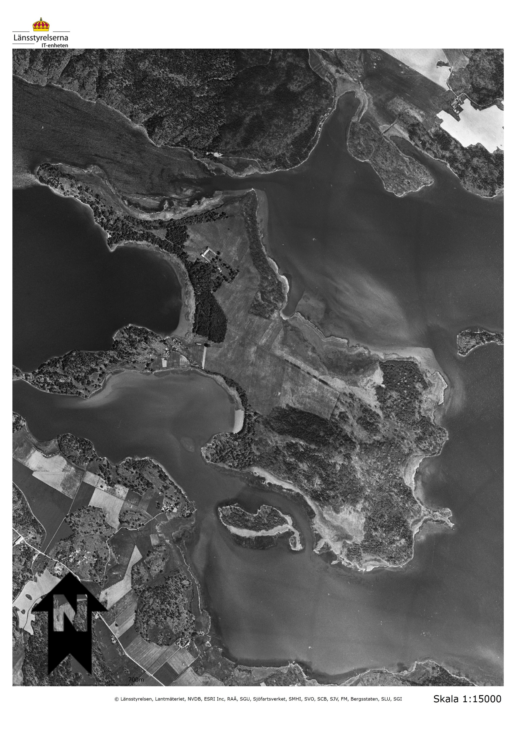
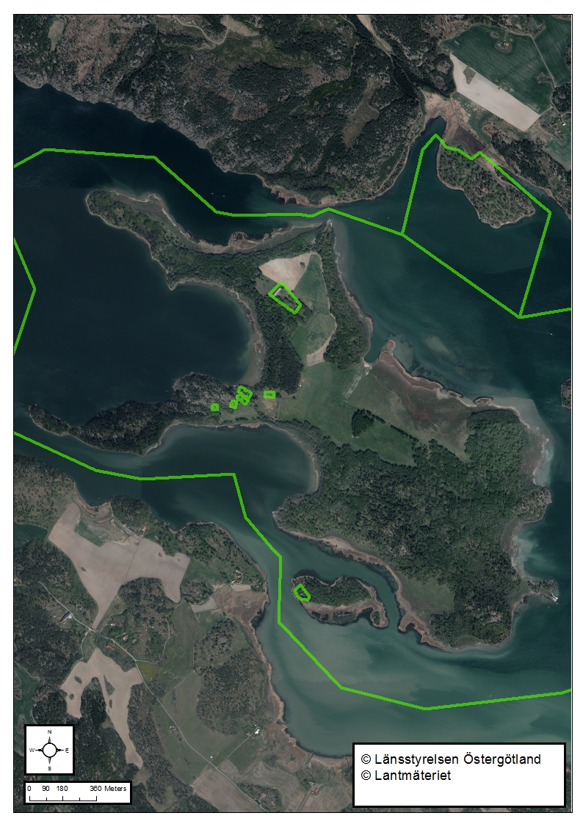
What has happened over the last 100 to 150 years?
Example from island of Eknön, Natura 2000-site SE0230135
1940´s
1960´s
2017 before measures in LIFE CB
Notes:
An example what have happened in the landscape since the 1940´s. Island of Eknön, Natura 2000-site SE0230135
In the 1940´s and likely during long time before that almost the total island was an open or semi-open landscape, see for example the areas along the waterfront in west and the big area on the southeastern part of the island.
About 20 years later the landscape was much more dense and dark.
Before project LIFE Coast Benefit started to do measures in some parts of the island the overgrowth had continued. Almost all forests on the island is much denser than in the 60´s and before that, although the island is one of the hardest grazed areas in County of Östergötland!
But the overgrowth has created new opportunities for nature conservation, some of you will see and here more about that tomorrow!

Slide 8
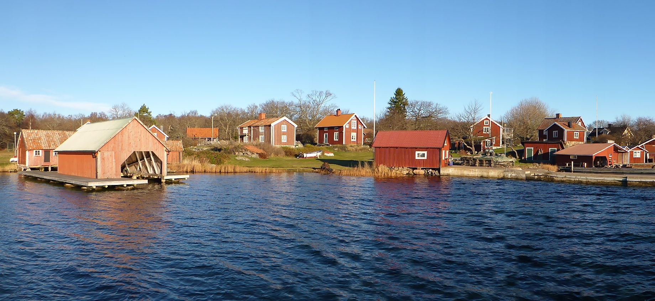
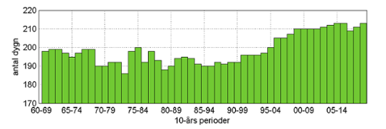
Dense and dark forests – a challenge today
Vegetation period in southern Sweden
Number of days
Time period
Notes:
The number of residents in the archipelago is much lower today than it was before the mid-1900s. Fewer need to do the work done by several years ago!
By that the number of animal herds has also decreased, but luckily we still have some people working with grazing livestock.
The forests that in the past was important for multiple use are not so important any more. Construction wood and tools are easier to get hold of in other places and fewer need wood for heating.
High values for conservation affects how forestry should be conducted and in combination with high cost for transports etc. profitability is difficult to achieve both in forestry and in management of grazed forests and wooded pastures, especially on islands.
On top on that we have climate change and atmospheric nitrogen that affects growth and vegetation period. The vegetation period in southern Sweden have been 20 days longer since the mid 80s.

Slide 9
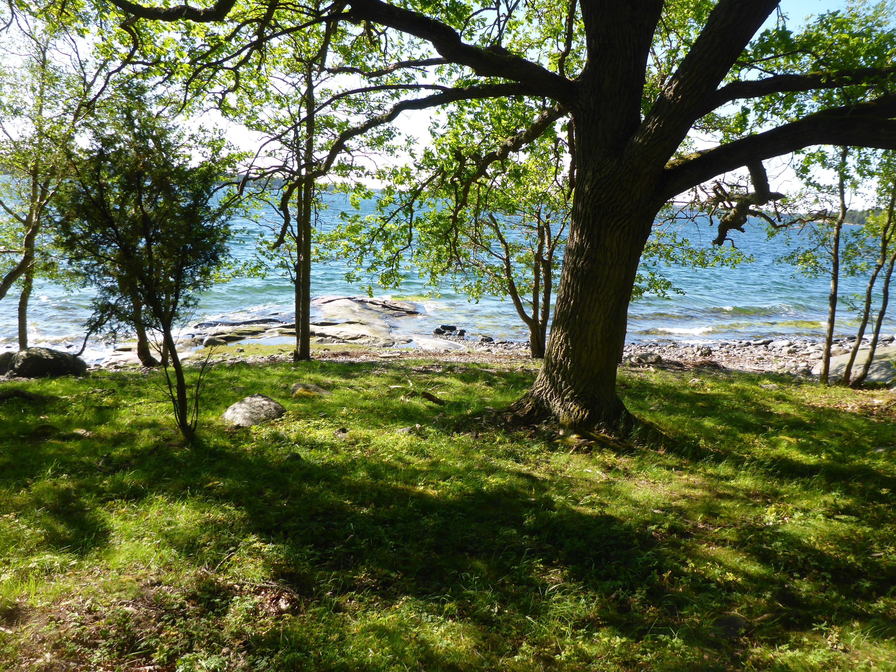
Restoration of grazed forests and wooded pastures
Notes:
The aim in the project for areas that are grazed or has structures (old trees with wide crowns, occurrence of flowering shrubs and openings with grass or typical flora) dependent on grazing has been to restore them to a more light-open landscape.
Openings has been widen, old trees with wide crowns and next generation of old trees as well as flowering shrubs have been favored.
We have also cleared around remnants from the past to give people the opportunity to better understand the historical landscape.
In total more than 1000 ha of grazed forests and wooded pastures have been affected by the measures in the project.
The majority of the measures have been performed by local or regional companies, for example farmers/animal keepers or small forestry companies.
Depending on the conditions in each site, forest harvesters (skördare) and forwarders (skotare) as well as manual work have been used.
The logistics and use of barges (pråmar) for machines and timber has been particularly important on islands.
The expectation has been that the restorations will improve the possibility to preserve and develop the biodiversity in grazed forests and wooded pastures.
Grazing by cattle and/or sheep is desirable but in some remote or logistically difficult sites periodic management with clearing have to be done instead.
By the measures the future management and possibilities for grazing has improved. By increased feed supply for the livestock many sites have improved their sustainability for grazing and by that it will be an easier work for the keepers.
At least 370 ha of grazed forests (maybe more in some years) that have been affected by the measures in the project will receive support from the rural development program to be grazed. Another 700 ha will also be grazed together with these areas or temporarily, for example as a resource dry years.
Especially on islands some of the sites was grazed before with no or very low financing but after the project the incentives to continue the grazing has increased.

Slide 10
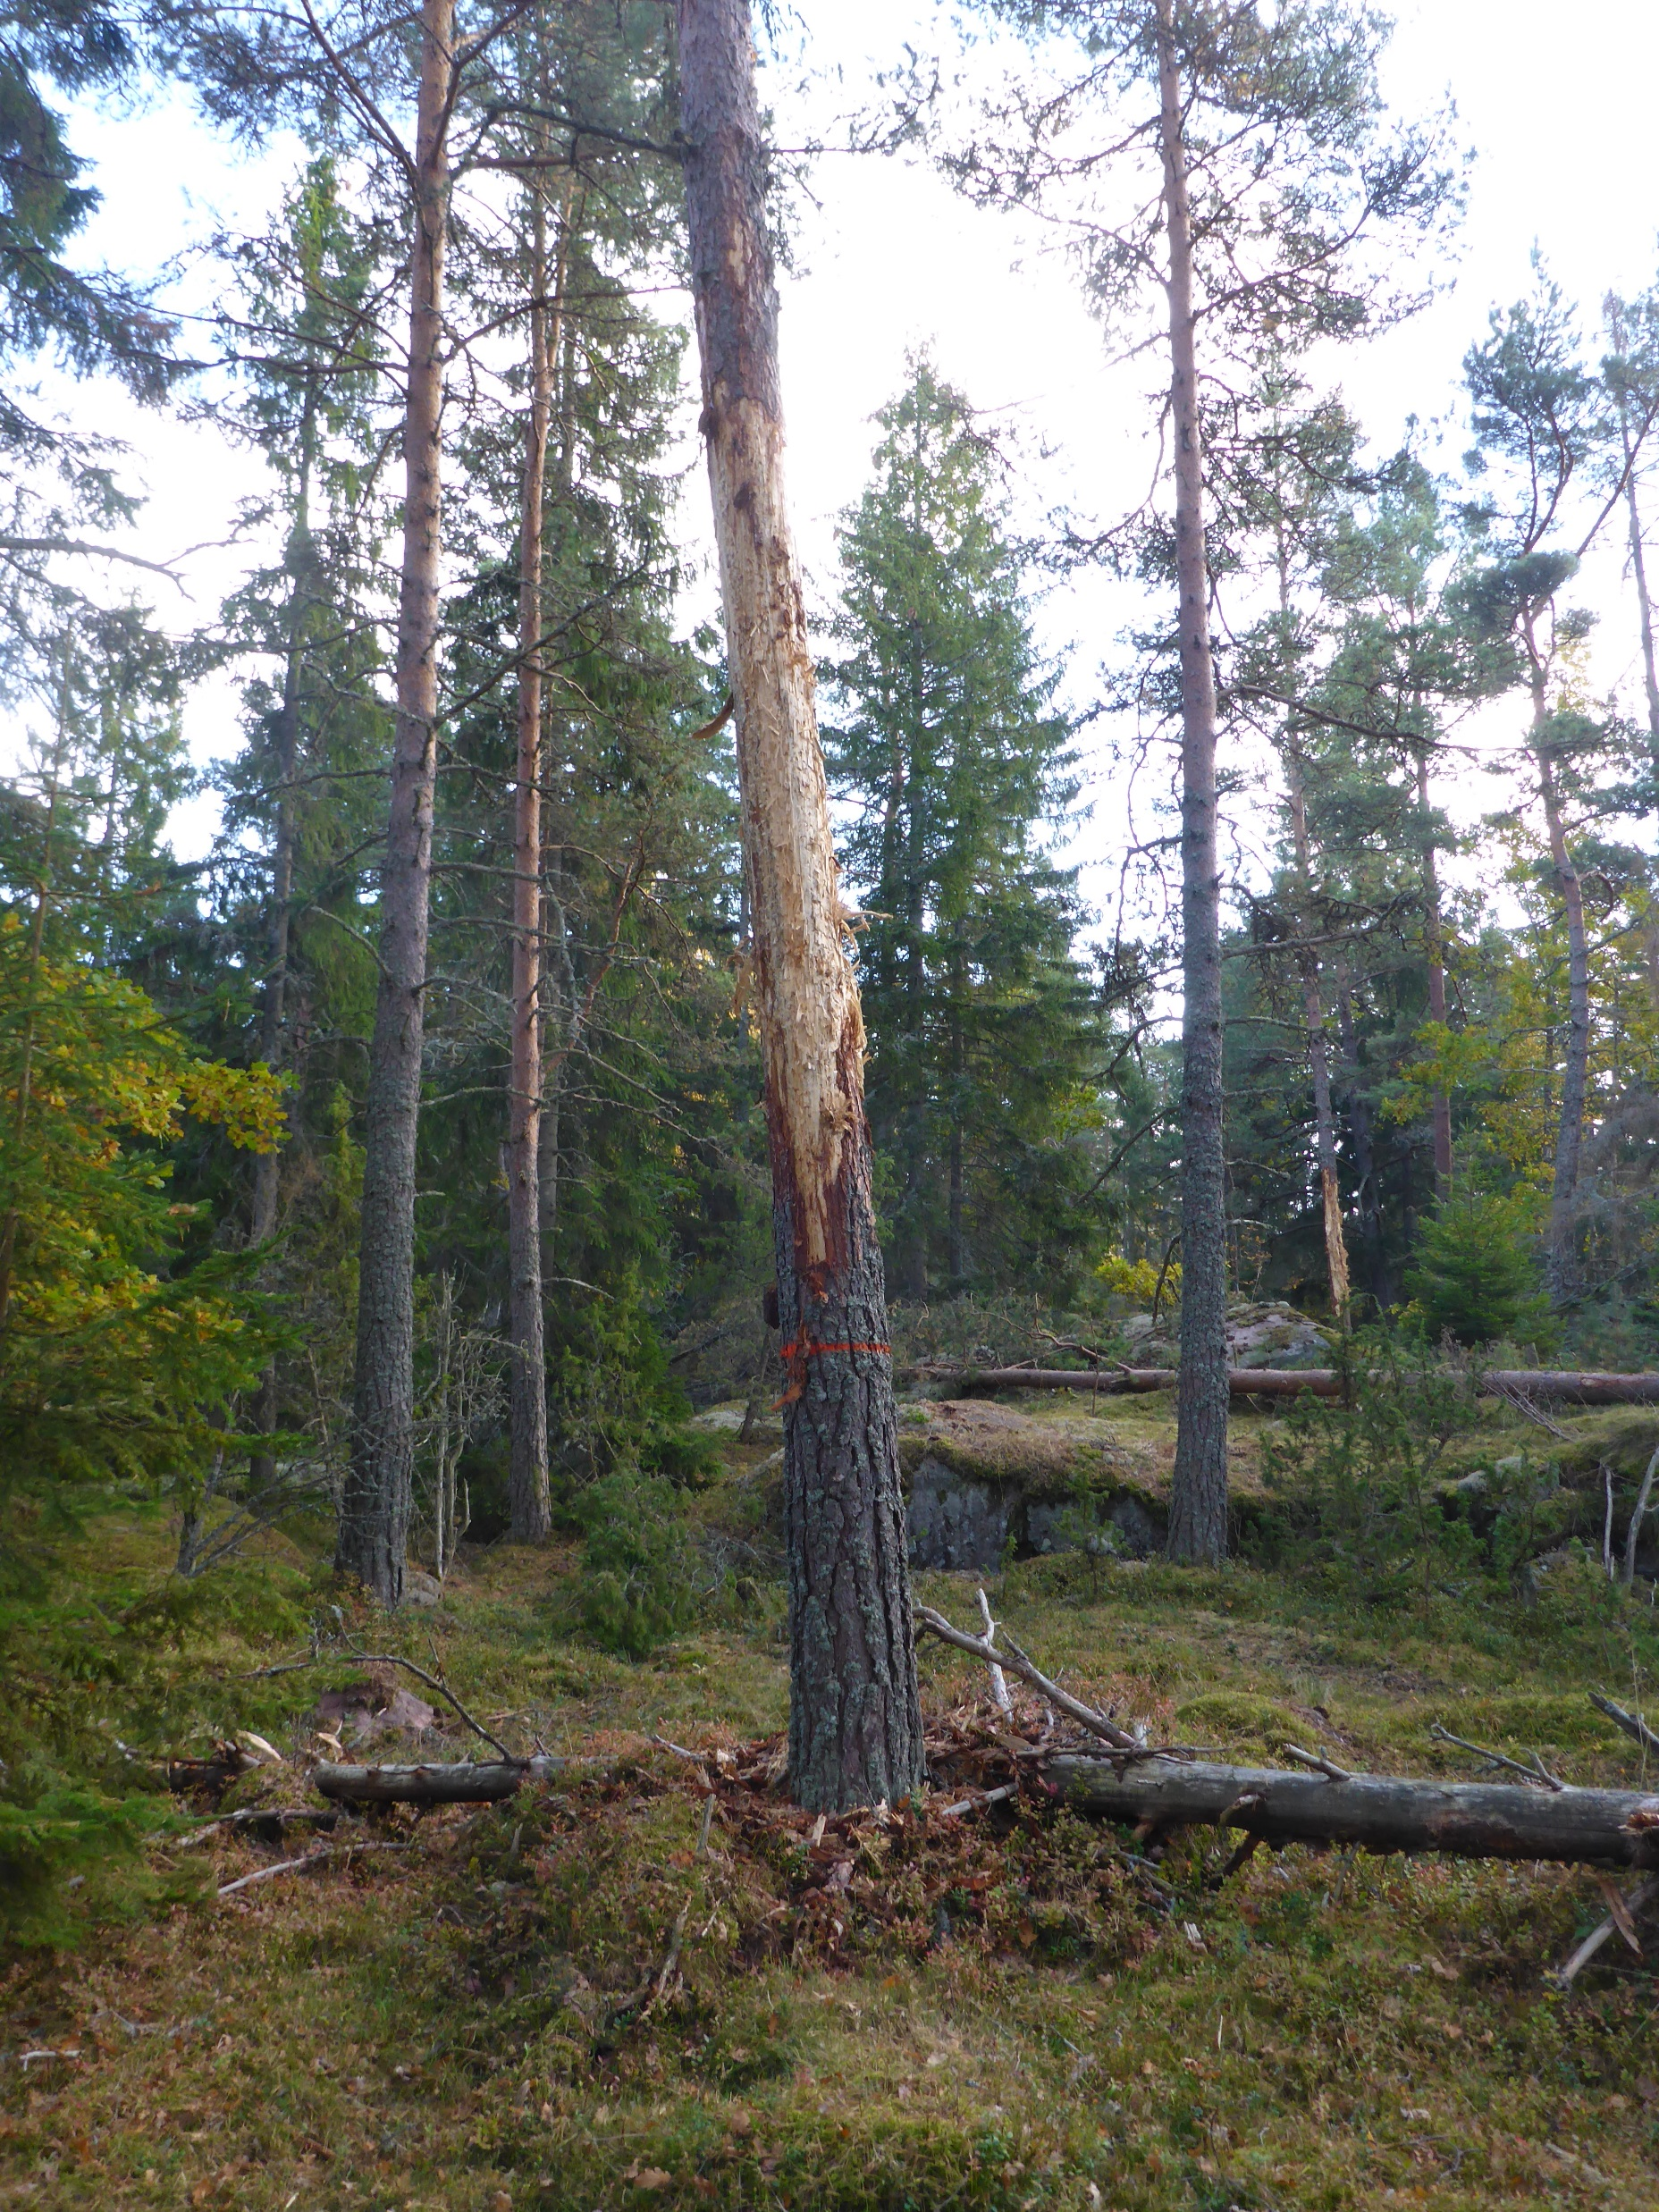
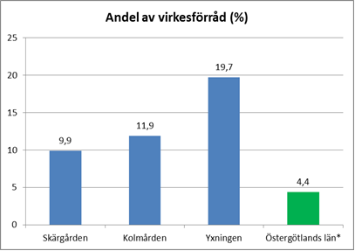
Laying and standing dead wood
Proportion of dead wood
Notes:
In the coastal landscape (based on what I have said) we often have better conditions for preserving and developing a high biodiversity connected to forests and other wooded habitat types than in other regions with for example more intensive forestry.
A bit surprising has investigations of the amount of dead wood in protected areas located in pine (Pinus sylvestris) dominated landscapes shown lower proportions dead wood in the coastal area than in other regions. Maybe an effect of the traditional use of the forests (the need of firewood and productive wooded pastures).
In general the amount and proportion of dead wood is higher in protected areas than in the matrix landscape but it is still too low amounts and deficiencies in quality! The proportion of dead wood in natural pine forests is often about 30-40% but the natural production of dead wood of pine is in general slow.
Based on that knowledge we have used the measures in the project to increase the amount of dead wood, especially pinewood, in many of our Natura 2000-sites.
Logs have been left (often in light-open positions). Other trees have been debarked to produce standing dead wood in short or long time. Also piles of thin wood and branches have been left for the biodiversity.
In addition, the measure benefits biodiversity, we use some of the material that otherwise should have generated more costs.

Slide 11
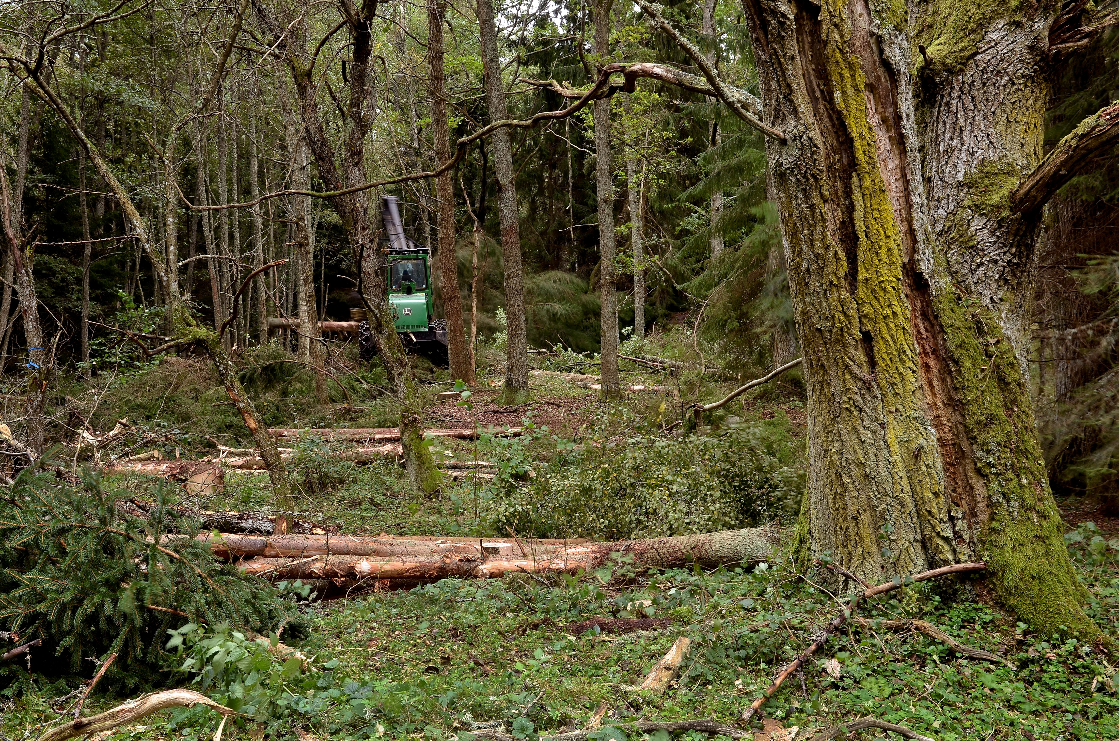
Clearing around veteran trees and successors
Notes:
Vigorous overgrowth by Spruce (Picea abies) and younger trees is often a big treat for old pine-trees and broadleaved trees.
If this will go on the microhabitat for species connected to them will be unfavorable and later on the trees will die.
In the project we have made measures to avoid this threat. To increase the variation in the forests we cut both plantations and invasive coniferous trees on 165 ha.
Clearings have been made around more than 4600 valuable ancient and veteran trees and also around next generation of old trees.

Slide 12
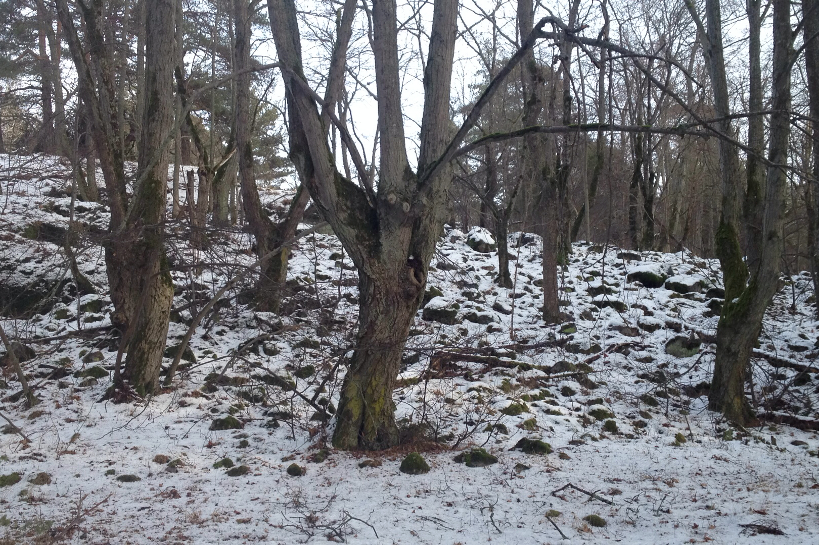
Crown reduction and pollarding
Notes:
In some sites we have old broadleaved trees that have been pollarded in the past. Many of them have raised crowns and heavy branches today which risks breaking the tree in the future, especially after measures have been done to open up around the tree.
By reducing and put down the crown of a tree, a measure done by trained arborists we expect to extend the life of the trees as well as let down more light through the foliage.
We have also done pollarding (hamling) on old pollarded trees and on young trees that can be the new ones when the old dies.
In a short film we will meet one of the arborists telling about his work with crown reduction.
In total approximately 1300 trees have been measured to reducing and put down the crown or re-pollarding.

Slide 13
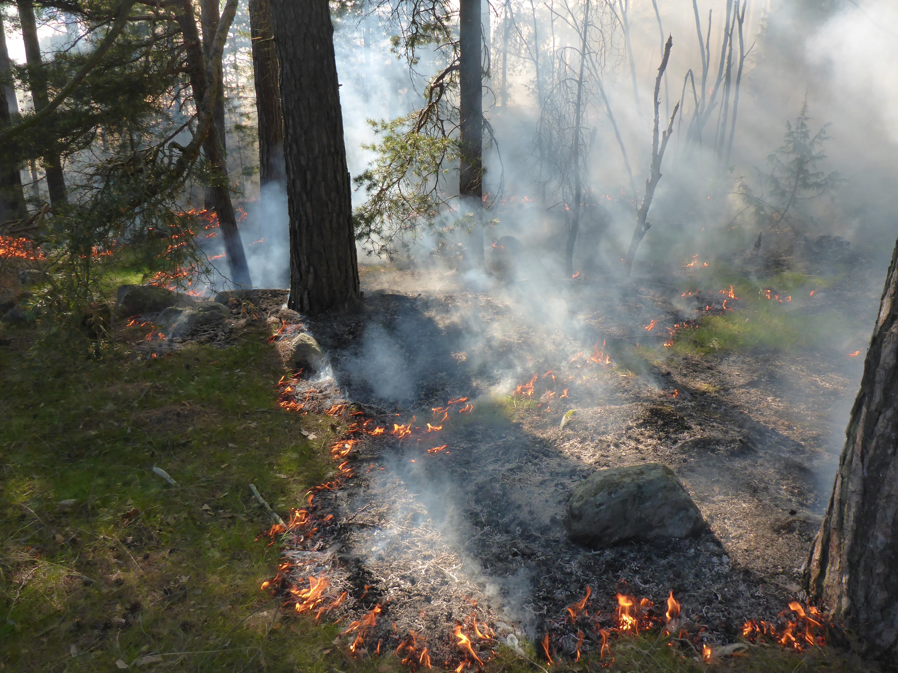
Prescribed burning
Notes:
The southeastern Sweden is a region where recurrent forest fires have had great impact on the forest in the past and we have many species that are direct or indirect favored by this.
We knew that the origin of these fires are both manmade (use of fire to open up for agriculture) and natural (combination of climate, soil type and thunderstorms).
In surveys of the historical fire frequency in our region the pine forests were affected by fires almost every 30 years, sometimes more often!
Surveys also show that the fire frequency declined some hundred years ago and has almost ceased today – a big threat for some species and a reason to dense and dark forests. Despite the massive forest fires we have seen in late years the annually affected area is lower than in historical times!
A short film about prescribed burning (on next slide you will have a short summary in English).
In the project prescribed burning have been done on 80 ha.
By monitoring of structures and insects we have seen that the measures has the desired effect, you can read more in our reports.

Slide 14
A short summary of the film about prescribed burning
- We are in a landscape with frequent historical forest fires and presence of many species that are direct or indirect favored by this.
- Before a prescribed burning we make a plan that describes how the burning shall be done, borders of the area, objects that have to be protected and safety issues etc.
- Exactly the right weather conditions (for example temperature, wind and dryness on the ground) are needed. The exact day the burning will be done is not possible to decide longtime in advance.
- Before the burning starts we are in the area for planning and in the same time bigger animals will be frightened away.
- Of course there are some small animals that can not escape the fires and heat but in the long run we creates structures and an environment that promote high nature conservation values.

Slide 15
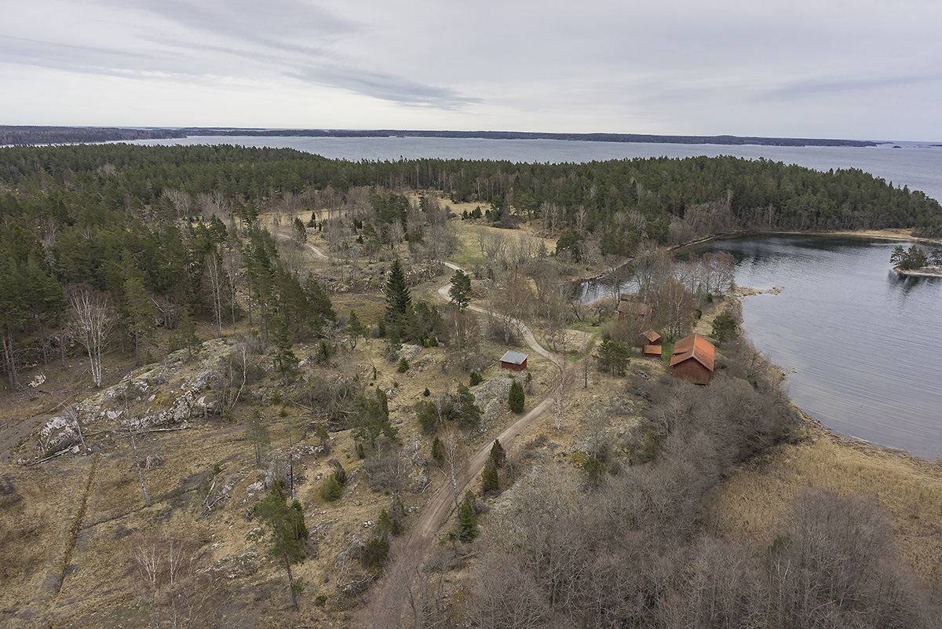
Changes in landscape after LIFE CB
Aerial photos before and after measures at Rösten Nynäs, Natura 2000-site SE0220126
Notes:
- Aerial photos before and after measures at Rösten Nynäs, Natura 2000-site SE0220126

Slide 16
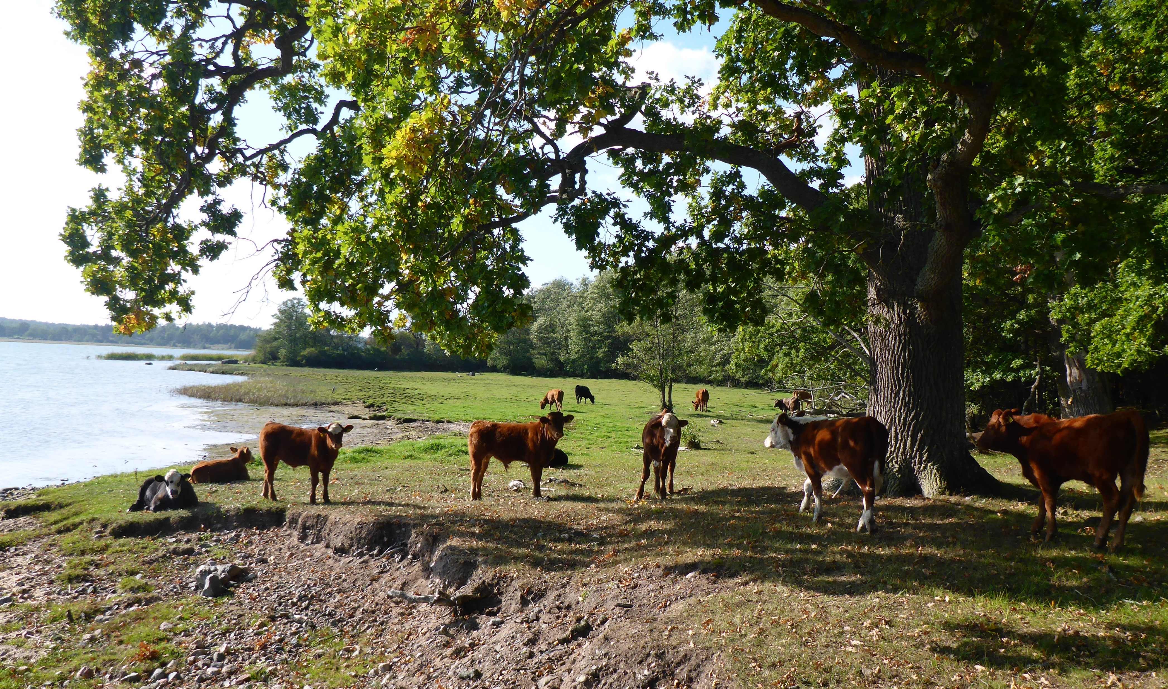
Thanks for listening!

