Slide 1
Predation control on bird colonies
Markus Forsberg

Slide 2
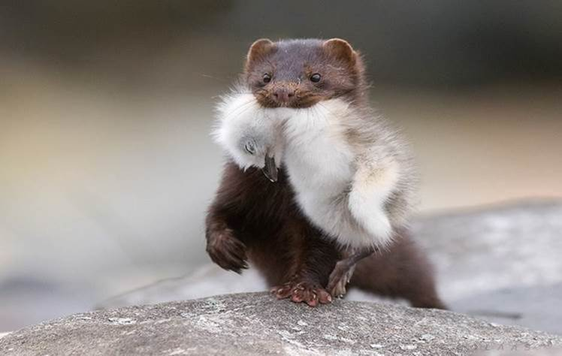
C5 Predation control on bird colonies
Establish an organisation for long term control of bird colony predation by the american mink (Mustela vison)
Start hunting mink in an organized way in 8 different areas of 3 Natura 2000-sites
Photographer: Terje Kolaas

Slide 3
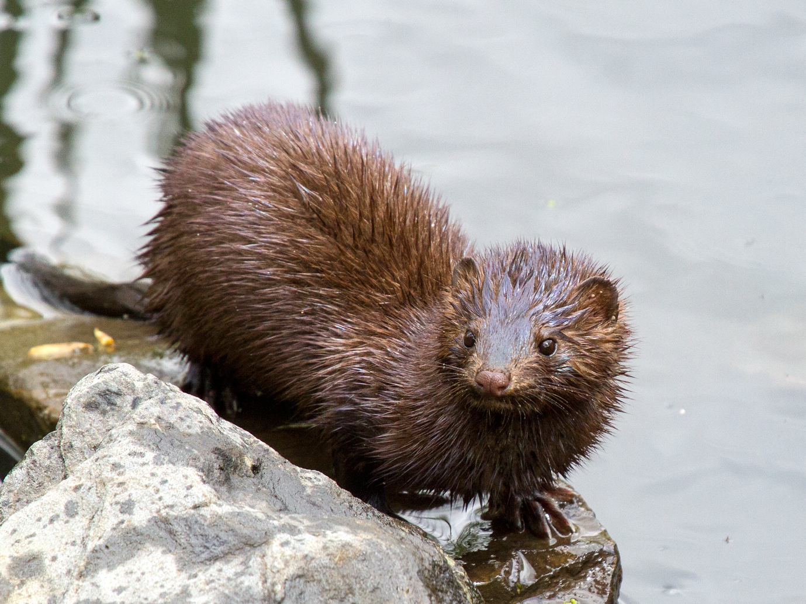
The year for the mink
Feb-mars, mating time
April, cubs are born in the end of april
(2-6 cubs/litter)
May, lactating and more solid food,
activity pattern rasing by factor 5
June, teach them to hunt (midsummer)
July, cubs still following her
August, cubs start to spread, young males first
Sept-feb Establishing there home range
Wikipedia.se

Slide 4
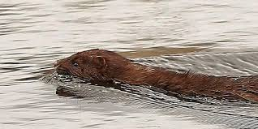
The mediocrity mink
Generalist, ”not very good at anything” but can handle both land and water
Swims very slow (almost lacking webbed feet), open water 500m no problems, 1km also within range, 2km more seldom
Don´t dive very: deep (0,5-3m, max 5m) far (30-35m) for so long (5-30sec, max 45sec)
Photograpfer: Håkan Knutsson
Notes:
Very good at adapting to new environments, successful where evere its introduced in the world.
Cant swim as good as an an otter or climb as a pine martin.

Slide 5
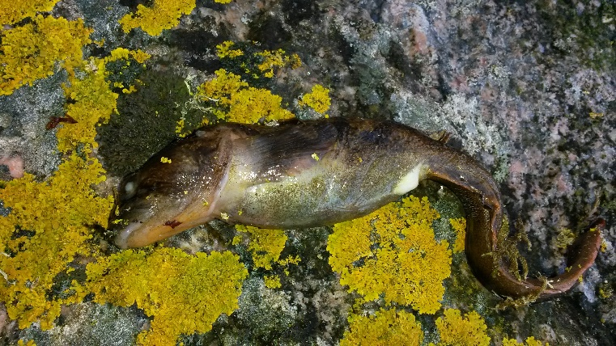
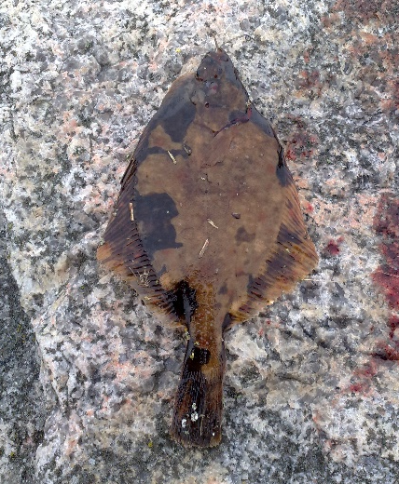
What are they eating?
Lacking eye membrane, hard to catch swimming fishes→scanning the bottom (<3m) for fish
Main food is fish and rodents, 3 month bird diet
European eelpout, Tånglake,
Zoarces viviparus
Flatfish, Plattfisk, Pleuronectidae
Shorthorn sculpin, Rötsimpa, Myoxocephalus scorpius
Notes:
The most common fishes thats found nearby there dense is flat fish, cabezone and eelpoot.
Only want fresh food, no cadavers.

Slide 6
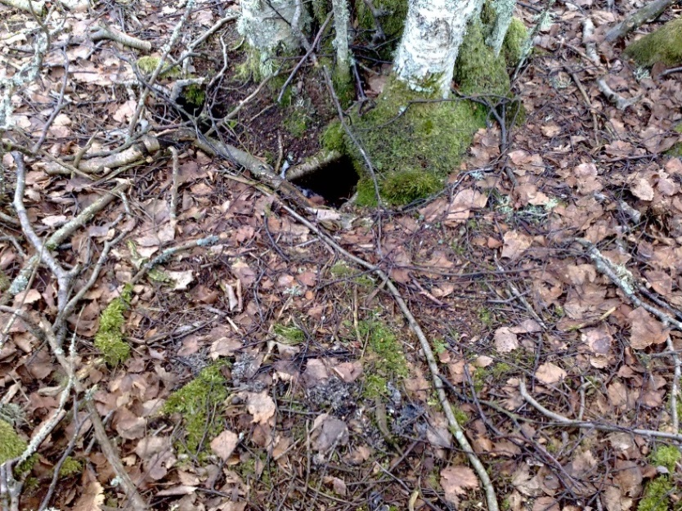
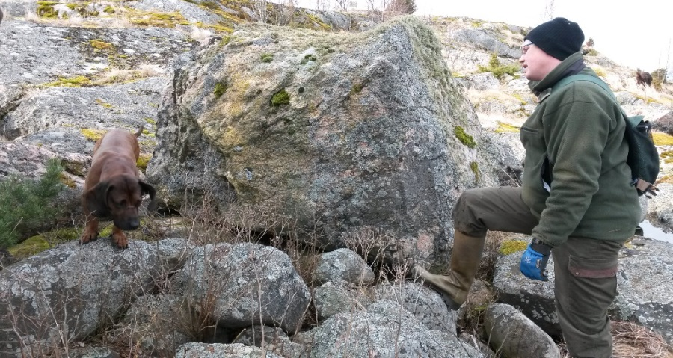
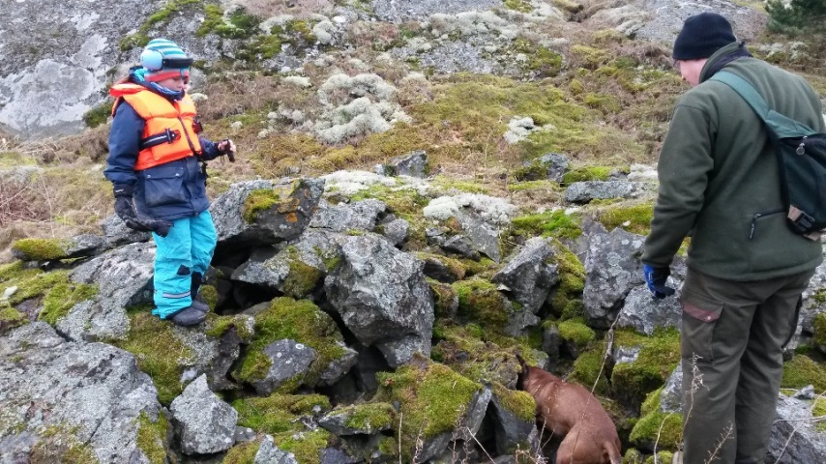
Where are they found?
Dry and windsafe places, close to the water
Uses existing holes/cavities, in the ground or among rocks/stones

Slide 7
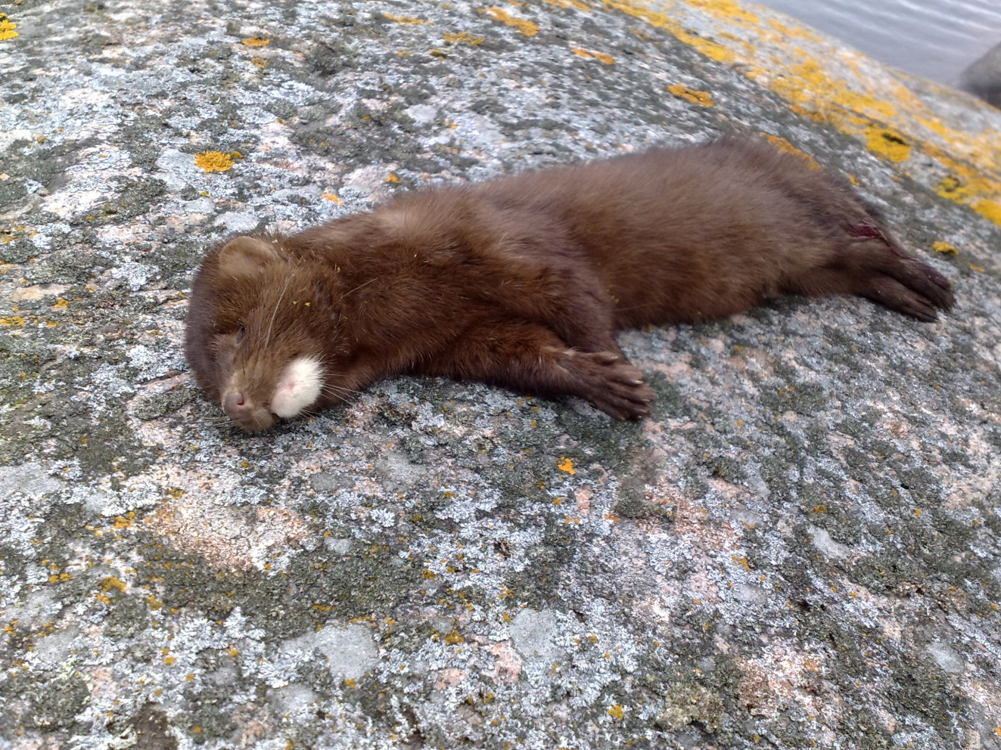
How old is an old mink?
78% dies before 1 year, than 50% mortality each year
Within 3 years is the whole population replaced!
Rare with minks older than 3 years (4 of 200)
We want to increase the mortality rate

Slide 8
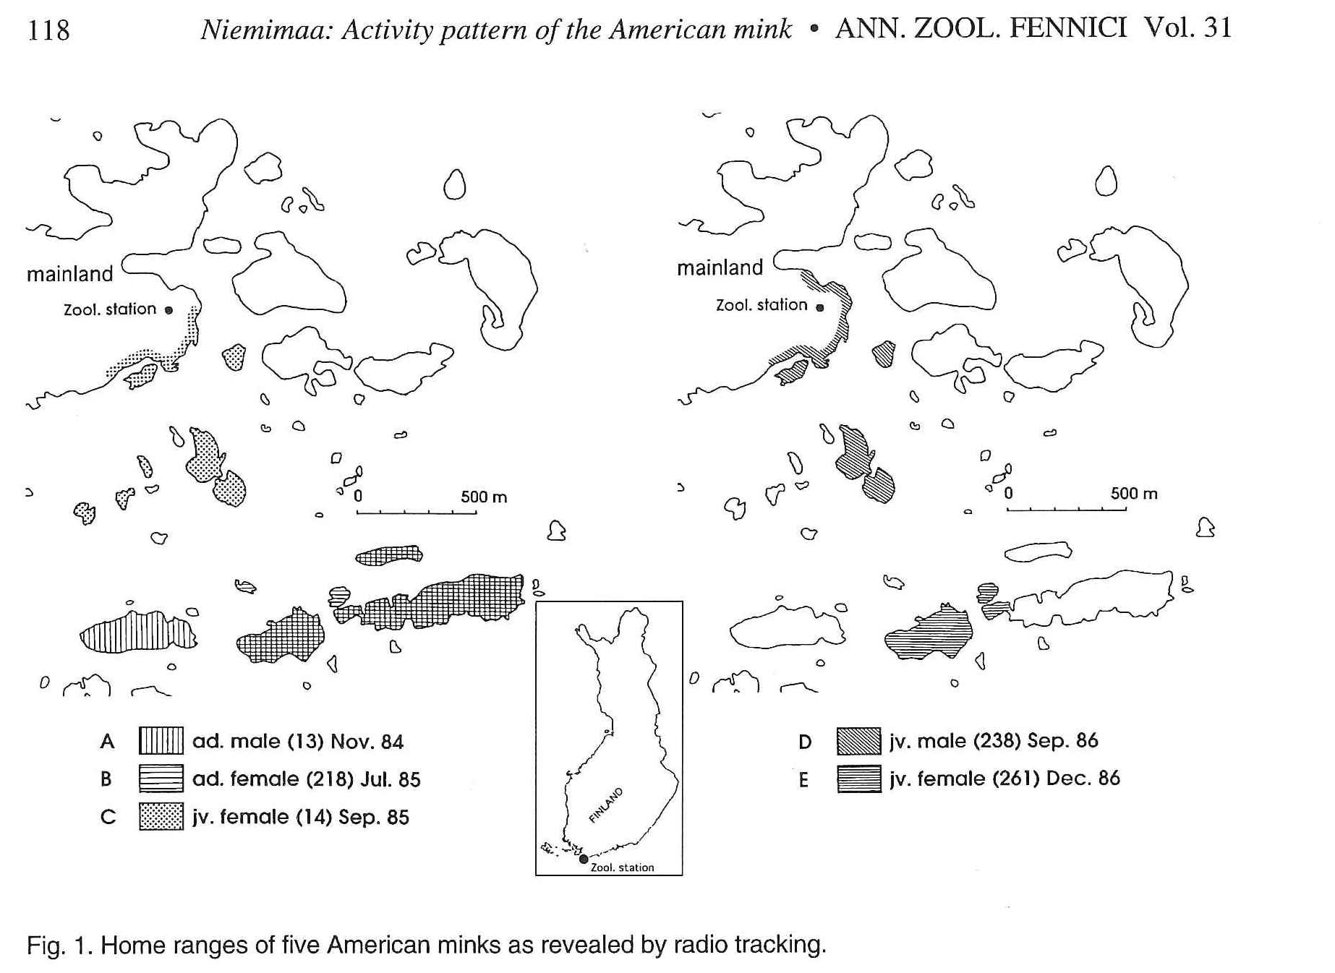
Home range
Archipelago in the Baltic sea 5-50ha land
Rivers and lakes Male 1,8-5.0km, Female 1,1-2-2km
No overlap male-male, overlap male-female, female-female
Notes:
Few relevant studies from the Baltic sea arcipelago (dark, cold winter and icecoverage, brackish and no tidal).
Overlap female-female is often mother and daughter

Slide 9
Unique breeding and territorial strategy
Within the same litter the cubs can have different fathers!
Males abandon territories when breeding, don´t returns!
Short delayed embryonal development (only the american mink)
Notes:
Ovulation several times during 1-2 month, every time the egg is receptive to be fertilized, fertilized eggs is waiting.
Hard to defend a female for so long time, better to try to mate with as many females as possible.
Males can get away 20-40km (80km) to search for females.

Slide 10
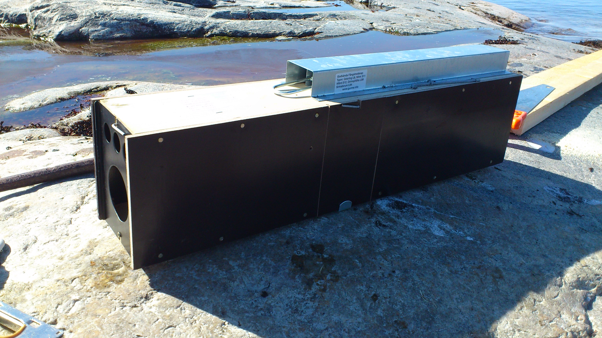
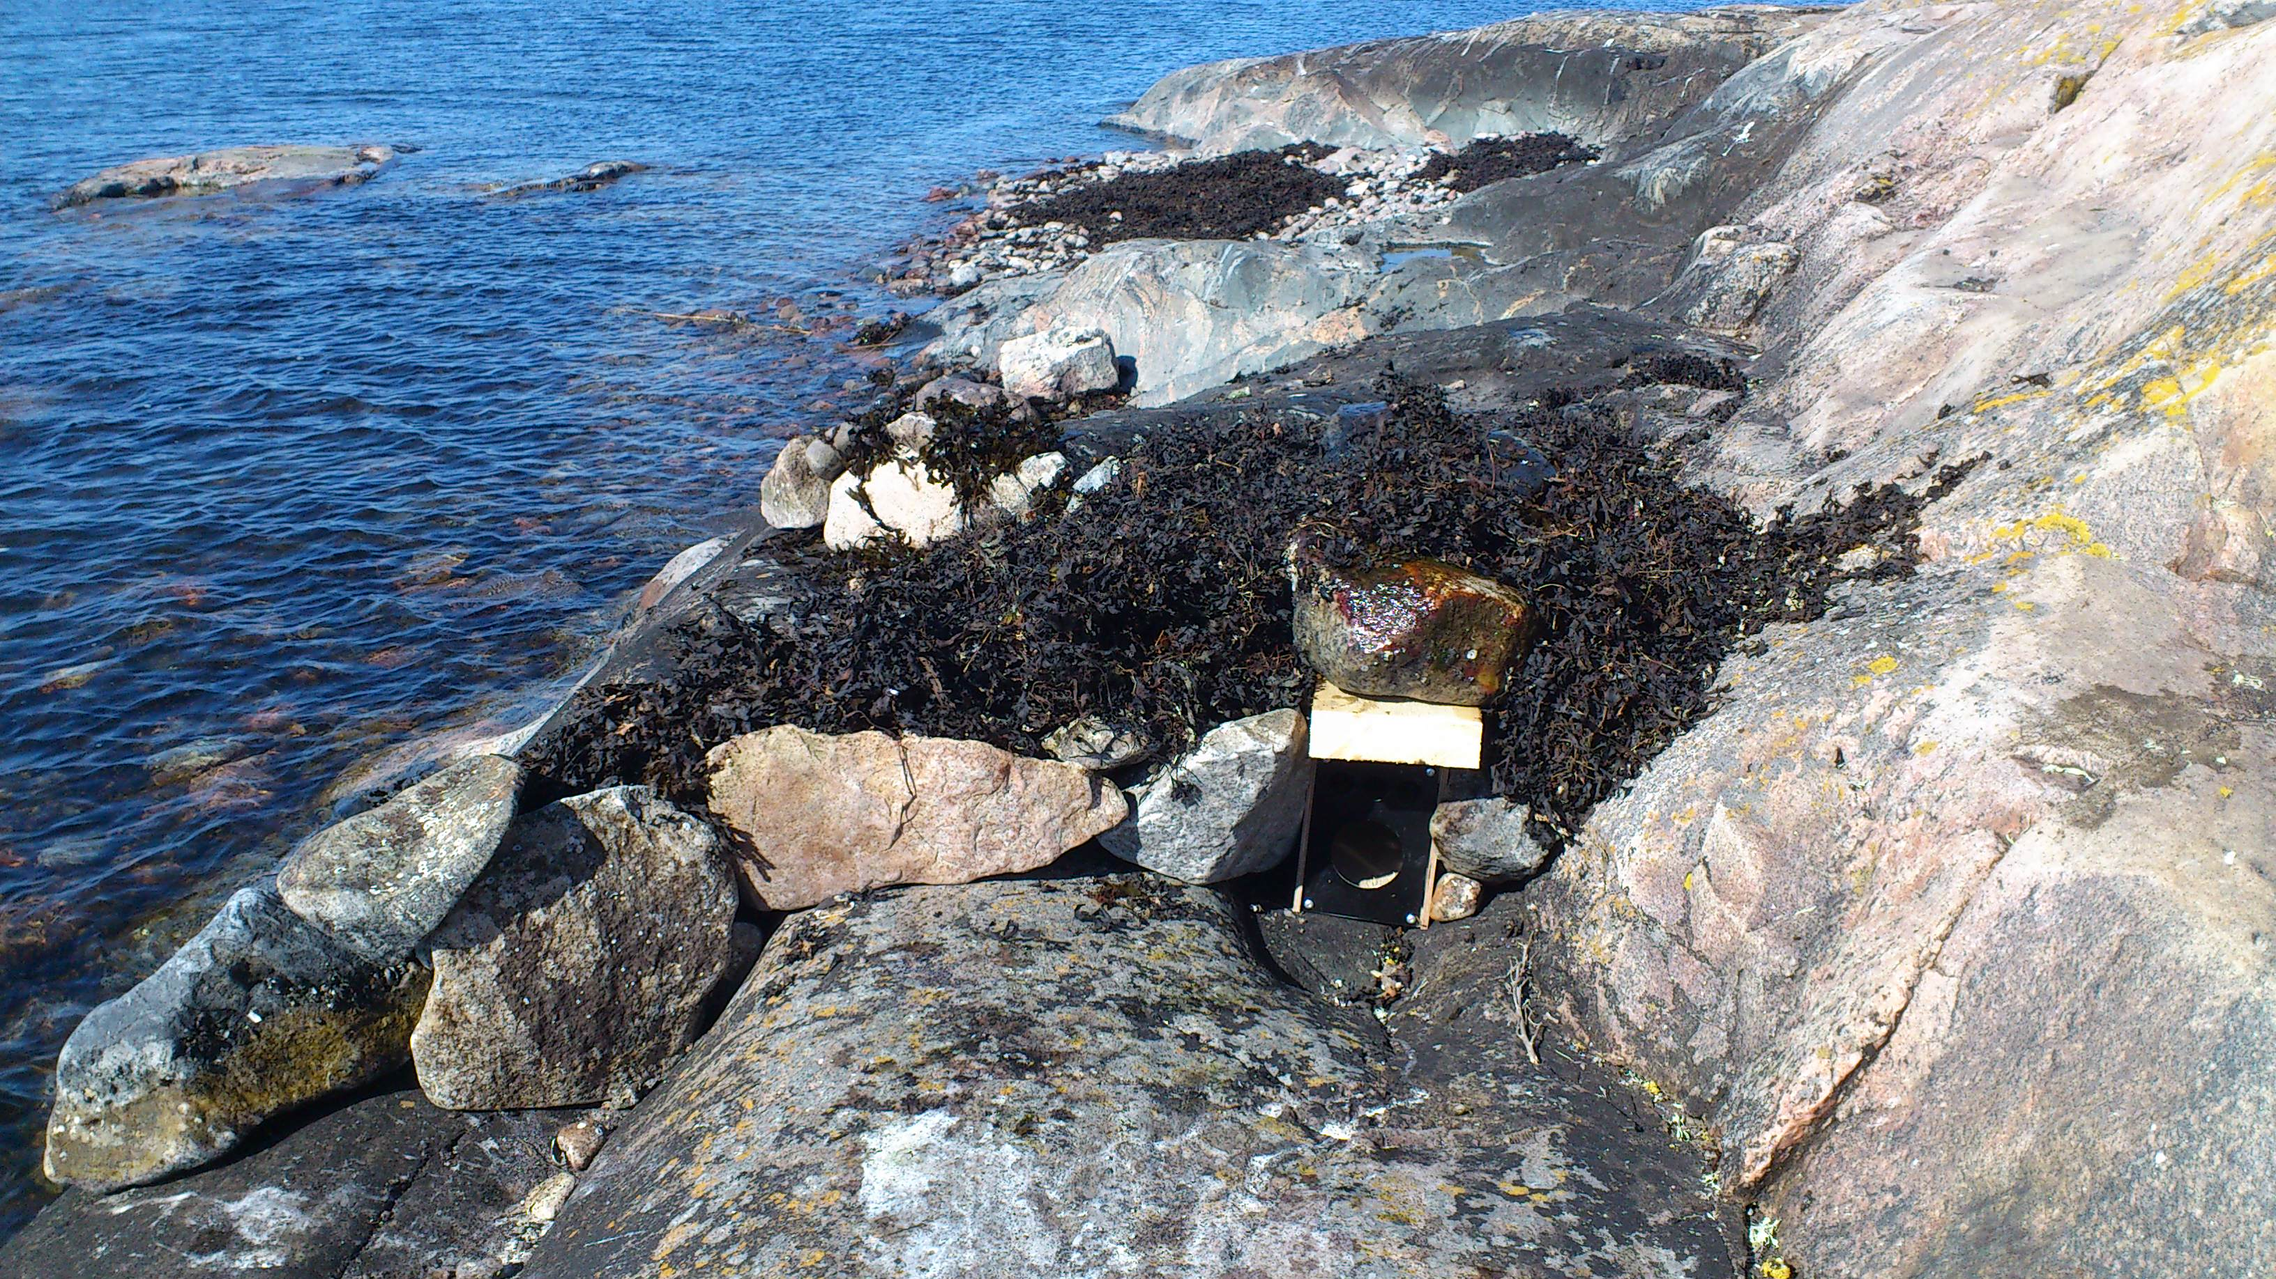
Method
Combination of:
Traps
Hunting with dogs (video)
Notes:
Catch minks with traps is effective for minks that´s spreading in to an area but it could be hard to catch the local minks. A trap catches as long as it´s set.
Dogs are very effictive to finding the local minks that is present in the area at the hunting occasion.
Placement of the traps are very crusial, using there curiousity to explore cavities and there natural passages. Baites can also be used, fresh bait attracts and unfresh repeals.
Hunting with dogs (showing the video), dogs searches and telles when they found mink, for safety the dogs are then leashed, for efficient hunting helping tools are used (smallcaliber pistol or ”leafblower” and shootgun), to cover large areas use one boatdriver and 2 dogkeepers.

Slide 11
Results
Established organisations for hunting mink in every sites (and some spin-offs), big interest among the local people
Each area has its own solution (local hunters, fishers, residents, tenants)
7 people with huntingdogs contracted, ~550 hunting hours
140 minks has been killed in the projectsites and as ”spin-off” from the project
Involved hunters experience a decrease in minkpopulation
About 130 mink traps in projectsites or nearby
Notes:
Successful startup-meetings, followup-meeting, information letters to everyone involved, reducing mink is something that unites the local people,

Slide 12
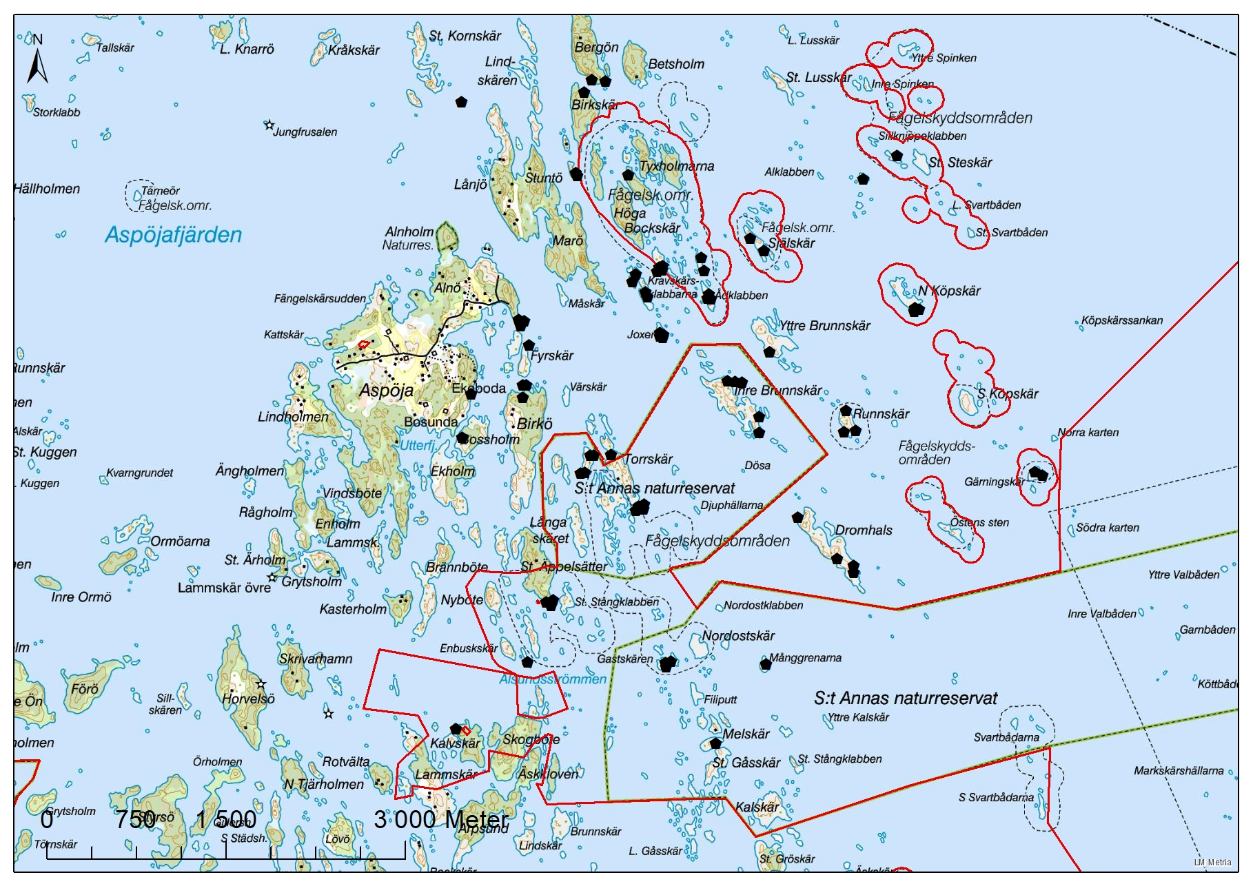
CAB E, Area around Aspöja
Total 75 minks, 43 trapped
3 hunters, 290h.
Traps and doghunt: 350 euro/mink.
Notes:
A typical pattern when hunting with dogs over large areas in the outer archipelago, its possible to reduce the population within 1-2 seasons

Slide 13
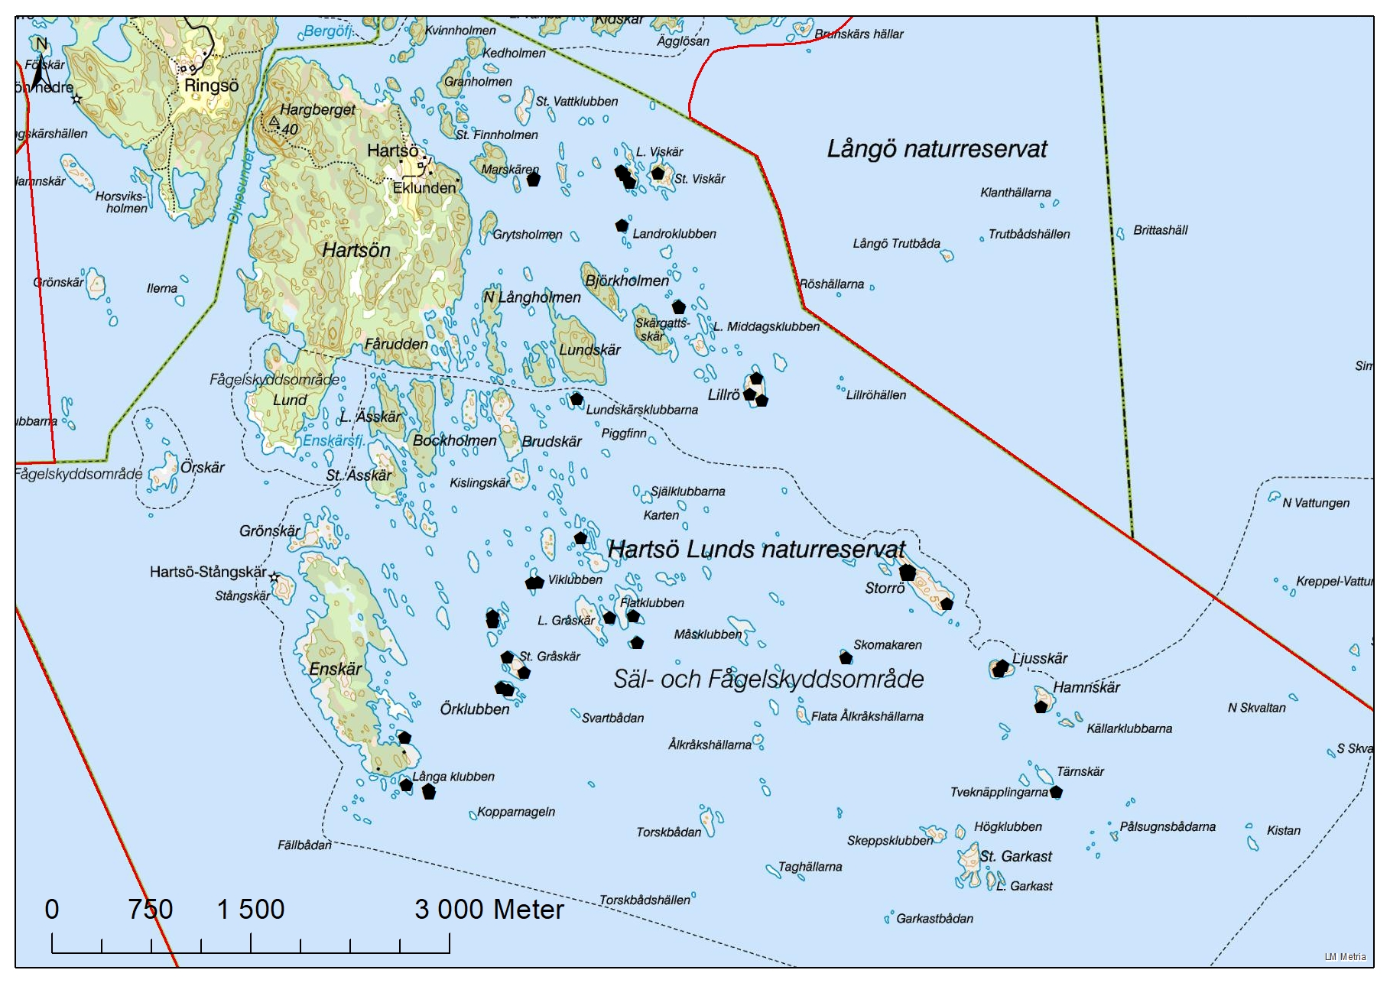
CAB D, Hartsö
Total 39 mink, 11 trapped
2 hunters, 192h.
Traps and doghunt: 220Euro/mink.

Slide 14
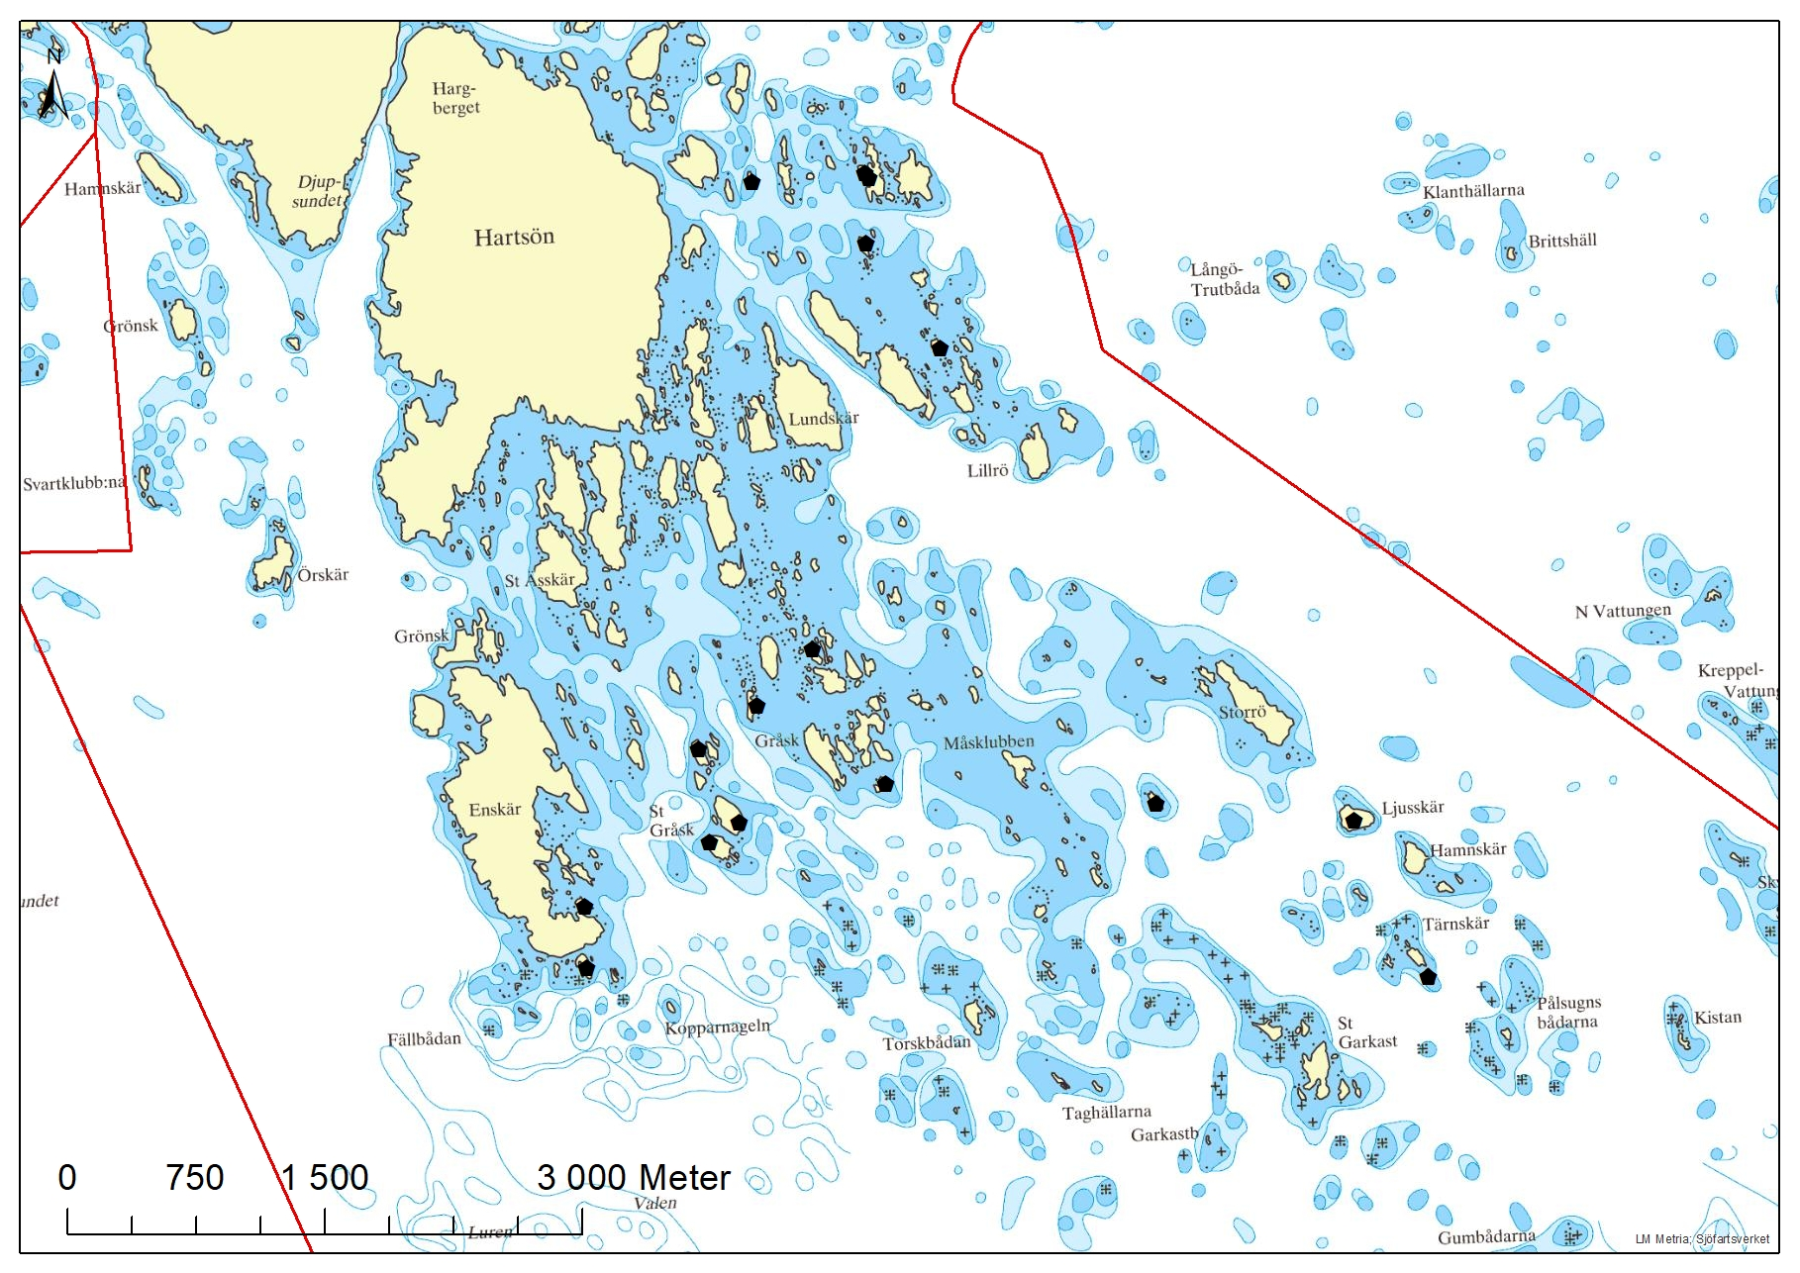
CAB D, Hartsö
16 female of 28 minks.
Females stays in their home ranges
Not easy to be a bird in Hartsö!

Slide 15
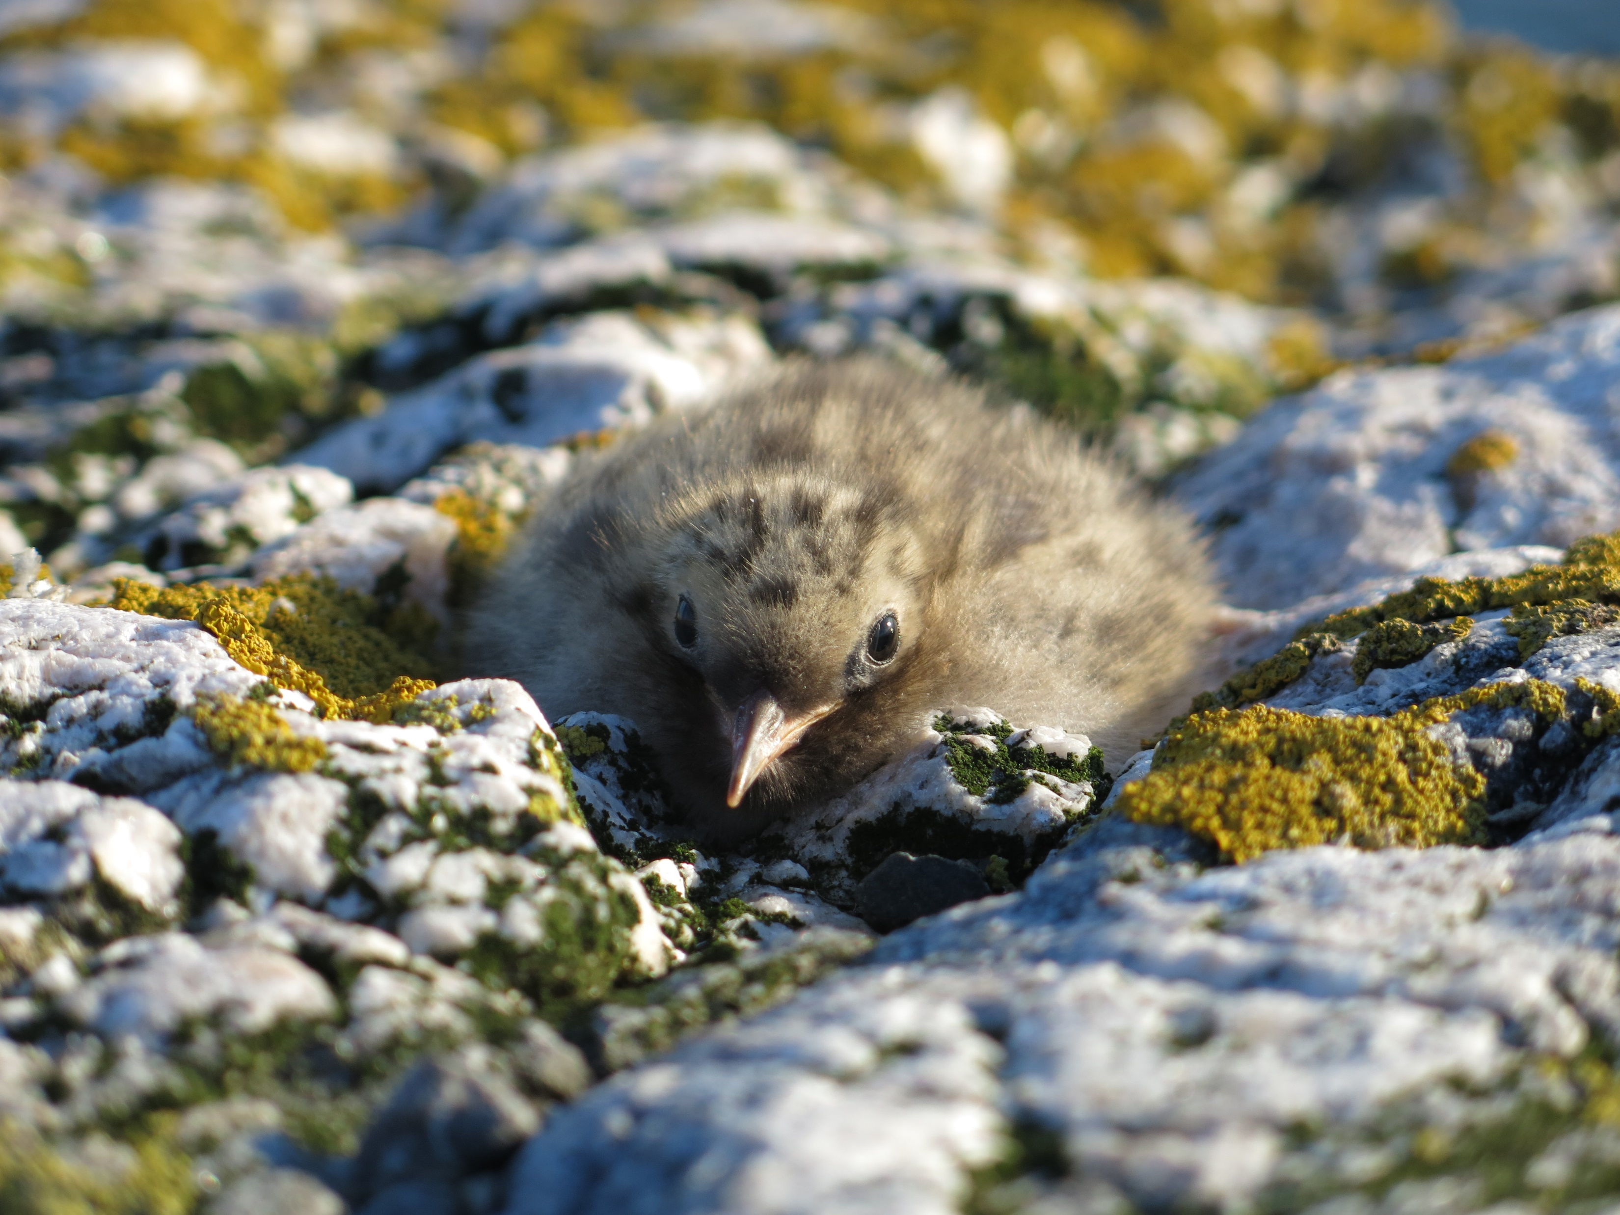
Conclusions
Its possible to reduce the minkpopulation in the outer archipelago
Combination with traps and dogs is nessessary
Every area needs its own organisation
A challenge to keep people and dogs interested when the population is reduced
A challenge to incorporate reduction of mink as an continuous management action for this nature reserves/Natura2000-sites
Photographer: Karl Ingvarson

Slide 16
Thanks!
Some referenses:
- Gerell, Rune. 1984. Lär känna minken- en artmonografi från Svenska Jägareförbundet. - Lariviére, Serge. 1999. Mustela vison. Mammalian species, no 608, pp. 1-9, 3 figs. American society of mammalogists. - Niemimaa, Jukka. 1995. Activity pattern and home ranges of the american mink Mustela vison in the Finnish outer archipelago. Ann. Zool. Fennici 32:117-121. - Nordström, Mikael m.fl. 2003. Minkfria öar i skärgården- en viltvårdsutmaning som ger resultat. Tidsskriften Skärgård, årgång 26 nr 2. - Roos, Stefan & Amkoff, Martin. 2010. Fågelfaunans utveckling i Uppsala läns skärgård efter införandet av jakt på mink. Länsstyrelsens meddelandeserie 2010:4.
Photografer Markus Forsberg for all the pictures without any other name.

