Slide 1
LIFE Coast Benefit
Pollination services
Magnus Stenmark, PhD, Ecologist

Slide 2
Pollination
Importance of pollination
Why pollinators are declining
How to stop that
How did Life Coast Benefit help?
Wich actions are necessary in after-life?
Notes:
Förslag på outline föredrag (ca 35 min + 10 min frågor):

Slide 3
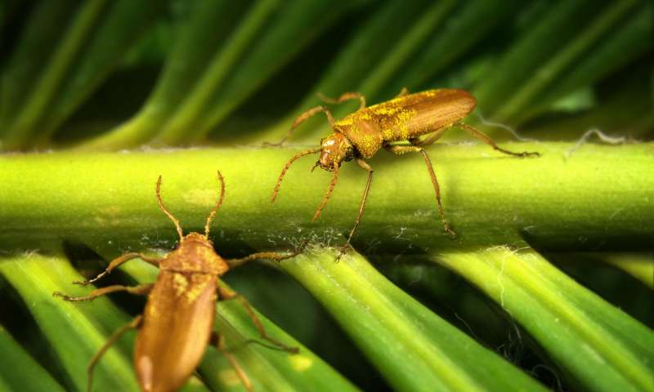
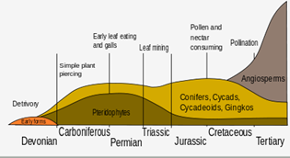
The importance of pollination
Cretaceous period
Notes:
Evolved during the cretaceous period, responsible for the evolution / coevolution. That is what made the present flora, evolving from ferns, cycads and conifers into FLOWERING PLANTS. 75 % of world’s flowering plants rely on insects and other animals 35 % of the crop yield relies on insect pollination

Slide 4
The importance of pollination
Cretaceous period
Notes:
Evolved during the cretaceous period, responsible for the evolution / coevolution. That is what made the present flora, evolving from ferns, cycads and conifers into FLOWERING PLANTS. 75 % of world’s flowering plants rely on insects and other animals 35 % of the crop yield relies on insect pollination

Slide 5
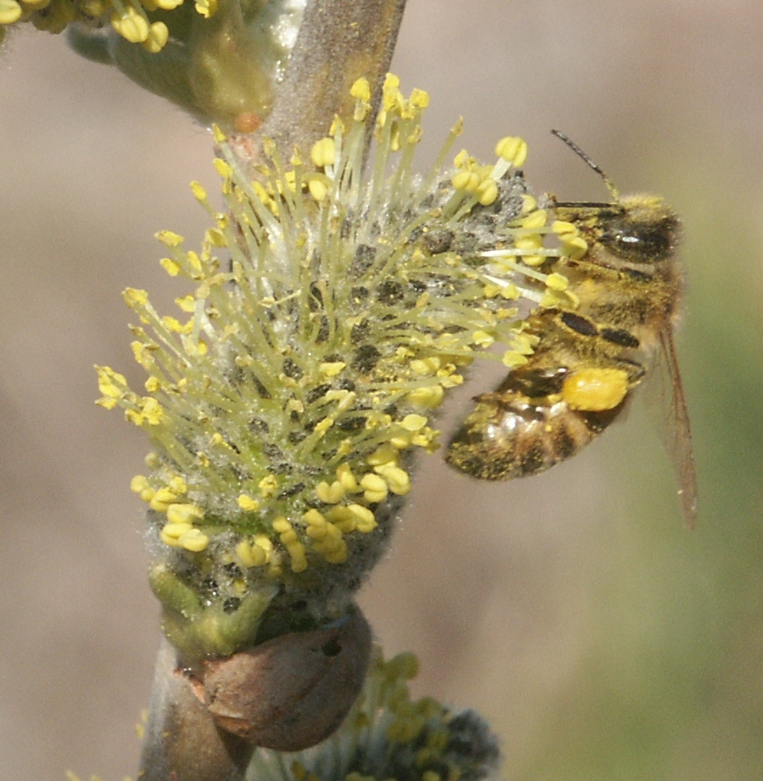
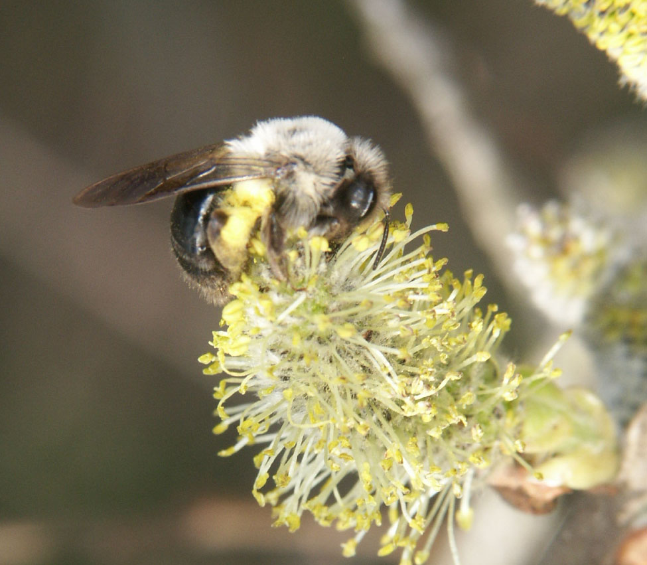
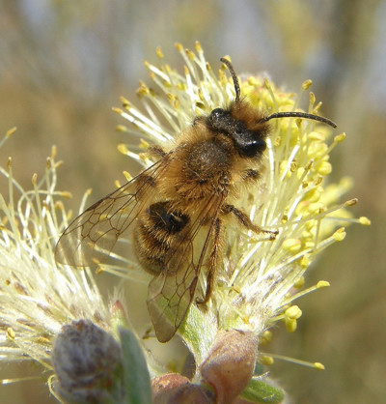
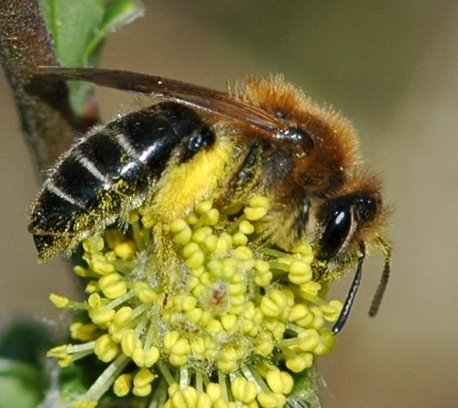
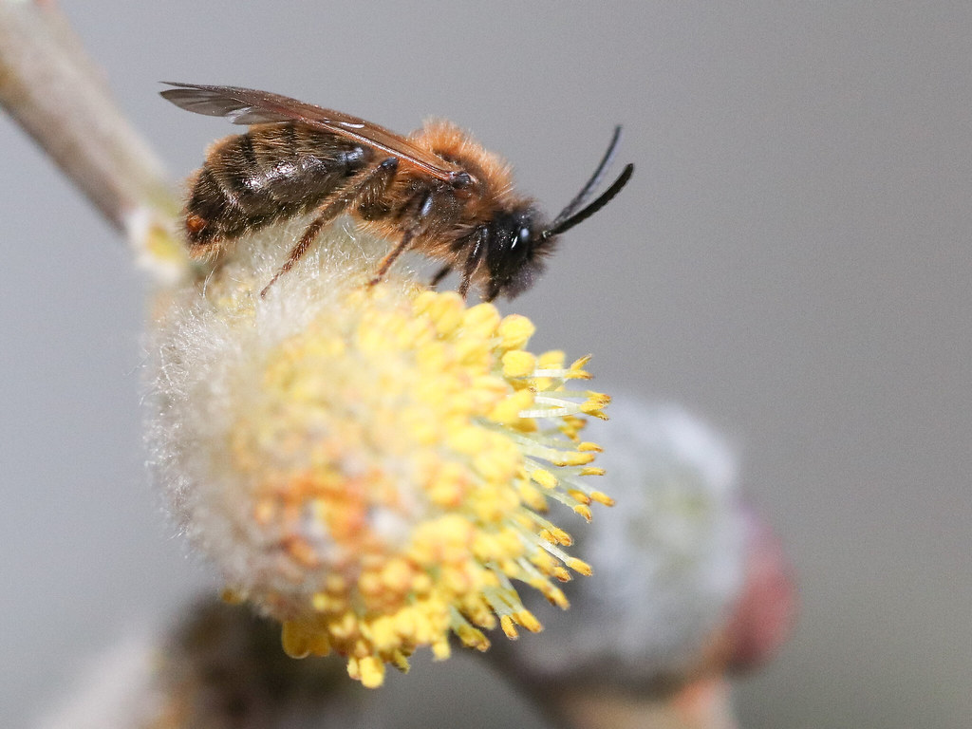
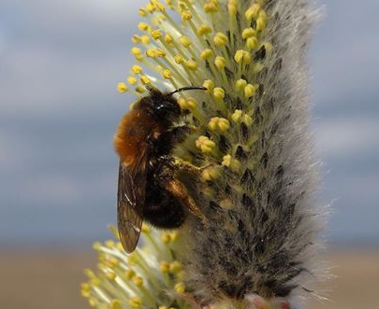
Salix spp.
Notes:
Willow catkins in a regular urban European area – might look as a regular overall buzz, if you look deeply you will see that each one of theam are different – representing not only different species but different ways of building nests, different ways of how to collect pollen - DIVERSITY

Slide 6
Salix spp.
Apis mellifera Andrena vaga Andrena nigroaena Andrena barbilabris
Andrena praceox Andrena bicolor Andrena haemorrhoa Andrena clarkella
Notes:
Willow catkins in a regular urban European area – might look as a regular overall buzz, if you look deeply you will see that each one of theam are different – representing not only different species but different ways of building nests, different ways of how to collect pollen - DIVERSITY

Slide 7
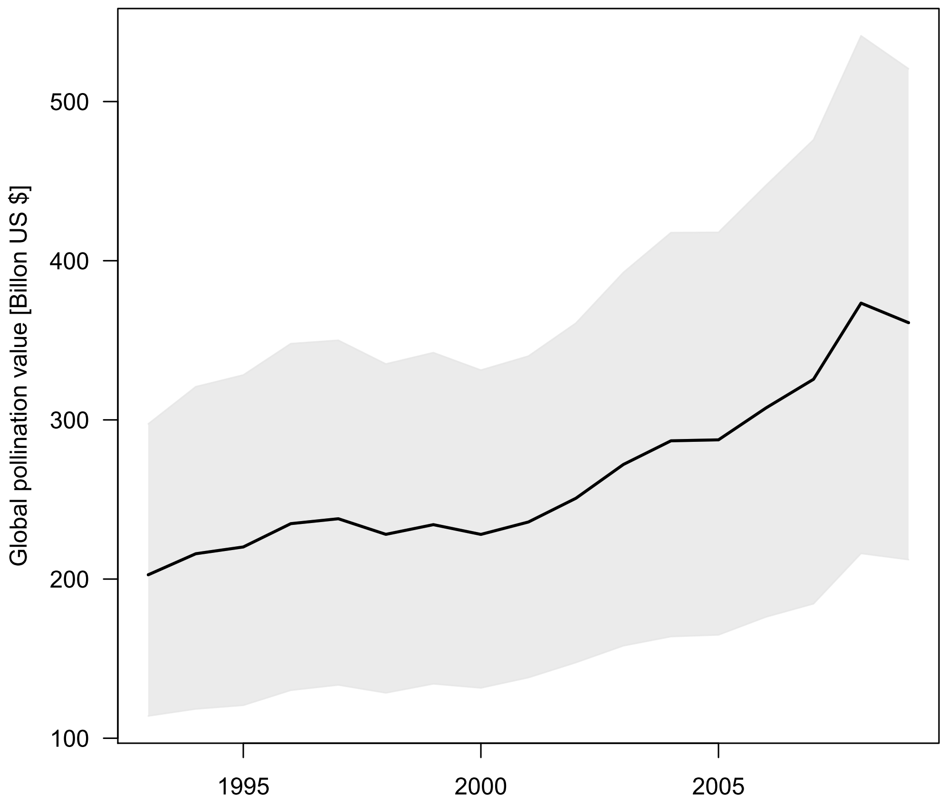
Value of pollination increases
Estimated by Helmholtz Association of German Research Centres
Notes:
Estimated to be annually more than US $ 300 billion

Slide 8
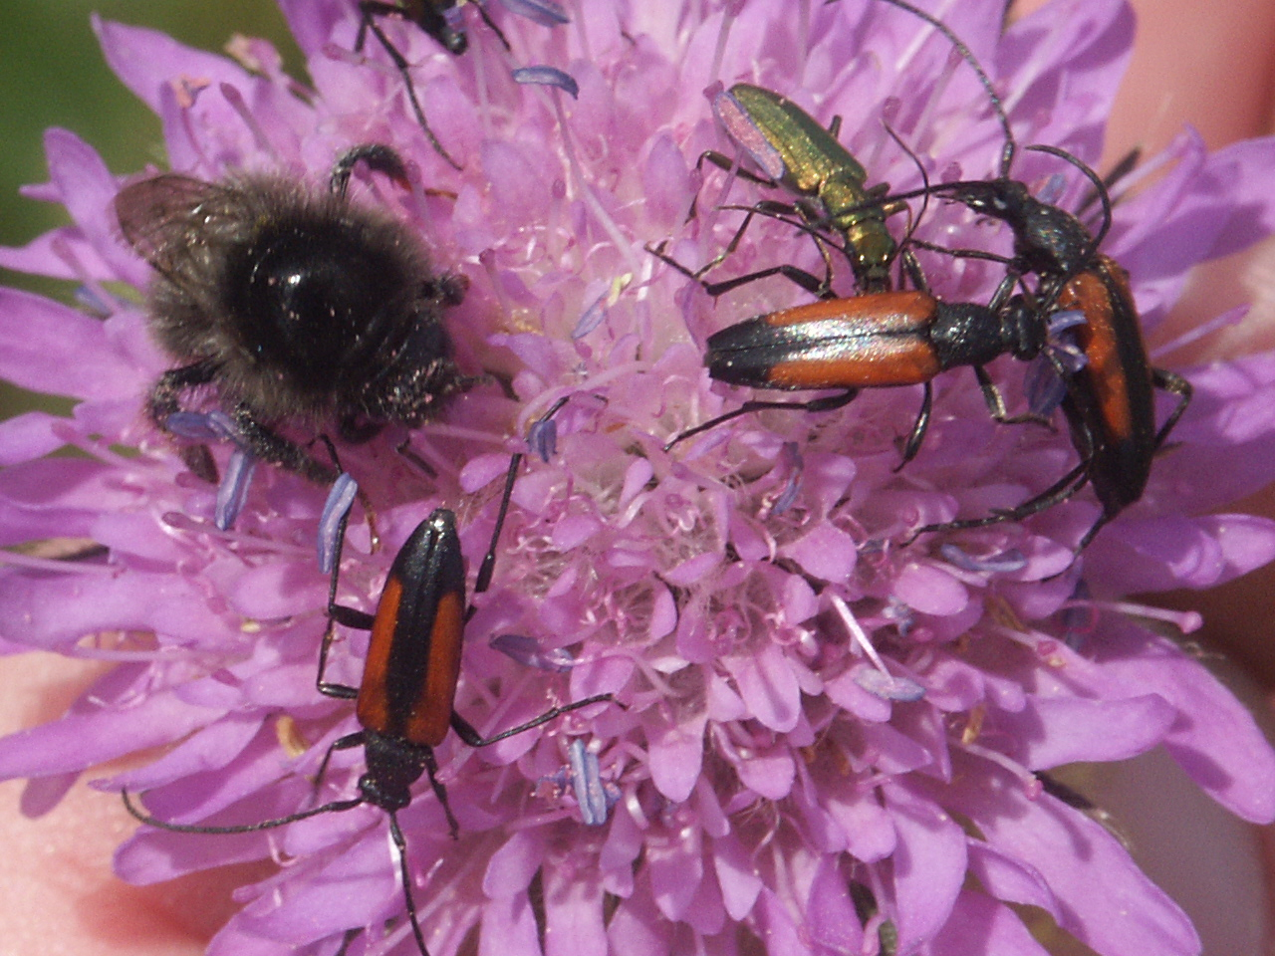
Fact: pollination is in danger
e.g. the Swedish rural landscape
69 % of red listed plants (347 arter)
57 % of red listed insects (1 165 arter)
Notes:
The effects for human populations would be the dramatic decline of pollinators in the rural landscape

Slide 9
Biesmeijer et al. 2006. Parallell decline… Science 313:351-354.
Notes:
Jag nämner inte Hallmann 2017 - 75 % biomasseförlust av insekter i en 27 års studie. Ej seriöst. The Guardian skrev då, baserat på den studien om Armageddon.

Slide 10
New level of local, regional and global awareness
Notes:
Nya miljöer skapas även i odlingslandskapet – infrastrukturbiotoper mm. Rödlistning verkar överskatta risker – för att man fokuserat på odlingslandskapets omdaningar. Migration sker fortare än vi trott.

Slide 11
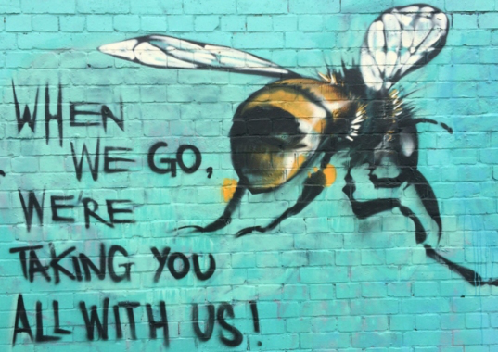
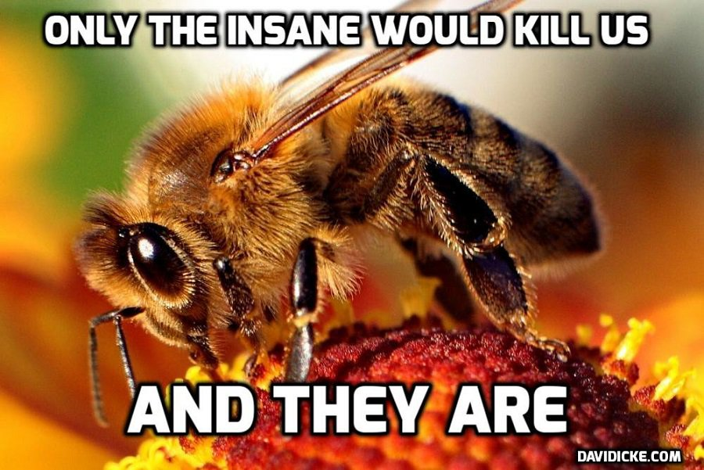
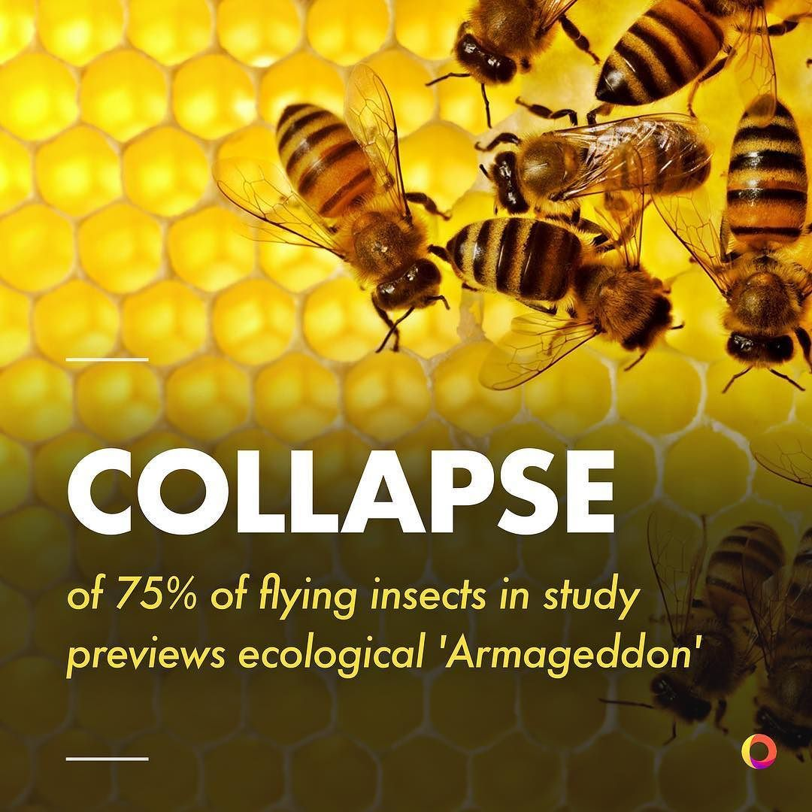
Nya miljöer skapas
Migration sker fortare än vi trott
Rödlistning överskattar risker
Naturvårdsåtgärder fungerar
Notes:
The awareness is something new, people are educated

Slide 12
New level of local, regional and global awareness
Increasing understanding
Notes:
Nya miljöer skapas även i odlingslandskapet – infrastrukturbiotoper mm. Rödlistning verkar överskatta risker – för att man fokuserat på odlingslandskapets omdaningar. Migration sker fortare än vi trott.

Slide 13
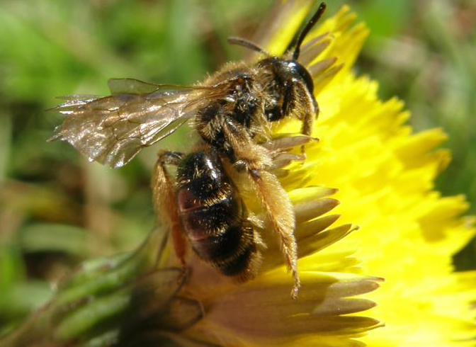
Andrena fulvago NT
Notes:
Vi vet vad vi ställer till med – vi vet att naturvårdsåtgärder fungerar. Best practice nu en del av både jordbruk och skogsbruk.

Slide 14
New level of local, regional and global awareness
Increasing understanding
New habitats are formed
Notes:
Nya miljöer skapas även i odlingslandskapet – infrastrukturbiotoper mm. Rödlistning verkar överskatta risker – för att man fokuserat på odlingslandskapets omdaningar. Migration sker fortare än vi trott.

Slide 15
Airports, urban areas, electric power lines are examples of new habitats that contain high biodiversity

Slide 16
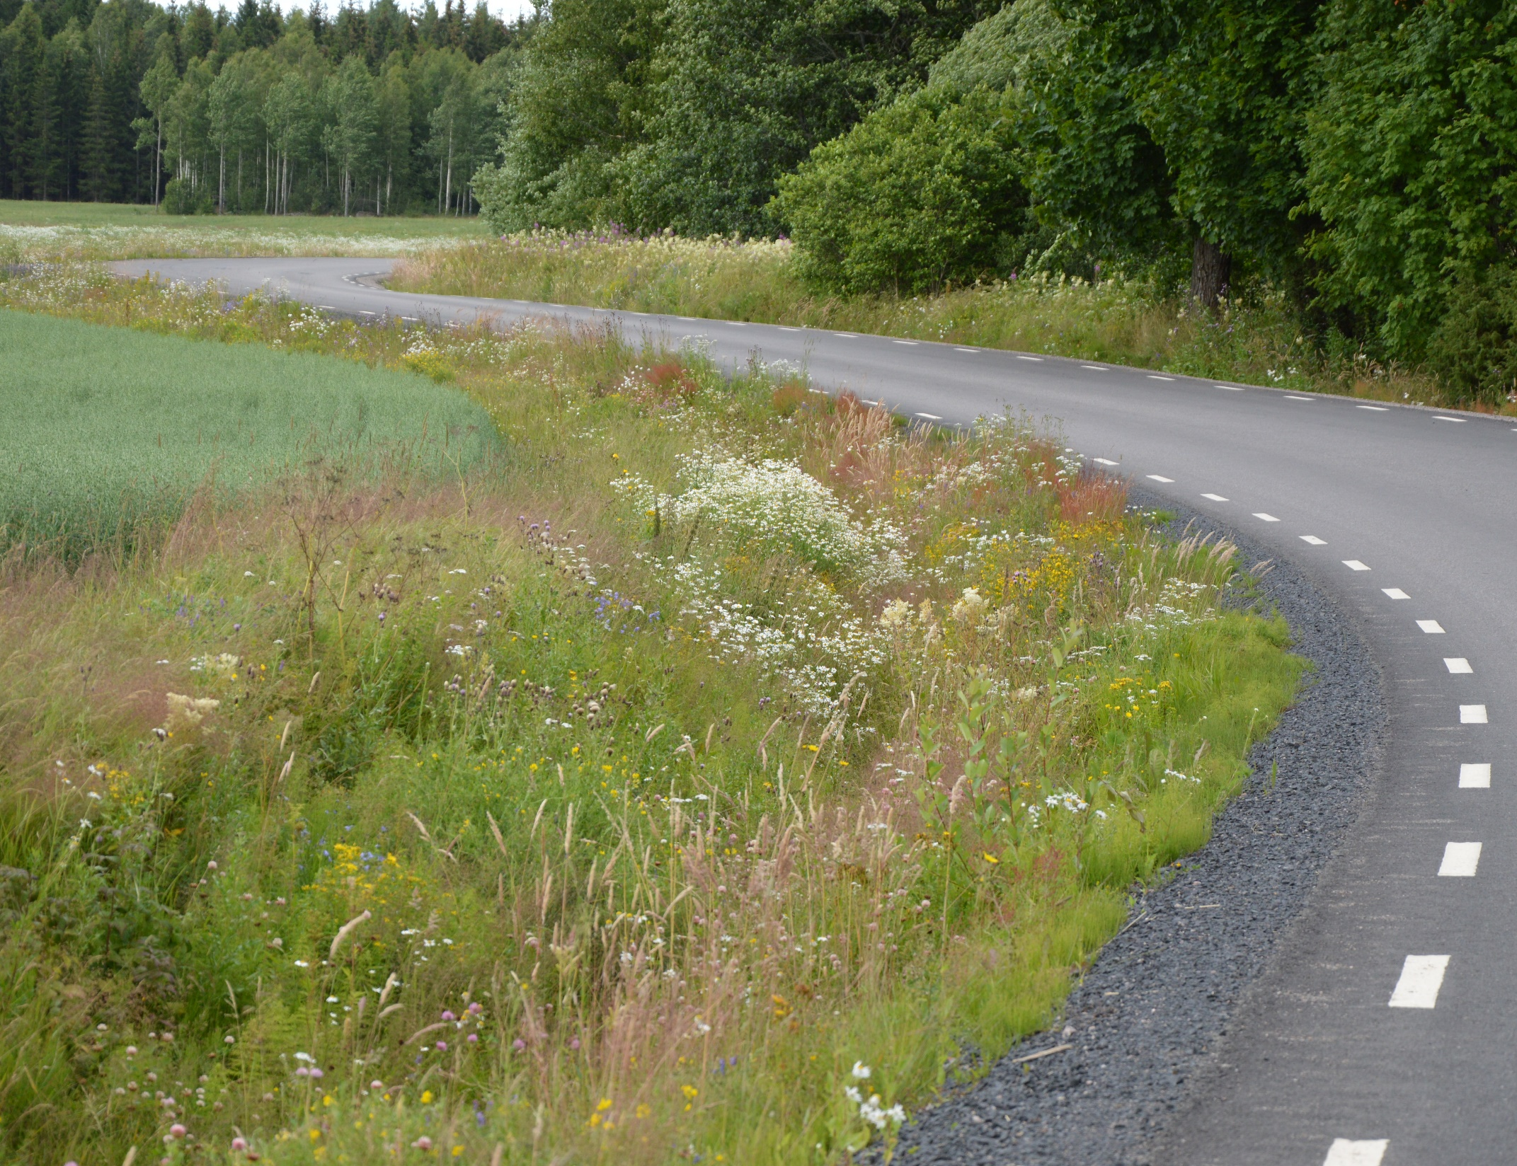
Area of road verges (200 000 ha) overrides area of traditionally mowed areas

Slide 17
Habitats
Habitats
Small scale pastures and meadows
Harsh environments
Decline in human population and overgrowing as a consequence
Aculeate wasps
600 species, 70 % of national fauna
Due to land use shift
Viable populaitons at risk
Dispersal at risk
Reduced pollination effect as a result

Slide 18
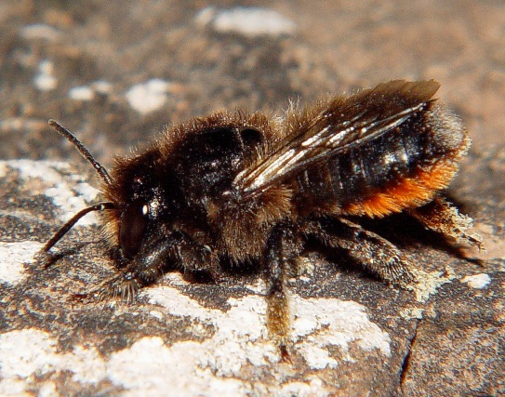
Megachile analis
Coastal habitats
Notes:
A quite rare species typical for coastal areas with large quantitites of Lotus corniculatus, Lathyrus and other Leguminoceae pollen plants. They nest under stones and can be considered a heath species.

Slide 19
Bombus muscorum
Notes:
A very beautiful and fastflying bumblebee, typical for pollenrich meadows far out in the archipelgo, where short toungued species do not exist and suppress mucorum.

Slide 20
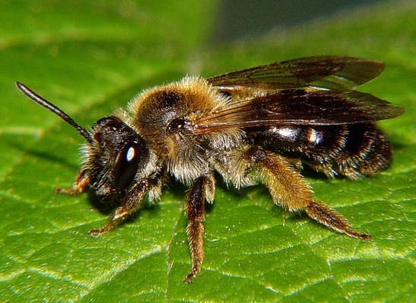
Andrena fulvida
Forest edges habitats
Notes:
A typical species for semi-opened pastures and for grazed forests. Collects pollen from Lonicera xylosteum and Rhamnus frangula

Slide 21
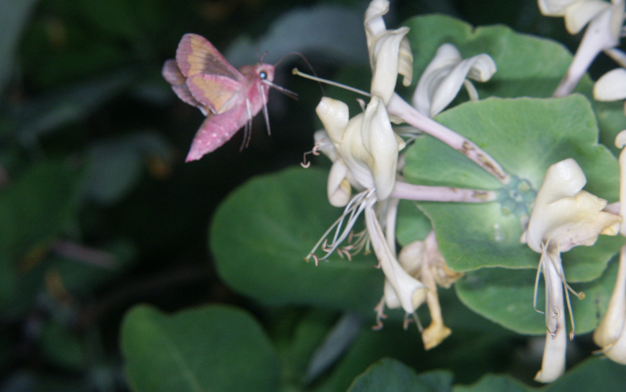
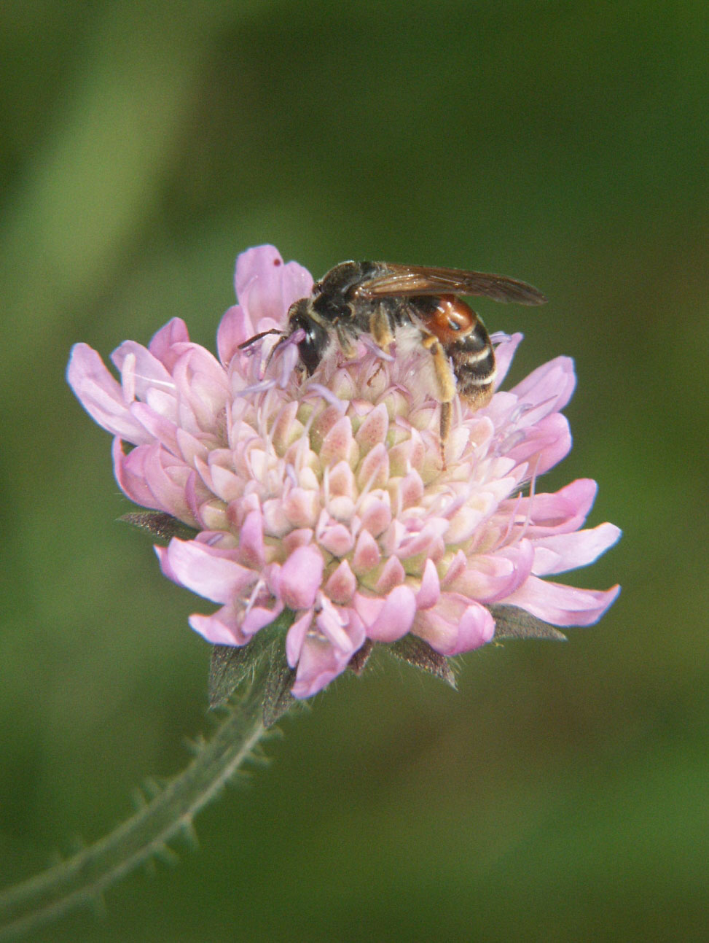
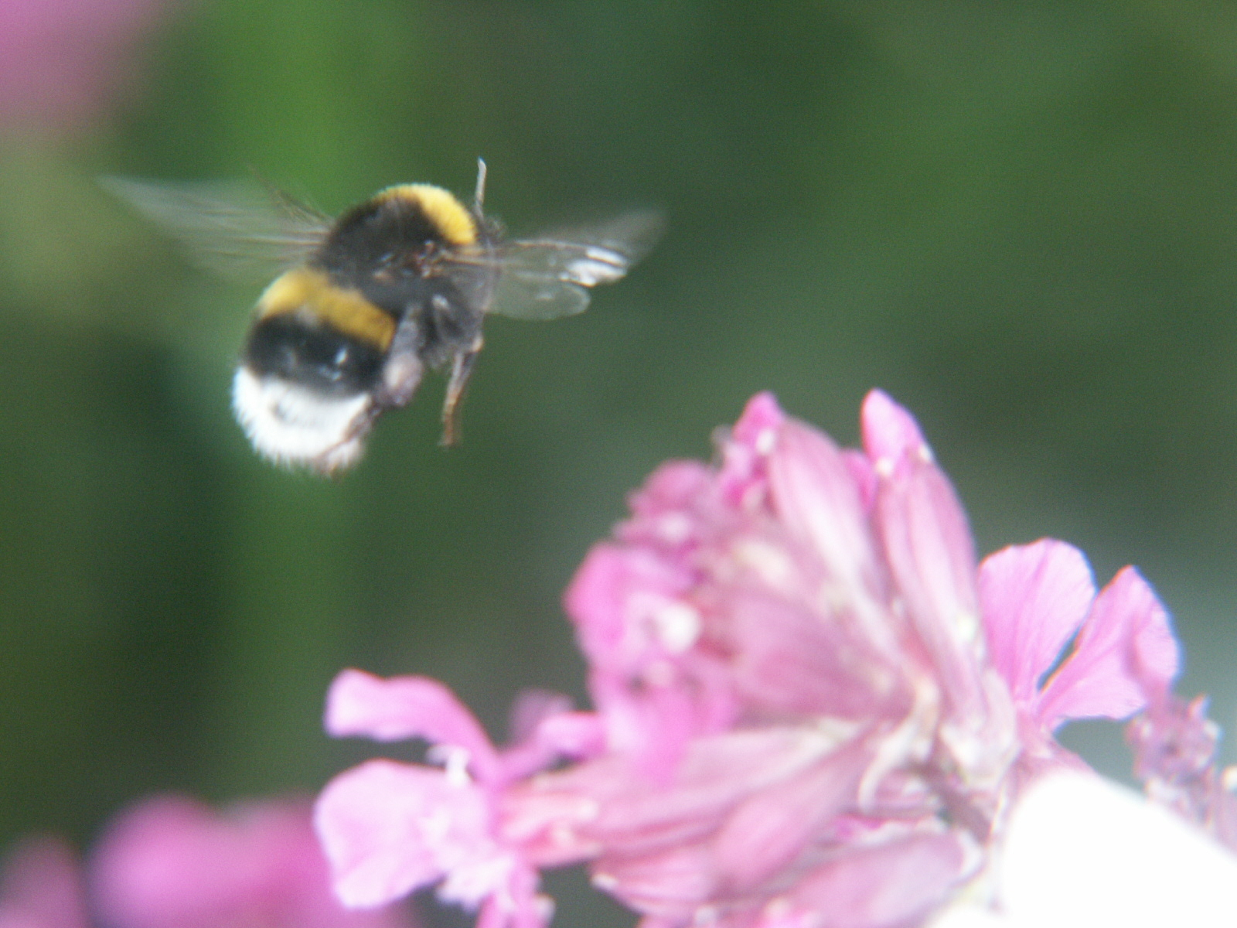
What pollinators need
Food
Nest
Notes:
The pollen species are the foundation for all pollinators. Many are specialixed on one species, or a set fo a few. They require a large and long term presence of that pollen.

Slide 22
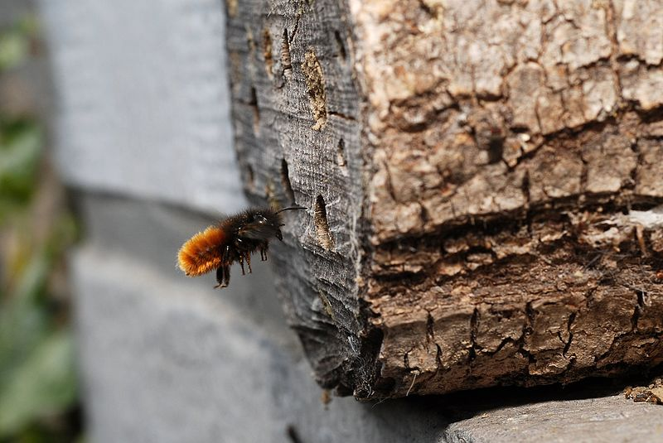
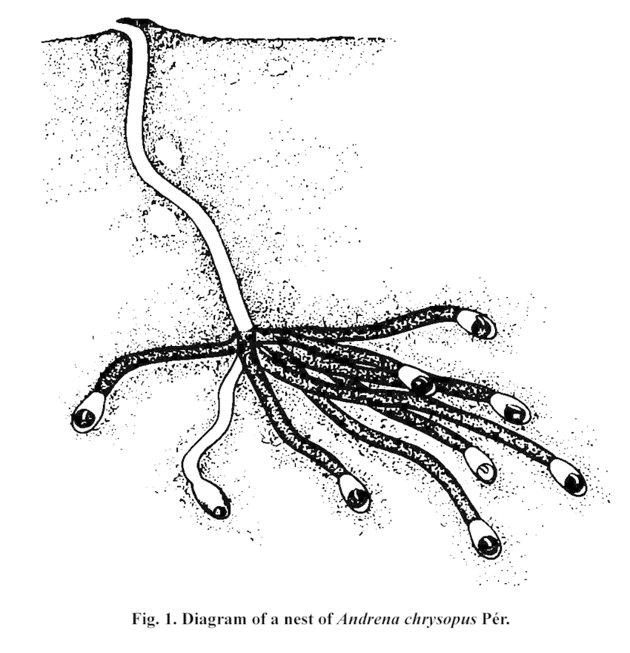
Wood nesting vs soil nesting
För insektsgruppen gaddsteklar
Notes:
I huvudsak bor insekter antingen i håligheter (ved, stenpartier mm) eller i lätta jordar – främst sand.

Slide 23
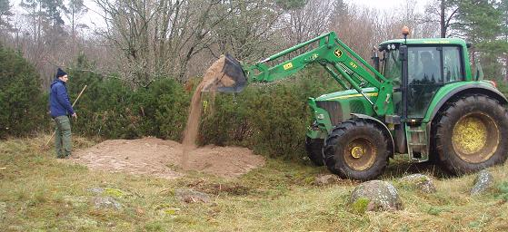
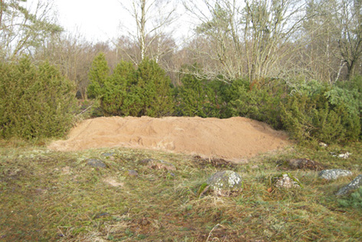
Lack of pollen plants and nesting sites
Land use changes
Fewer farms
Lack of fires
Atmospheric nitrogen
Mineral fertilization
→
Overgrowing Fragmentation

Slide 24
Results of LIFE Coast Benefit
Which actions increase habitats for pollinators?
For how long?
What is necessary to do as after LIFE actions?

Slide 25
Results of LIFE Coast Benefit
Which actions increase habitats for pollinators?
Food
Nest
Wood nesting
Grazed forest
Semi-open
Soil-nesting
Milling
Elsewhere in restored areas
158 ha open grasslands
613 ha semi open grasslands
346 ha grazed forests
398 ha 2-season grazing
Milling stumps/tuffts

Slide 26
Results of LIFE Coast Benefit
For how long?
Restoration requires management
No specific nectar and nesting actions
(these normally function for 10-15 years)

Slide 27
Results of LIFE Coast Benefit
What is necessary to do as after LIFE actions?
Socio-economical aspects most important
Identify critical islands/areas/farms
Push towards long-term financially reliable solutions, e.g. infrastructure
Adapt to current and future business solutions
Technical aspects
Dialog and information to farmers and other landowners

Slide 28
Examples of actions

Slide 29
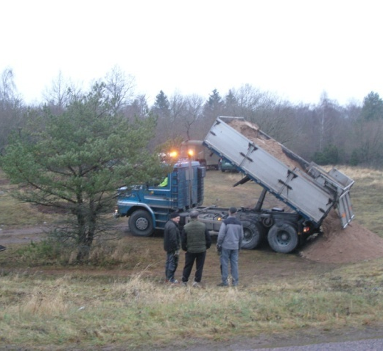
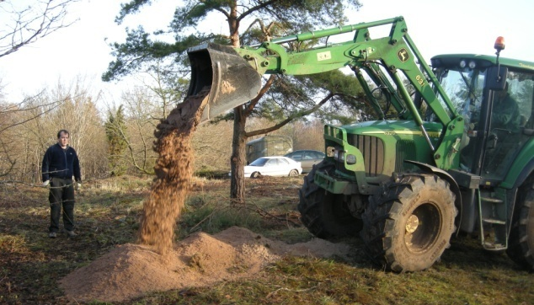
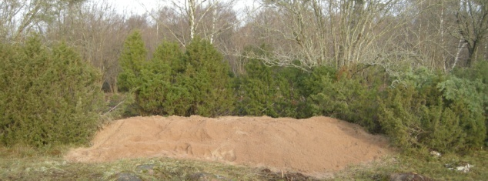

Slide 30
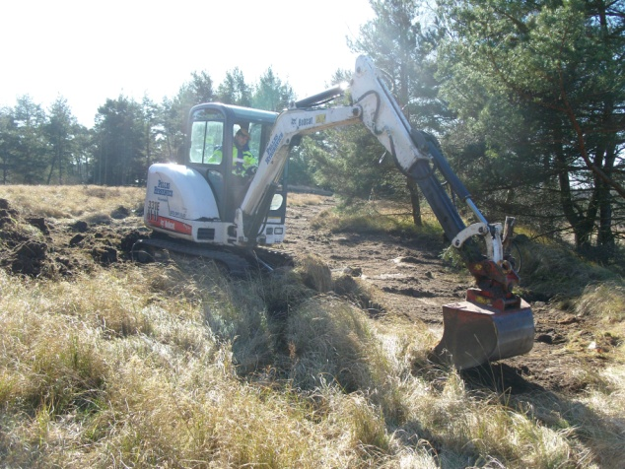
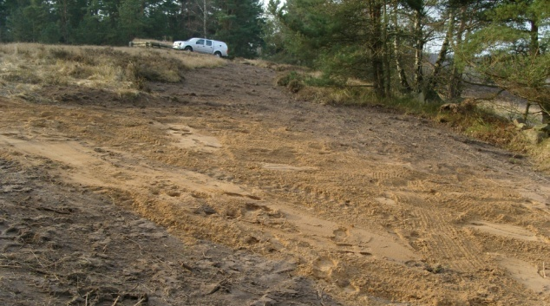
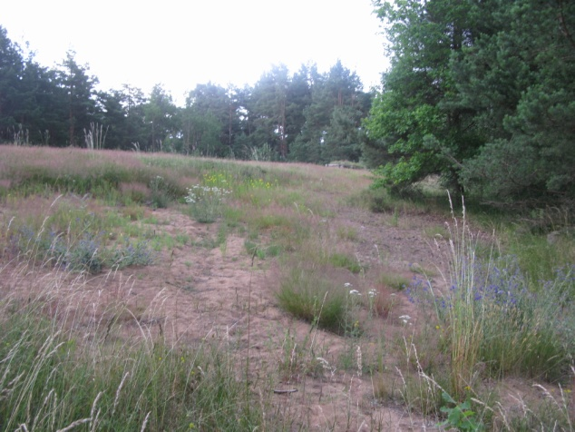

Slide 31
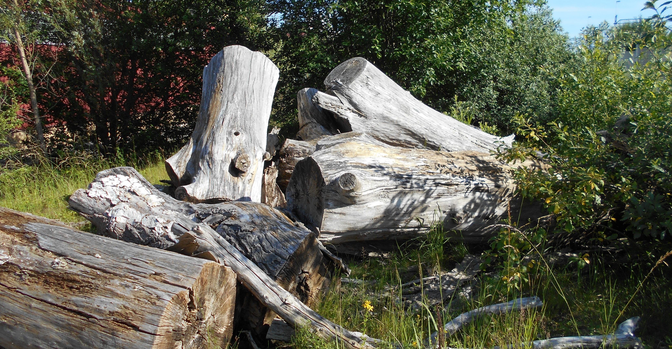

Slide 32
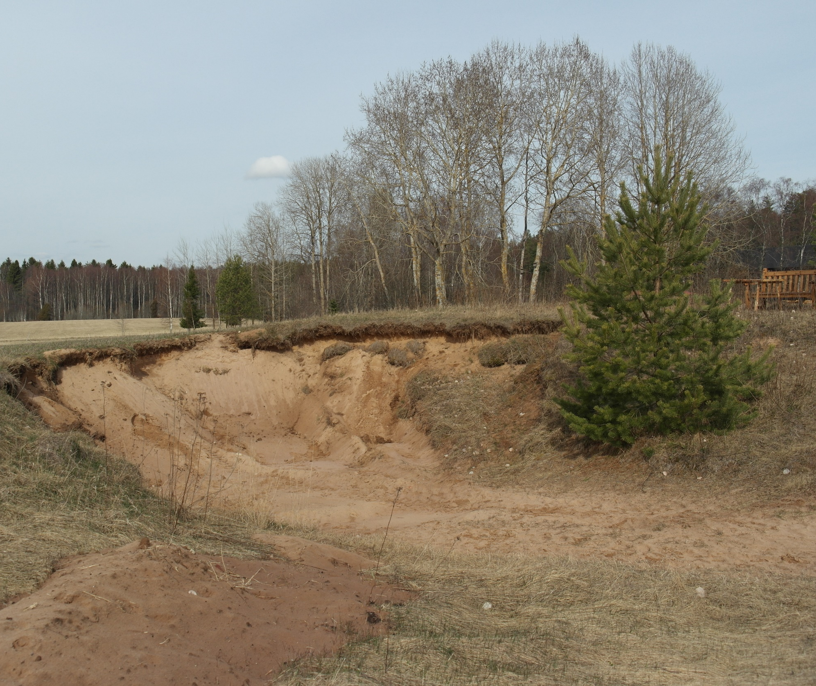
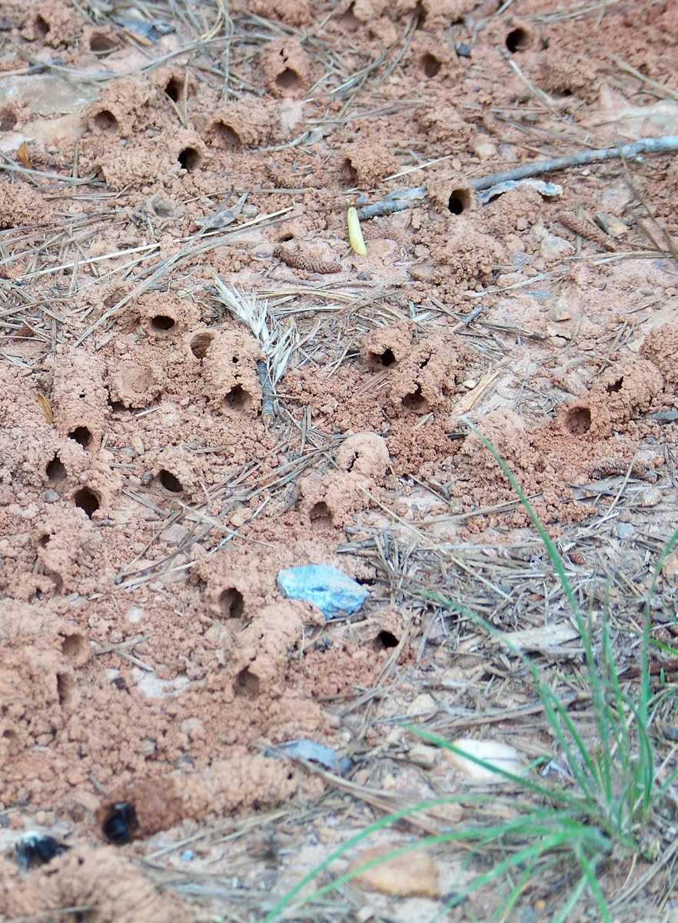
Notes:
Har man väl slagit sig ner och förundrats i en aggregation av solitärbin som kan omfatta över 20 000 aktiva bon
Då blir man en förespråkare av sand
Uppmärksamma boplatser
Husbehovstäkter
Blotta sand och jord
Lägga ut sand (bibäddar)
Sandig betesmark
Åtgärdsplaner
Alla kan göra något

Slide 33
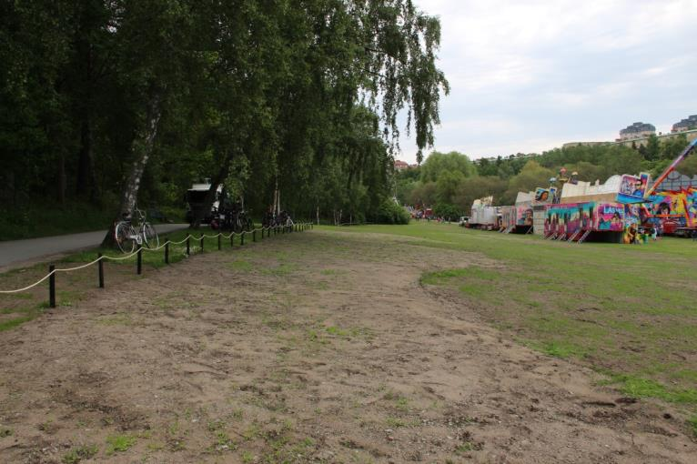
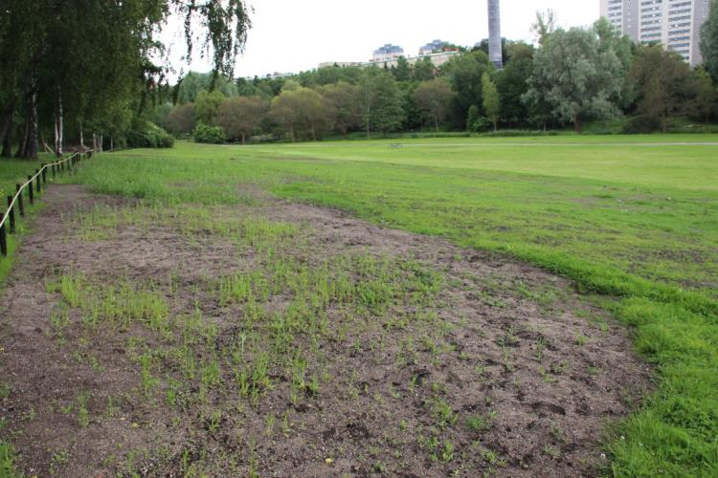
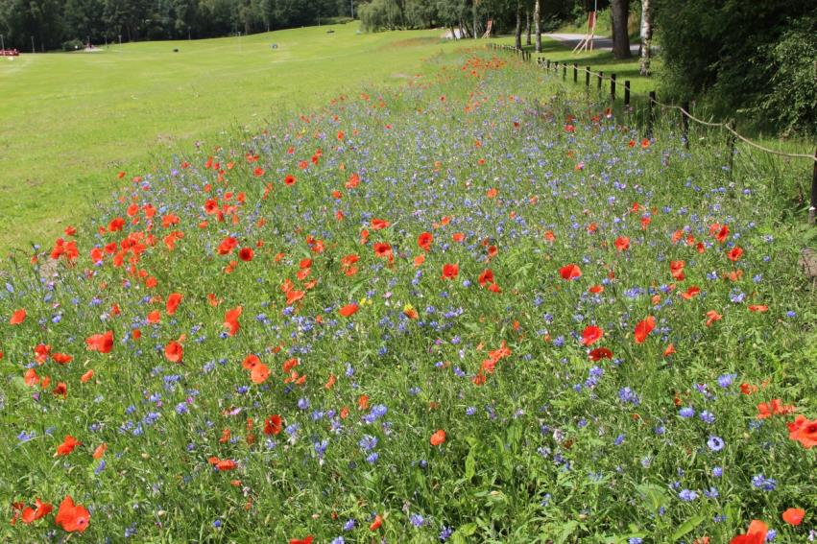
Juni 6, 2015
Juni 26, 2015
Juli 20, 2015

Slide 34
Thank you for your attention

