Slide 1
Coastal grasslands – habitats on the move
Sara Cousins
Department for Physical Geography
@SAOCousins
Notes:
Coastal grasslands – habitats on the move.
How livestock can mitigate plant diversity decline
Who am I : historical ecology, community ecology landscape ecology also part of the bolin centre for climate research in the area on biodiverisy and climate
Two stories linked to the coastal project and some food for thought for the future

Slide 2
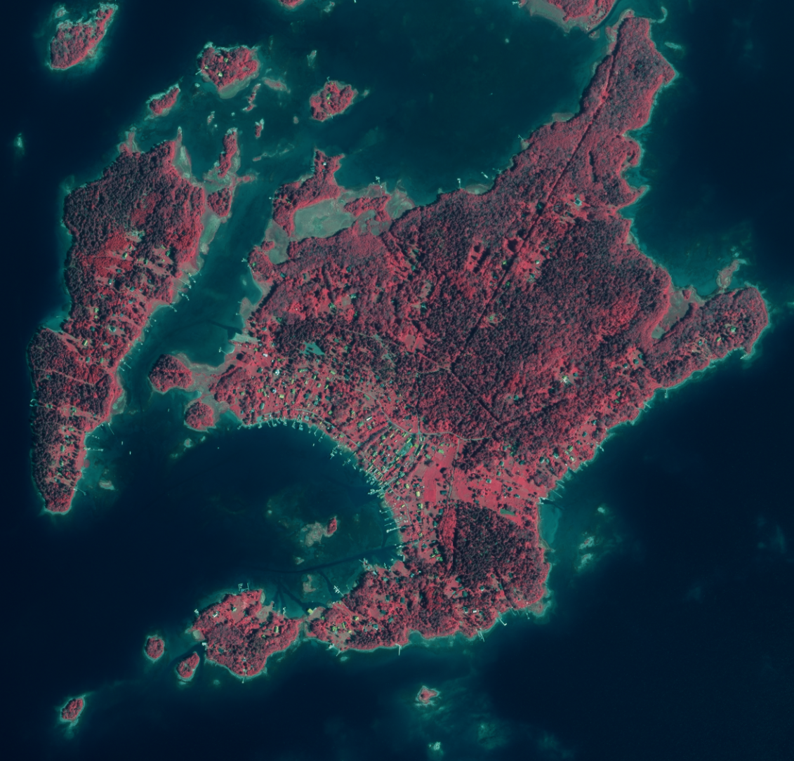
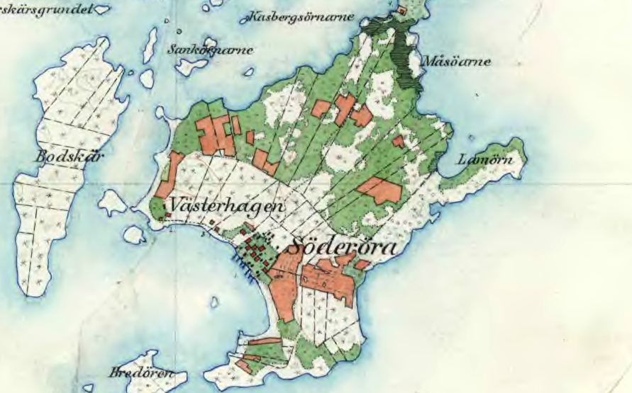
1780
1901
Notes:
Söderöra!

Slide 3
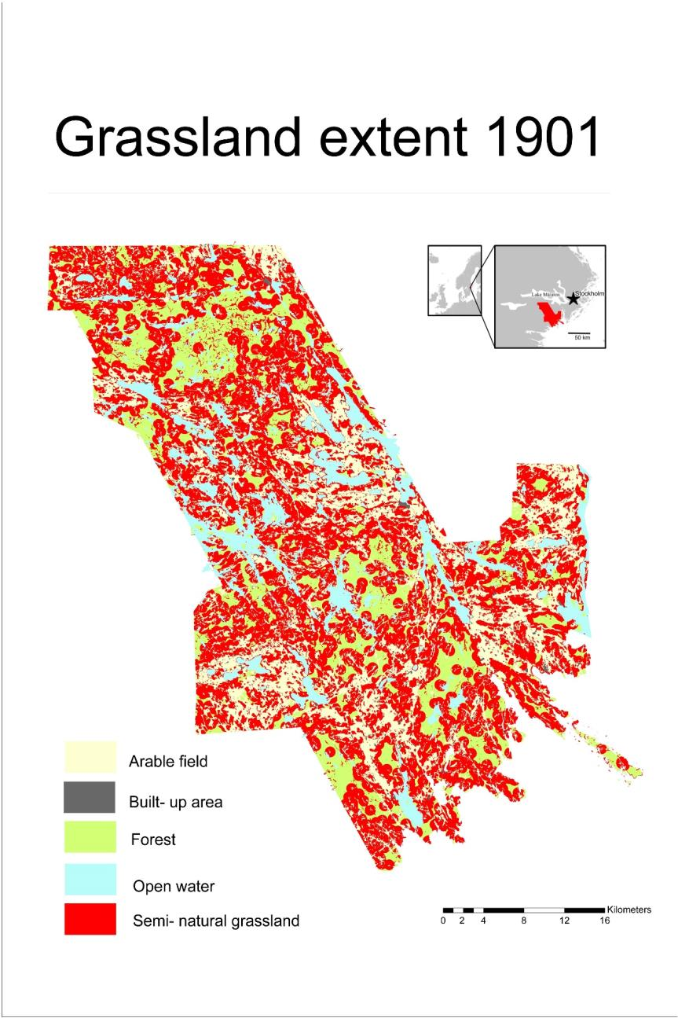
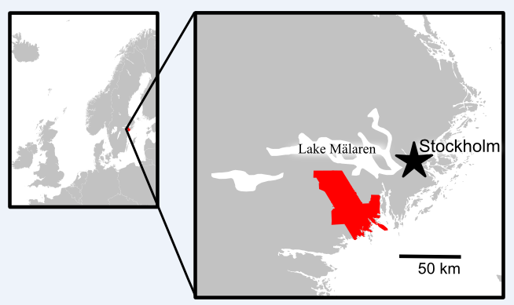
96% Grasslands gone
16 km
Cousins et al. 2015 AMBIO
Notes:
How can you investigate the effects of functional connectivity or other spatial effects on plant diversity

Slide 4
Wild strawberries
Cock’s-foot
St. John’s wort
Wood anemone
Annual bluegrass
Dog violet
Lady’s mantel
Silver cinquefoil
Burnet-saxifrage
Red sorrel
Yarrow
Sheep’s fescue
Dactylorhiza lati.
Ribwort plantain
Harebell
White clover
Hairy wood-rush
Timothy grass
Buttercup
Cowslip
Bellflower
Speedwell
Sedge
Mouse-ear hawkweed
Bitter vetch
Lady’s bedstraw
Sweet vernal grass
0.25 m²
Notes:
Where were the species before grassland management
One of the world’s most species-rich habitats , Long continuity of management Build-up of species, More than 90% have been lost during the last 100 years
Tack jessica och emelie
Bilden tagen 16 maj 2018
27 arter
Ca 50 x 50 cm

Slide 5
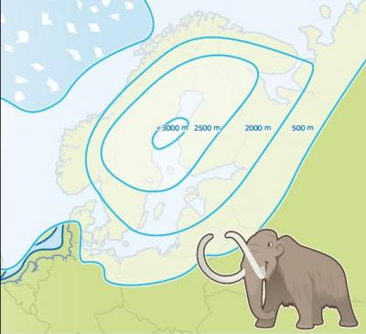
www.kvarken.fi/varldsarvet/geologi/istiden/

Slide 6
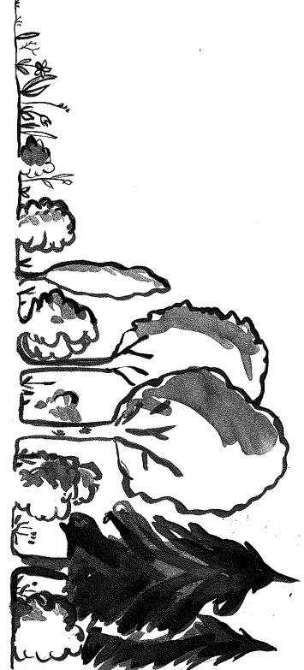
Landscape scale
DTM 23000 km² area
Land uplift model ~ 4000 years potential meadow areas =
slopes of 1-2 degrees
Site scale
Plant diversity in
10 managaged shore meadows
10 unmanaged former shore meadows
Notes:
Our selection input data

Slide 7
4000 years of land uplift (Upland and
Södertörn)
Norrtälje
Stockholm
Notes:
Obs 7900 omfattar också södertörn
Ungefär hälften av detta land kan ha varit strandäng, vilket är yta som är lika stor som hela Gotland

Slide 8
Results
Norrtälje
7900 km² land emerged
2400-3400 km² potential meadow
Potential meadow 50-150 km²/100 yr
Svartlöga
Notes:
Potential shoremeadow the equvalient of Gotland
Obs 7900 omfattar också södertörn
Ungefär hälften av detta land kan ha varit strandäng, vilket är yta som är lika stor som hela Gotland
Coastbenefit have restored 9 km2

Slide 9
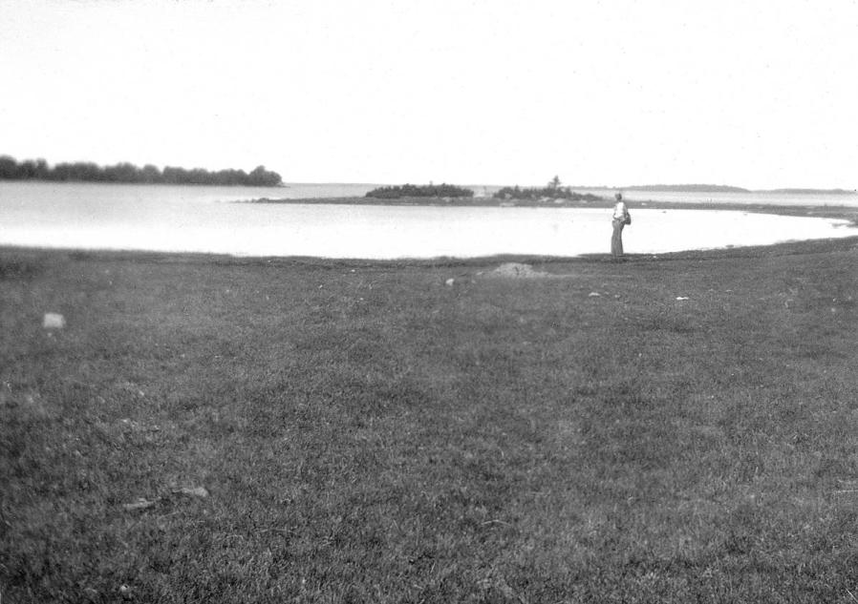
X
X
Photo: S. Sternberg
Photo: Cousins
1920
2018
45 cm isostatic rebound in 100 years
Notes:
Interesting to understand how connectivity will change with future sea level increase that can’t be compensated by isostatic rebound

Slide 10
Historical map from 1901

Slide 11
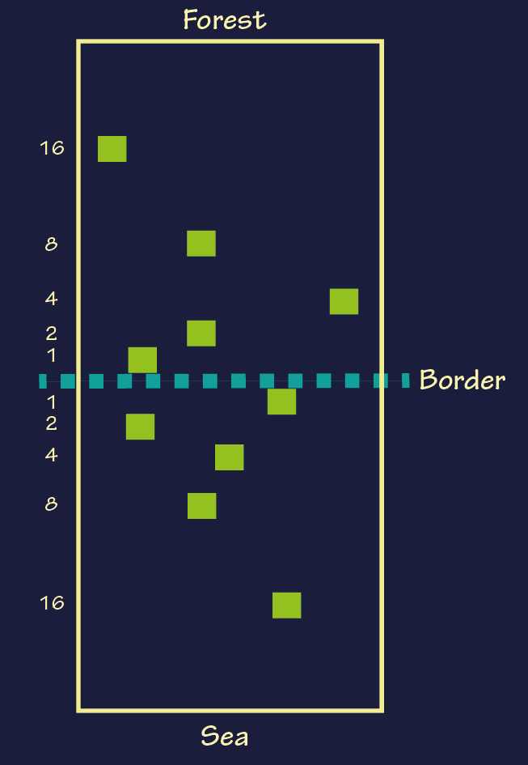
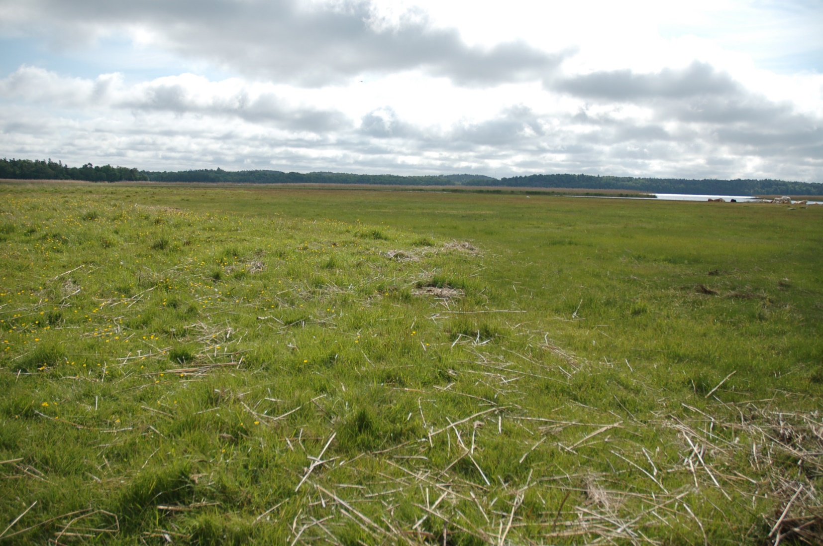
Sample design

Slide 12
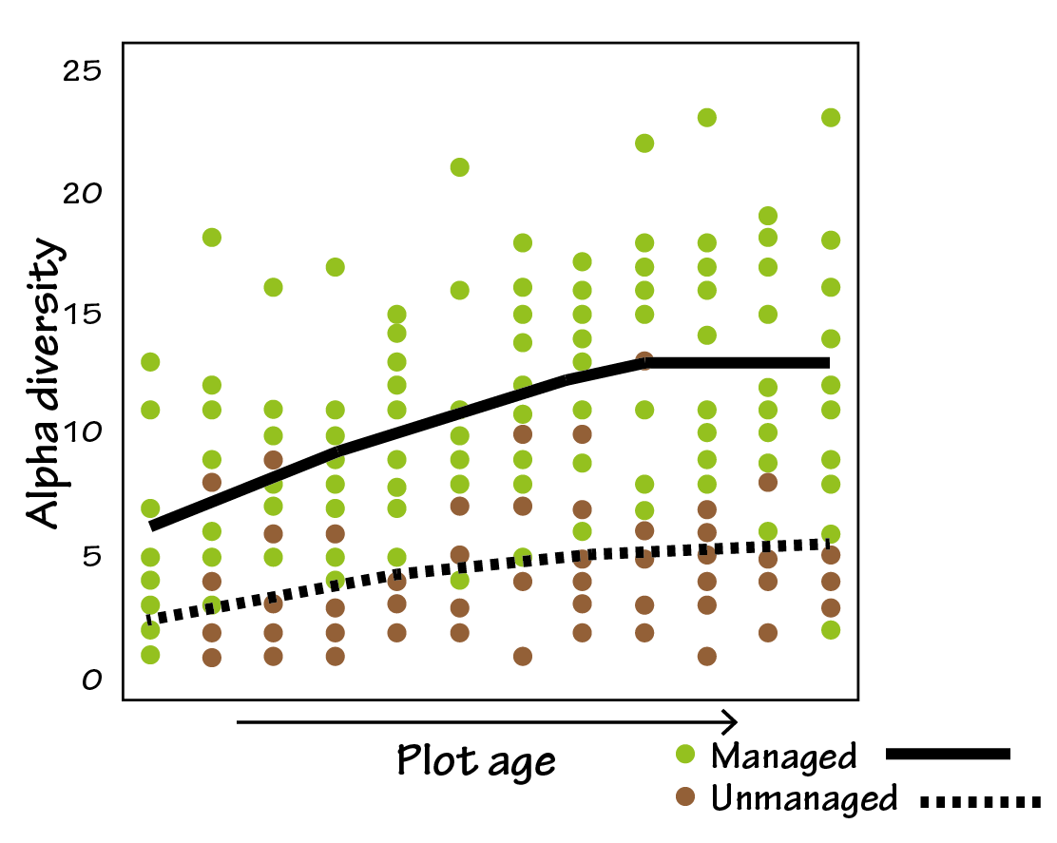
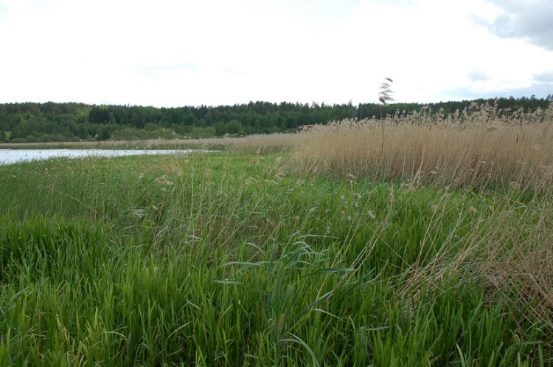
25 20 15 10 5 0
No of plant species (1m²)
Relative age
Auffret & Cousins 2018 Proceedings B
Notes:
Med hjälp av historiska kartor plockade jag ut områden som användes som strandäng för 120 år sedan. Vi inventerade 10 strandängar som fortvarande betas och 10 där hävden upphört. Föga förvånande så är andelen arter mycket högre på de områden som betas idag jämfört med de som inte gör det. Betesdjuren är viktiga, de sprider frön, de håller nere konkurrenterna

Slide 13
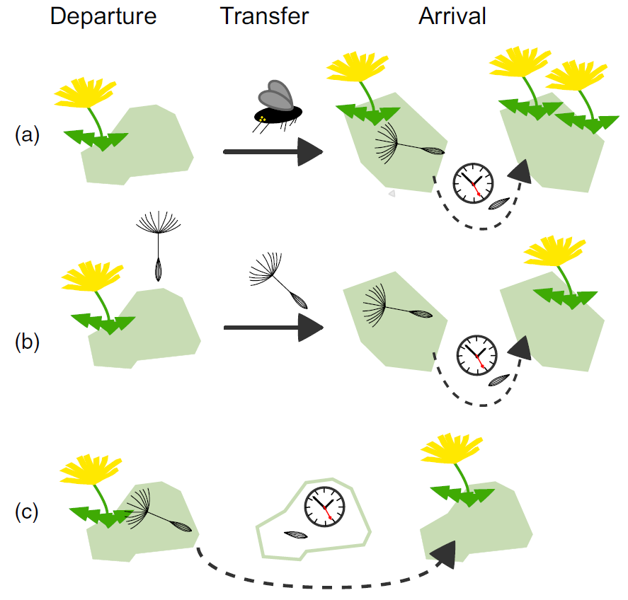
Plant functional connectivity defined as the effective dispersal of propagules or pollen among habitat patches in a landscape
Depends on landscape structure interactions between plants, environment & dispersal vectors
Auffret et al 2017 J Ecology
Notes:
Following recent advances, the functional connectivity concept is now able to move beyond landscape
structure to consider more explicitly how other external factors such as climate and resources
affect species movement. We argue that these factors, in addition to a consideration of the complete
dispersal process, are critical for an accurate understanding of functional connectivity for plant species
in response to environmental change.
3. We use recent advances in dispersal, landscape and molecular ecology to describe how a range
of external factors can influence effective dispersal in plant species, and how the resulting functional
connectivity can be assessed.
4. Synthesis. We define plant functional connectivity as the effective dispersal of propagules or pollen
among habitat patches in a landscape. Plant functional connectivity is determined by a combination
of landscape structure, interactions between plant, environment and dispersal vectors, and the
successful establishment of individuals. We hope that this consolidation of recent research will help
focus future connectivity research and conservation.
Connectivity is the degree to which the landscape facilitates or impedes movement among resource patches

Slide 14
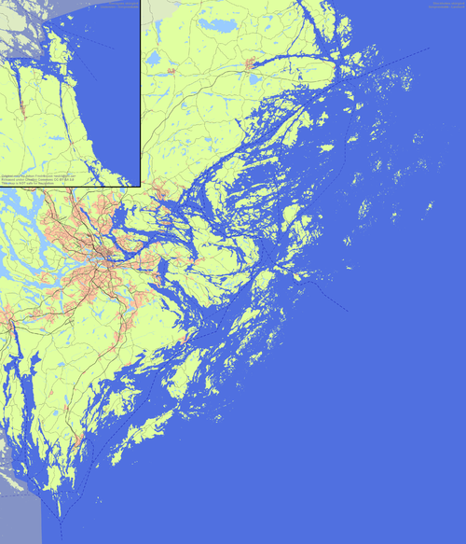
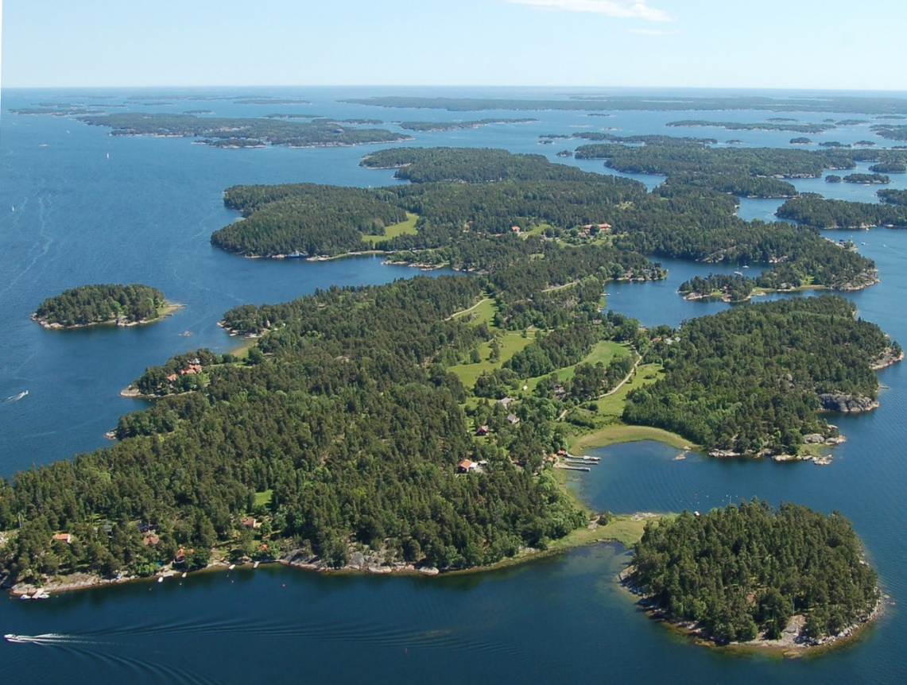
Gällnö-Hjälmö archipelago
Photo: Cousins
50 km
Notes:
Excellent study system for looking into both landscape history and effects of fragmentation

Slide 15
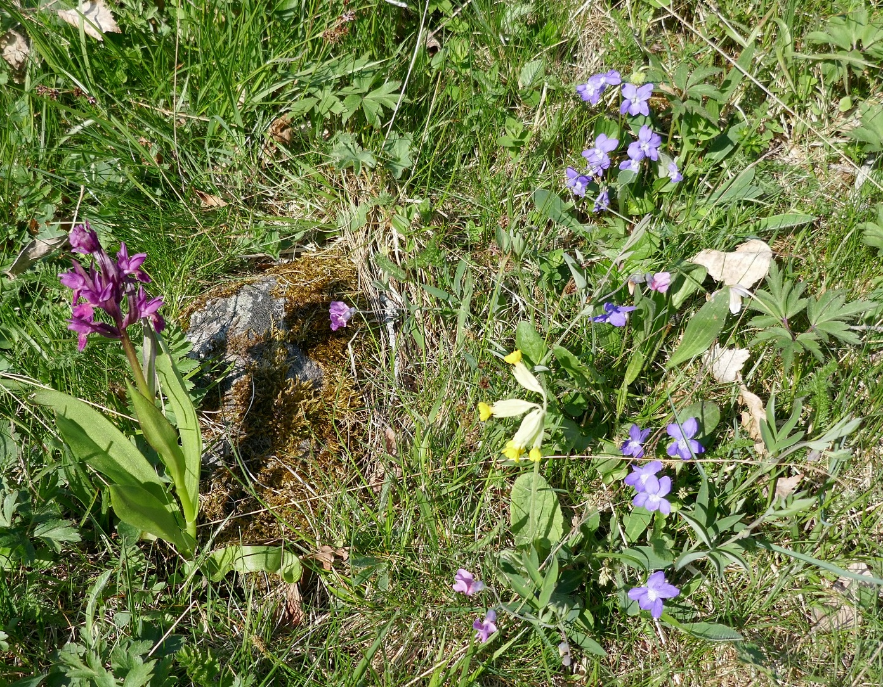
Questions
Campanula rotundifolia
Does plant diversity decline if rotational grazing (spatial dispersal) ceases?
Can seed banks (temporal dispersal) maintain local plant diversity?
Does rotational grazing have an effect on genetic diversity?
Notes:
I will only talk about two questions here rotational grazing is a way to investigate spatial dispersal

Slide 16
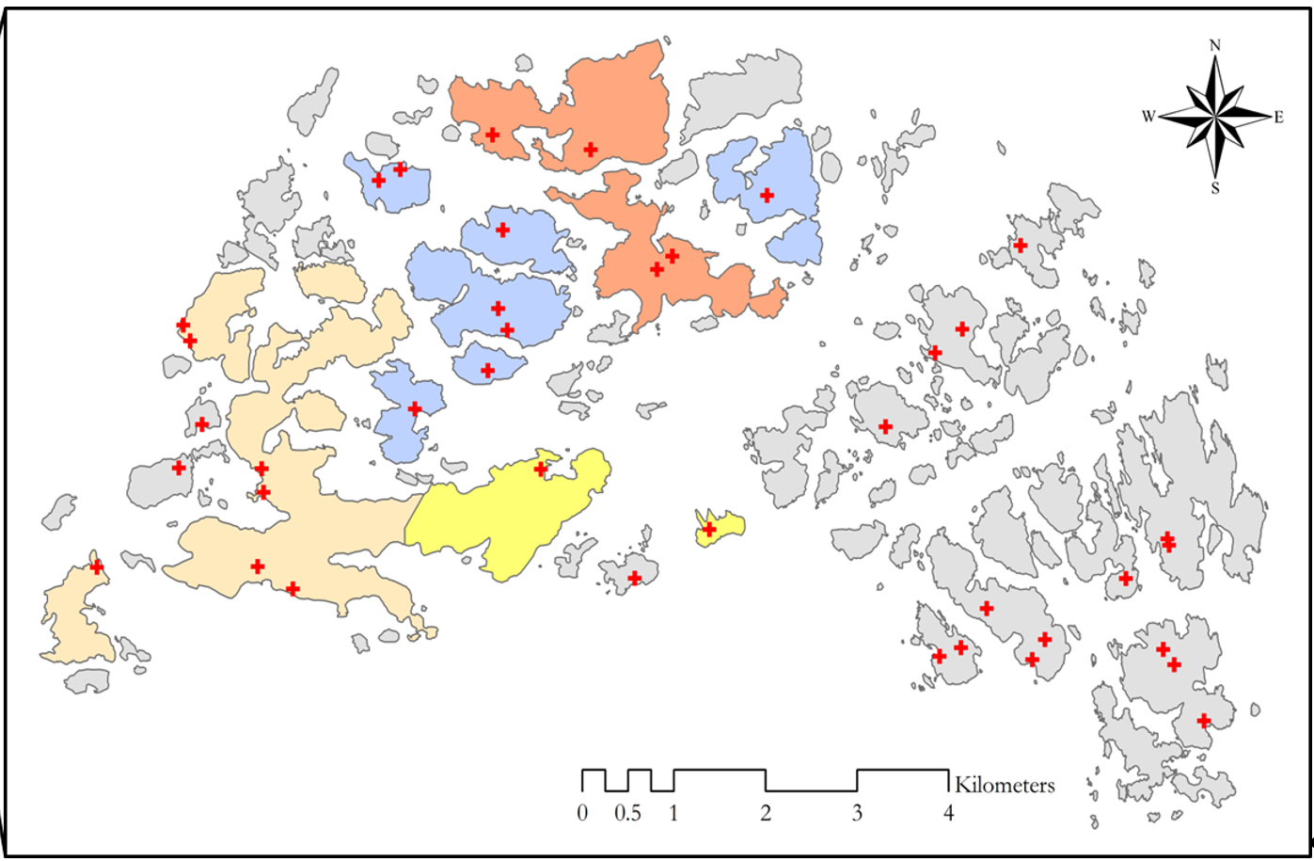
Vegetation sampling Seed bank
Genetic diversity
77 plots
(14 islands with rotational grazing networks/ 13 without)
Notes:
14 islands with rotational grazing networks and 13 withoutThe different colours show the networks to the right (grey) are the islands without traditional grazing networks, the different coloured islands belong to each respecitive network)
50 core samples in each plot 3,5 cm diameter and 5 cm deep excluding the litter layer9

Slide 17
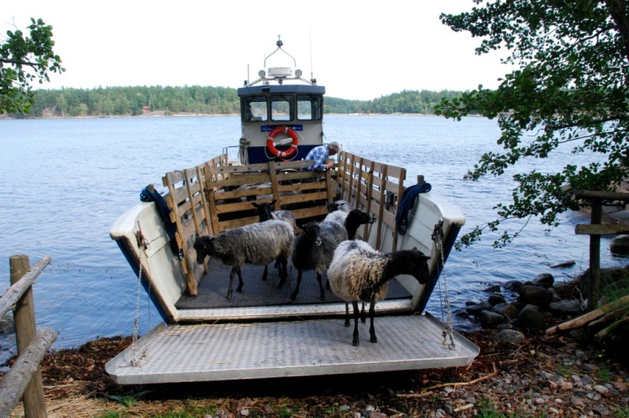
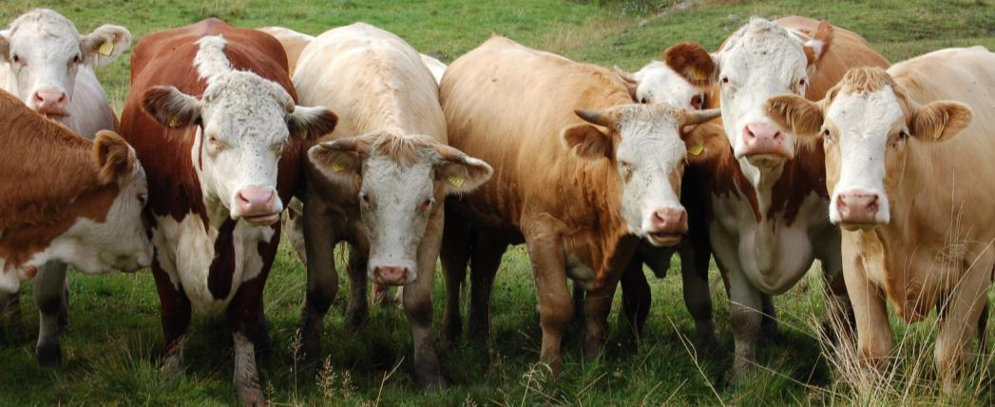
1 cow=96000 seeds/season
Photo: Brännäng
Notes:
What did we ask

Slide 18
Landscape data
4 maps 1850-2015
27 islands, present management
Species richness
138 plots in grasslands
200 plant species
Traits for 160 species
Genetic diversity
Campanula rotundifolia 760 individuals/36 populations
Notes:
Our selection input data
Common harebell perennial herb largely self-incompatible and bee-pollinated, wind dispersal but short range, epizoochorous dispersal appears uncommon, endozoochorous dispersal may persist in remnant populations ensuing fragmentation and abandonment, recovering quickly upon management restoration
Traits according to persistence or dispersal
Genetic diversity using micrositellites to analyse total number of allels, allell richness, gamatic heteroyzyogy

Slide 19
Environmental variables
Presence of rotational grazing
Grassland area
Island size
Distance to nearest grassland and island
160 years of change
Notes:
Grassland area = patch size, island size to account for habitat variation and species pool size,

Slide 20
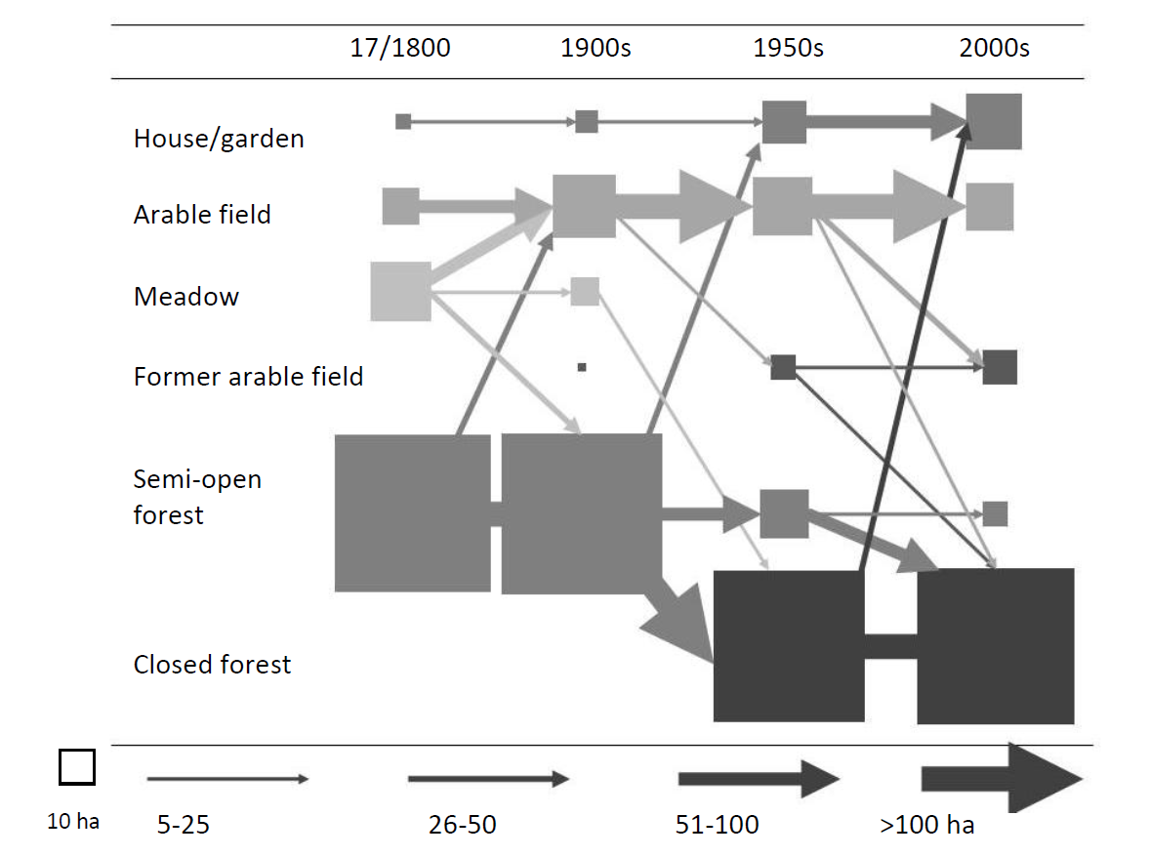
habitat
Rejmark 2011

Slide 21
habitat

Slide 22
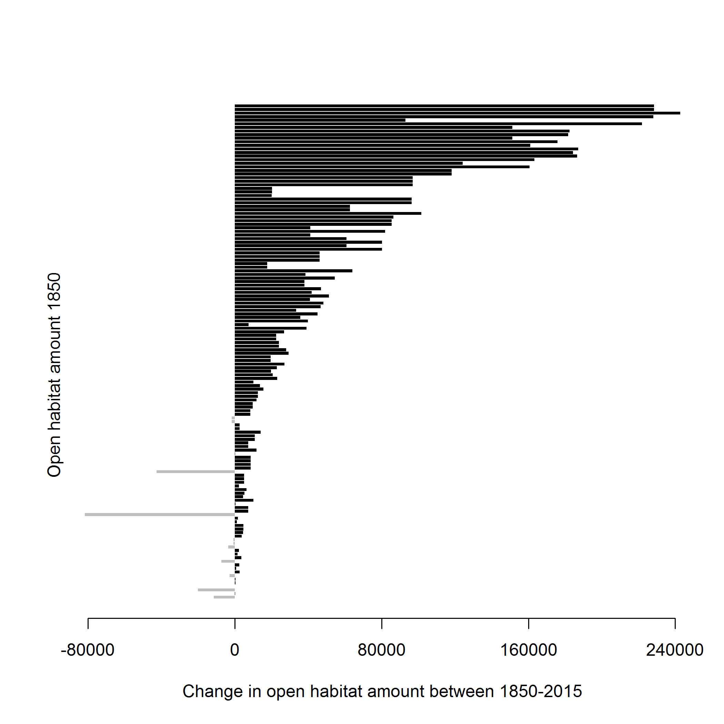
Change in open habitat 1850-2015
Habitat loss =80% Increase in isolation =20%
Gain
Loss
8 ha
0
8 ha
24 ha
Notes:
Average habitat loss 73% individual habitat loss 80%. The remaining open patches are more isolated today
The loss is not linear but

Slide 23
Results
Campanula rotundifolia
177 species: 147 field layer, 113 species (21082 emergent seedlings in the seed bank)
~1/3 less species without rotational grazing
~ Twice as many grassland specialists with rotational grazing
Notes:
I will only talk about two questions here

Slide 24
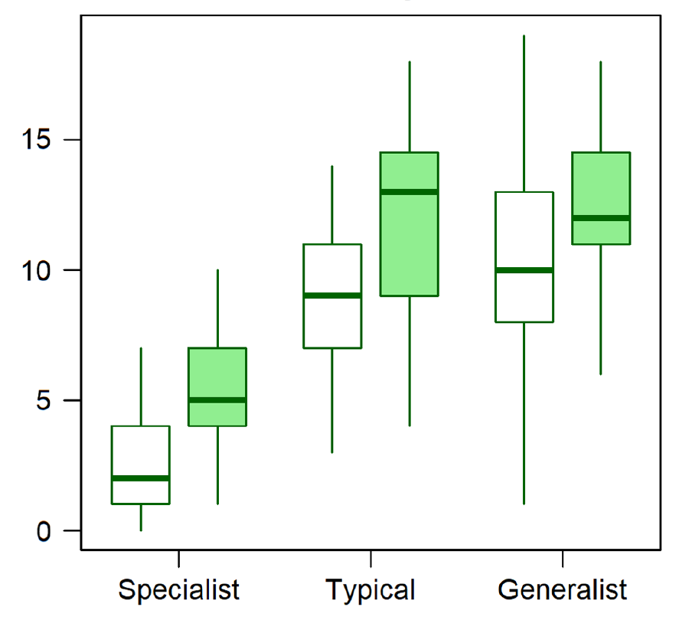
Results
Field layer
Campanula rotundifolia
Patch scale diversity
Rotational grazing +
Patch size +
Increasing distance –
No rotational grazing Rotational grazing
Notes:
Specialist are those that are strong dependence on grassland management, typical are more abundant in grasslands wereas generalist species are not dependent or indifferent on grassland management
Beta diversity is has the inverse effect where the grasslands become more dissimilar without rotational grazing and decreased with increasing size

Slide 25
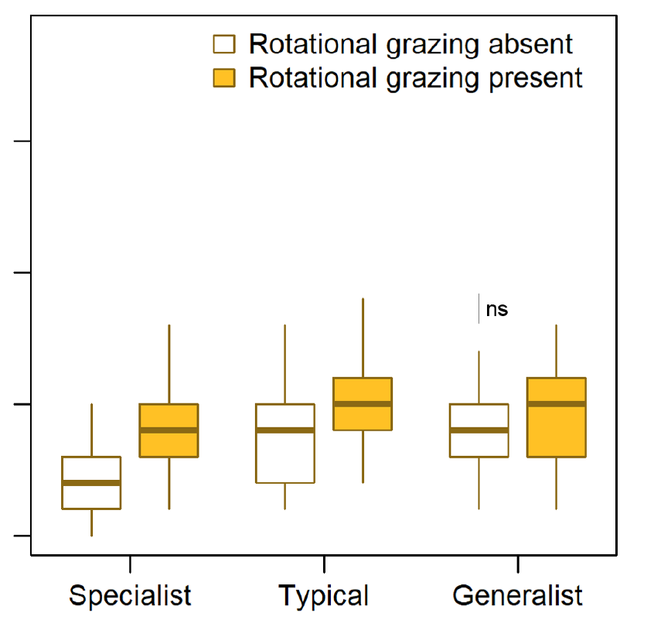
Results
Seed bank
Campanula rotundifolia
Patch scale (seed bank)
Rotational grazing +
Patch size +
Increasing distance –
No rotational grazing Rotational grazing
Notes:
Beta diversity is has the inverse effect where the grasslands become more dissimilar without rotational grazing and decreased with increasing size here generalist species in the seedbank there is a significant difference with higher beta diversity in grasslands without rotational grazing

Slide 26
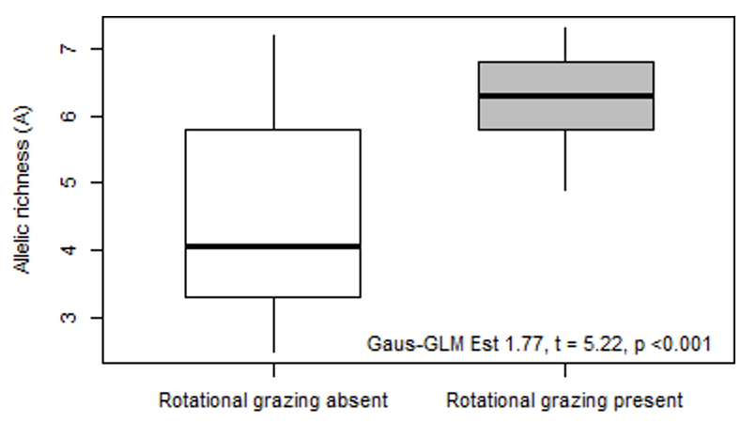
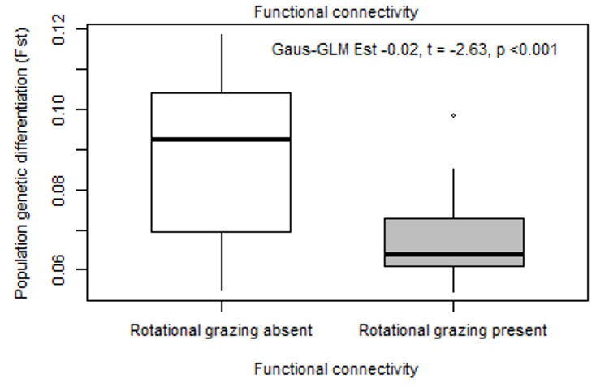
Allelic richness
No rotational grazing
Rotational grazing
Population genetic differenciation
No rotational grazing
Rotational grazing
Plue, Aavik & Cousins 2018 Diversty & Distribution
Notes:
Seed dispersal is considered secondary to pollen flow in outlining landscape-scale patterns in genetic diversity and structure, particularly among fragmented plant populations.. Here we investigated whether landscape-scale genetic diversity, differentiation and spatial structure among isolated populations of Campanula rotundifolia relates to the presence or absence of functional connectivity.
total number of alleles (sum of all alleles across all loci), effective allelic richness,
Boxplots on the effect of rotational grazing presence on genetic diversity metrics and pairwise, between-population genetic differentiation of 39 Campanula rotundifolia populations across the archipelago

Slide 27
Landscape structure
Present management
1850
Present
Stationary
Rotational grazing
+
Species diversity (15 sp)
+
Species diversity (14 sp)
+ (area)
+
Community diversity
+ (connectivity)
+
Genetic diversity
Notes:
15 species past structure Alchemilla glaucescens, Anthriscus sylvestris,Galium album,Galium boreale,Galium verum,Leucanthemum vulgare,Plantago lanceolate,Prunella vulgaris,Ranunculus auricomus,Rumex acetosa, mixed response both historical and present Briza media,Cerastium sp.,Helictotrichon pubescens,Potentilla reptans,Trifolium medium
14 species presentCampanula rotundifolia,Deschampsia flexuosa,Elytrigia repens,Festuca ovina,Festuca pratensis,Filipendula vulgaris,Geum rivale,Hypericum perforatum,Polygala vulgaris,Stellaria graminea,Taraxacum officinalis,Veronica chamaedrys,Veronica officinalis,Viola canina
22 indifferent (51 species in total) Achillea millefolium,Agrimonia eupatoria,Anthoxanthum odoratum,Campanula persicifolia,Carex spicata,Centaurea jacea,Fragaria vesca,Hieracium pilosella,Hypericum maculatum, Lathyrus linifolius,Lathyrus pratensis,Luzula campestris,Melica nutans,Pimpinella saxifrage,Phleum pretense,Phlatanthera chlorantha,Poa pratensis,Primula veris,Rancunculus acris,Trifolium pretense,Trifolium repens,Vicia cracca

Slide 28
Conclusions
Campanula rotundifolia
Local diversity (species and genes) declines without rotational grazing but seed banks may buffer (for a while)
Rotational grazing provide a powerful management tool for conservation
Plue & Cousins 2018 OIKOS
Notes:
Not surprisingly it is the most specialists species that disappears first. The grassland communities on the islands without grazing networks becomes more dissimilar as species goes locally extinct
We can clearly

Slide 29
Time-lags
Functional diversity
Community diversity
Directly affected species
Genetic diversity (C. rotundifolia)
Grassland change (habitat loss, increasing isolation, lack of dispersal vectors)
1850
Time
Adapted from Essl et al. 2015 Diversity & Distributios
Notes:
Directly affected species. We know that 15 species distribution and abundance were related to the habitat area 165 years ago but we cant say if there are timelags in other speices if the time lag have already been “paid”
degree of specialization, longevity, dispersal capacity,

Slide 30
0.3 km² managed
shore meadow today
Last 100 years =80 km² ”shore meadow”
Notes:
Proportion Bara under de senaste 100 åren har upp till 80 km2 mark som skulle kunna vara strandäng stigit upp ur haven - ett område dubbelt så stort som Lidingö. Det kan jämföras med att det bara finns 30 hektar betad strandäng inom samma området idag. Torr gräsmark 265 km2 ?

Slide 31
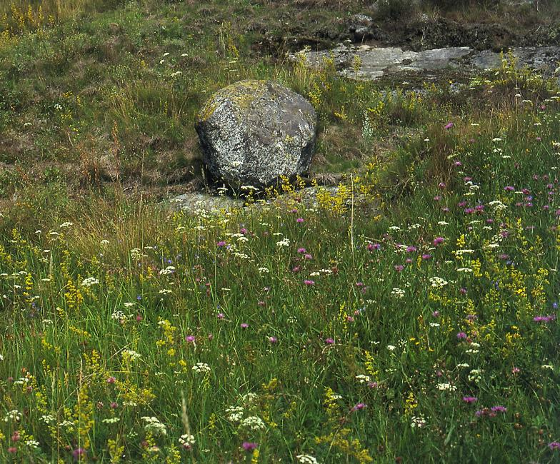
Today
0.3 km² managed
shore meadow
265 km² managed
semi-natural grassland
Notes:
Coastbenefit have restored a total of 9 km/ 2,3 km of shore meadow
Bara under de senaste 100 åren har upp till 80 km2 mark som skulle kunna vara strandäng stigit upp ur haven - ett område dubbelt så stort som Lidingö. Det kan jämföras med att det bara finns 30 hektar betad strandäng inom samma området idag. Torr gräsmark 265 km2

Slide 32
New challenges
X
X
Photo: S. Sternberg
Photo: Cousins
1920
2018
45 cm isostatic rebound in 100 years
67 cm sea level rise in the next 80 years*
*SMHI 2017 future sea level change
Notes:
Interesting to understand how connectivity will change with future sea level increase that can’t be compensated by isostatic rebound
I would get wet feet!

Slide 33
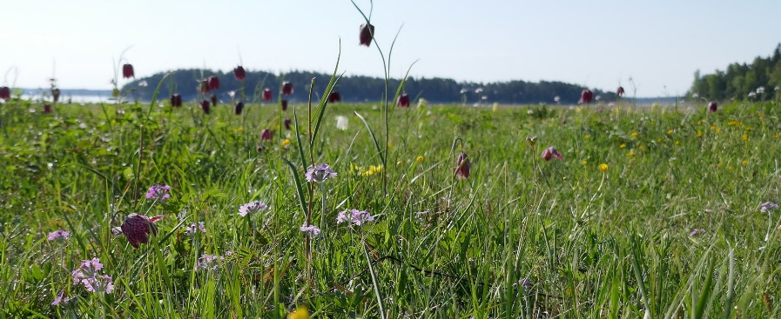
Conclusion and Future?
Notes:
Our combination of approaches identifies uplifted coastal meadows as an additional original niche for grassland plant species, while highlighting that low-intensity disturbance through grassland management
is essential for the maintenance of diversity at multiple scales. Animals are important!
67 cm högre år 2100? Interesting to understand how connectivity will change with future sea level increase that can’t be compensated by isostatic rebound
Även om vi inte kan stoppa havsytehöjningarna i ett nafs så kan vi alla fall planera landskapen, se till att det finns betande djur som knyter ihop de punkter som finns och att se till att det finns gräsmarker ovanför de nuvarande så att växterna kan vandra uppåt (och insekterna och fåglarna)

Slide 34
Tack!
@SAOCousins

