Slide 1


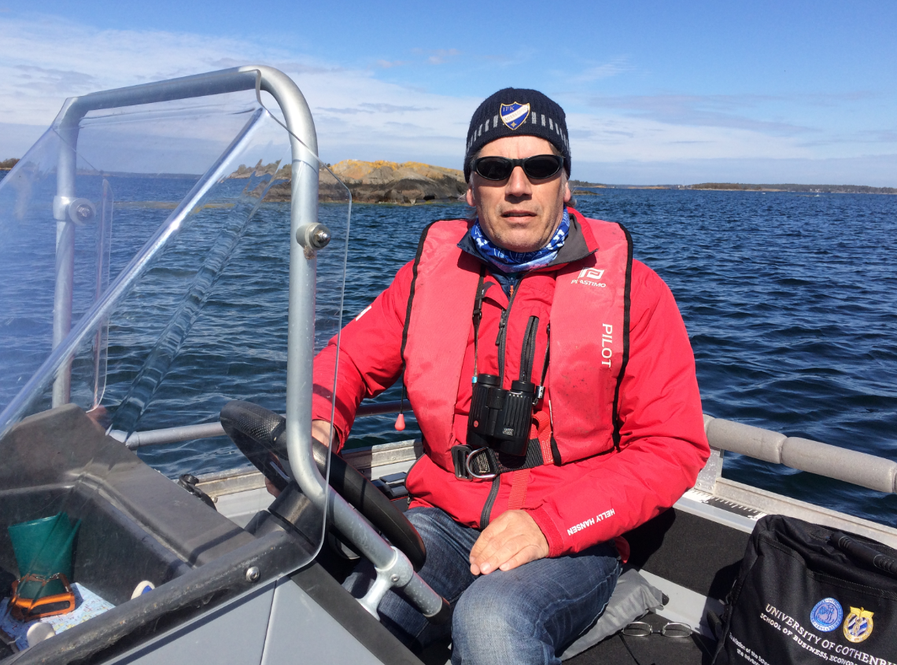
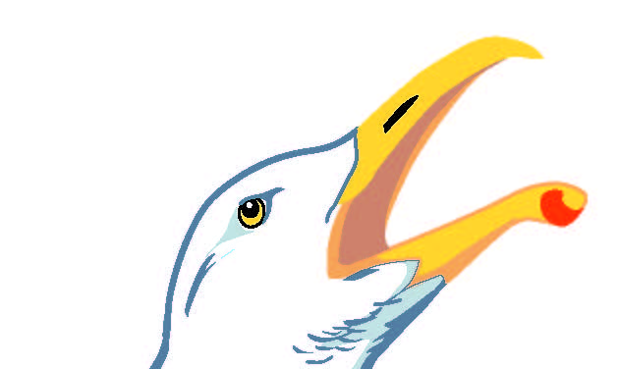
LIFE Coast Benefit
Coastal Birds
Lars Gezelius, CAB Östergötland.
Protection and monitoring. Marine habitats.
lars.gezelius@lansstyrelsen.se
Notes:
I have worked at CAB Östergötland, division of Nature protection, since 1993. I do revisions of Bird and Seal sanctuaries and establish new marine MPA, marine mapping and monitoring and recently I also handle fishing matters. PHOTO: Vesa Jussila.

Slide 2

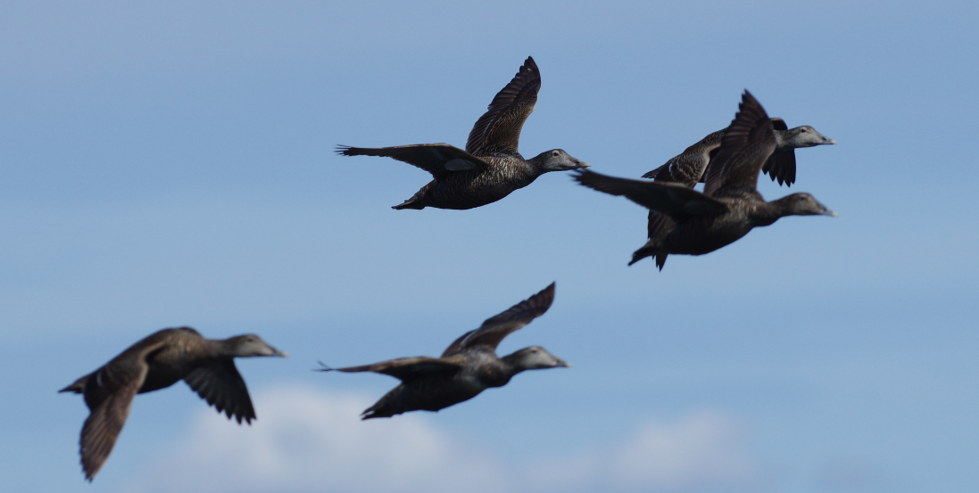
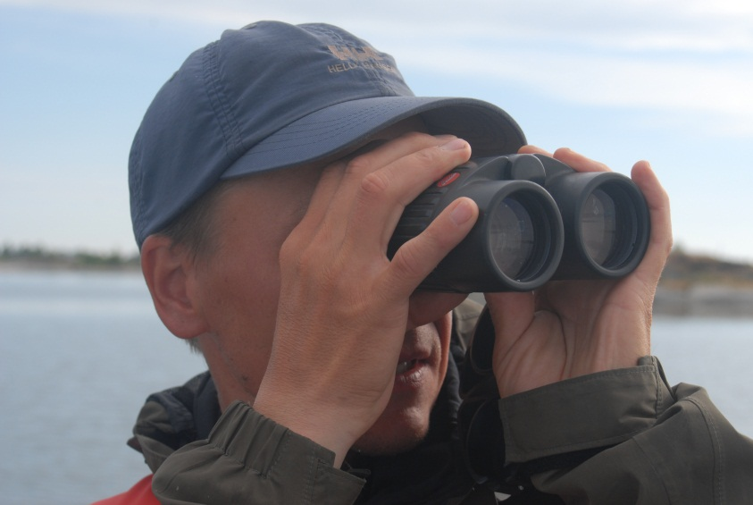
Trends, threats and reflexions on the coastal bird fauna in Östergötland
Coastal birds – Grebes, Swans, Cormorants, Ducks, Waders, Skuas, Gulls, Terns and Auks.
Some charactreistic species: Eider (Ejder) Somateria molissima, Velvet Scooter (svärta) Melanitta fusca, Arctic tern (silvertärna) Sterna paradisea, Caspian Tern (skräntärna) Hydroprogne caspia, Razorbill (tordmule) Alca torda and Turnstone (roskarl) Arenaria interpres.
Generally: over 50-70 years the coastal bird fauna has become more species-rich and a bit less maritime.
Freshwater species (mainly fish eaters and vegetarians) have increased – eg. Mute Swan (knölsvan) Cygnus olor, Gadvall (snatterand) Anas strepera, Shoveler (skedand) Anas clypeata, Common Tern (fisktärna) Sterna hirundo.
Colonies of Gulls are important sites for waders and ducks.
Significant decreases the last decades in some species.
Notes:
The seabirds at the Baltic coast comprises around 40 species in the groups of Grebes, Swans, Cormorants, Ducks, Waders, Skuas, Gulls, Terns and Auks (doppingar, skarvar, svanar, änder, labbar, måsar, tärnor, alkor.) In general terms the coastal birdfauna in Östergötland has become less maritime. Freshwater species/vegetarians have increased. Herring Gull (gråtrut) Larus argentatus is a key-species as their colonies are important breeding sites for other Gulls, Ducks and Waders. The coastal bird fauna has changed significantly in many respects the last decades. PHOTOS: Lars Gezelius.

Slide 3
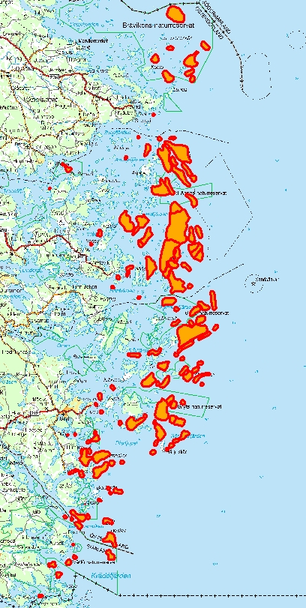
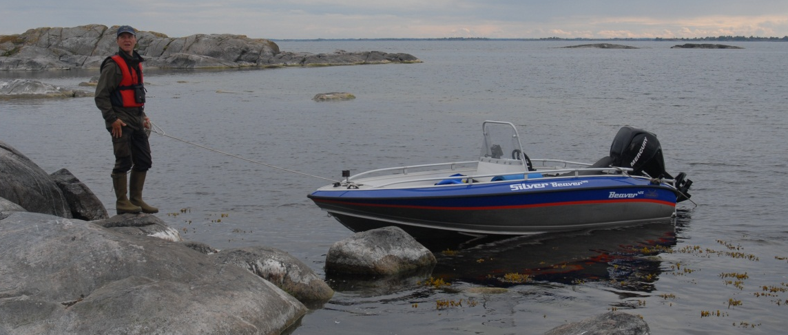
Monitoring of coastal birds
Monitoring programs - Östergötland
Counts at about 2000 islands. Every 10:th year since 1981
Counts at 41 Herring Gull (Gråtrut) colonies. Every 3:rd year since 2007.
Monitoring in 12 standard plots 2x2 km. Yearly since 2015.
Monitoring of various actions.
All monitoring covers mainly central and outer archipelago.
Notes:
In Östergötland we monitor the coastal birds in three programs within the CAB:s regional environmental monitoring program. The map shows monitored zones in the extended monitoring of coastal birds performed every 10:th year, comprising about 2000 islands and skerries of around 1300 hectares. All monitoring covers mainly central and outer archipelago. PHOTO: Lars Gezelius.

Slide 4
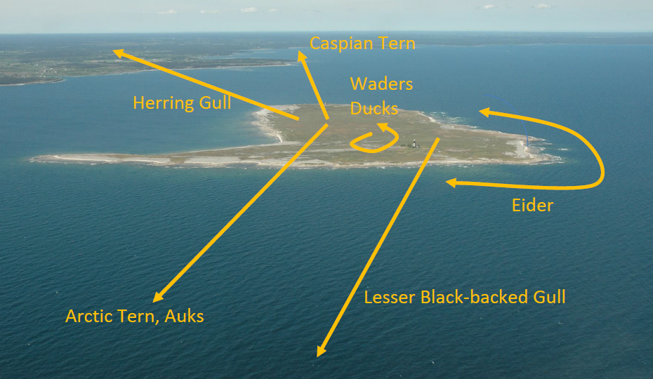
Spatial distribution during breeding
Breeding grounds – relatively similar
Feeding grounds – great differences
In the next slides follow trends for some coastal bird-species:
Notes:
Coastal birds have different requirements during breeding. For many species the breeding sites are relatively similar, but the feeding grounds can be fundamentally different. Gulls, Terns and Aauks (trutar, tärnor och alkor) may feed far from the breeding sites. Wades and ducks (vadare och änder) feed close to breeding site. PHOTO: Kjell Larsson.

Slide 5
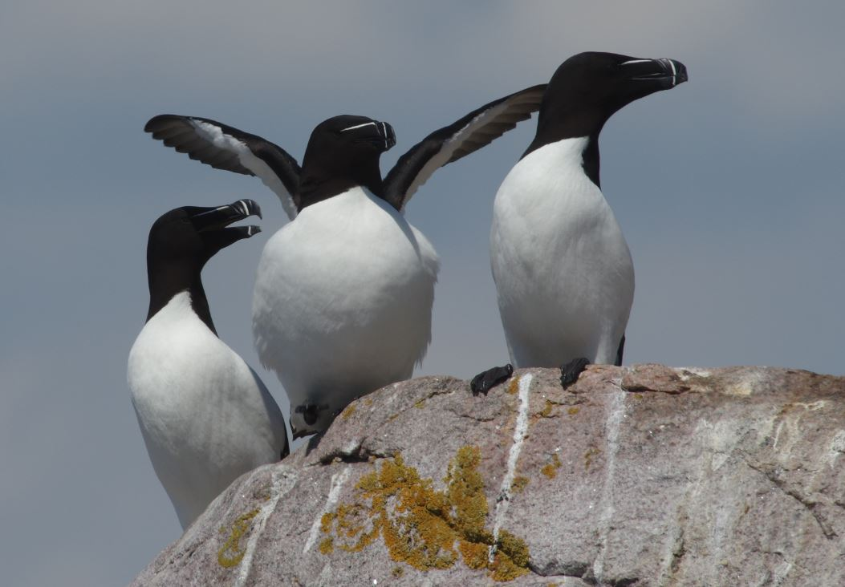
Fish eaters – deep divers (40-50 m)
Razorbill (tordmule) Alca torda is a winner – fourfold increase. The food source - pelagic fish, eg. Sprats (skarpsill) Sprattus sprattus - has increased. Nest in cavities in rocky skerries.
Notes:
Razorbill has increased fourfold in Östergötland in the last 35 years. They breed on rocky skerries with cracks and big boulders in the outer achipelago. It is a typical species in the habitats 1260 (Vegetated sea cliffs of the Atlantic and Baltic coasts ) and 1620 (Boreal Baltic islets and small islands). They feed on pelagic fish and dives down to 40-50 meters deepth and can feed some 10-20 km from nesting sites. PHOTO: Lars Gezelius.

Slide 6
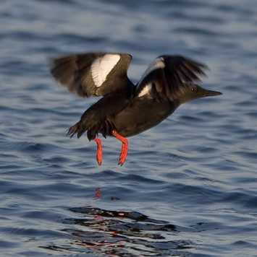
Fish eaters – deep divers
Black Guillemot (tobisgrissla) Cepphus grylle (NT)
Not doing very well.
Breeds on outer skerries, rich in boulders,
dives 10-30 m.
Östergötland population
32 pairs 1997
12 pairs 2007
9 pairs 2017
Threats: American Mink, oil spill.
Typical species in the habitats 1230 and 1620.
Notes:
Black Guillemot (tobisgrissla) Cepphus grylle, has decreased in Östergötland and in the Swedish central Baltic. In Stockhom archipelago the decrease was 78 % between 1975 and 1999. Total decrease in Sweden the last 20 years is 20 %. It feed on fish and also invertebrates. The breeding habitat may be improved by making artificial nesting cavities. PHOTO: Lars Gezelius.

Slide 7
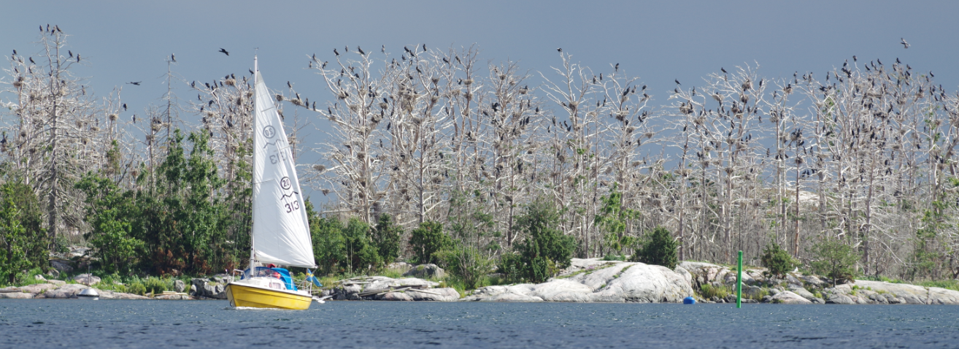
Fish eaters – deep divers
Cormorant (storskarv) Phalacrocorax carbo sinensis – increase but stabilizing. About 4000 pairs in Östergötland. Causing conflicts with fishermen and local residents. CAB:s has given several permits to reduce colonies. Opportunistic fish-eater.
The largest colony in Östergötland at Källskär. 1500 pairs. 35 Sea Eagles seen in the colony…
Notes:
PHOTO: Lars Gezelius.

Slide 8
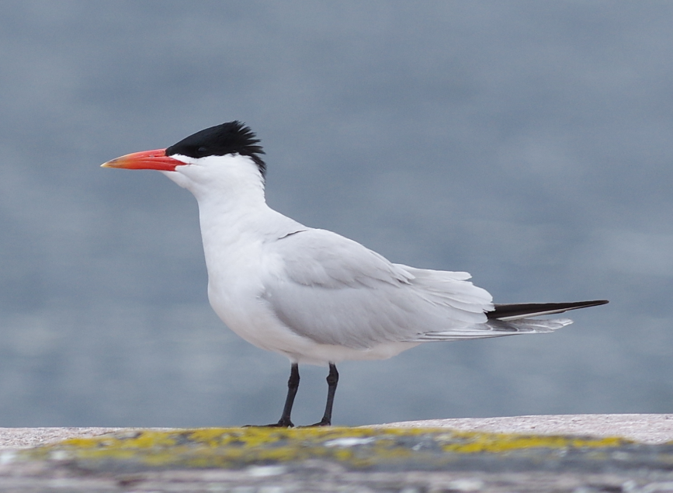
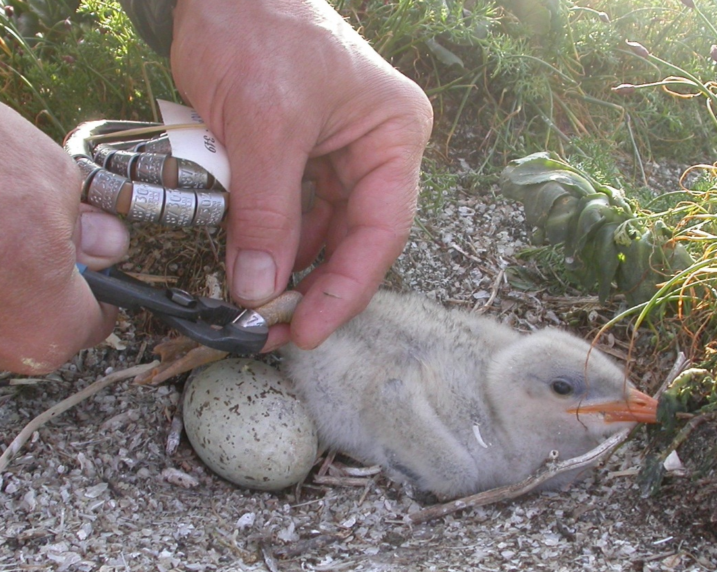
Fish eaters – shallow divers
Caspian Tern (skräntärna) Hydroprogne caspia (NT)
Two colonies in Östergötland
About 60-100 par.
Census every year, also ringing and predation control.
Feed often in inland lakes or coastal lagoons. Mainly Perch/Roach.
Suffer from predation (Mink, Herring Gull and Sea Eagle) in recent time.
Notes:
In Östergötland the Caspian tern breeds in two main colonies, one in the north and one in the south. The population is vulnerably small (60-100 pairs), fluctuating but relatively stable. Main threat is now predation from American Mink, Herring Gull (gråtrut) and White-tailed Sea Eagle (havsörn). It feed on fish in shallow zones, often in inland shallow lakes or coastal lagoons several 10:th of kilometers from the breeding site. Mainly Perch (abborre) Perca fluviatilis / Roach (mört) Rutilus rutilus. PHOTOS: Lars Gezelius.

Slide 9
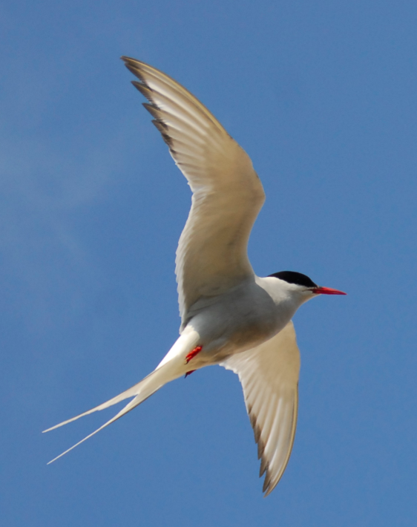
Fish eaters – shallow divers
Arctic Tern (silvertärna) Sterna paradisea
More than a fivefold increase!
Feed on small fish – e.g. sticklebacks
(spigg)
Breed in colonies in outer archipelago on open skerries
Notes:
The Arctic tern (silvertärna) shows a strong increase in Östergötland since 1981! It feeds on small fish in shallow zones– e.g. Sticklebacks (spigg) Gasterosteus aculeatus. PHOTO: Lars Gezelius.

Slide 10
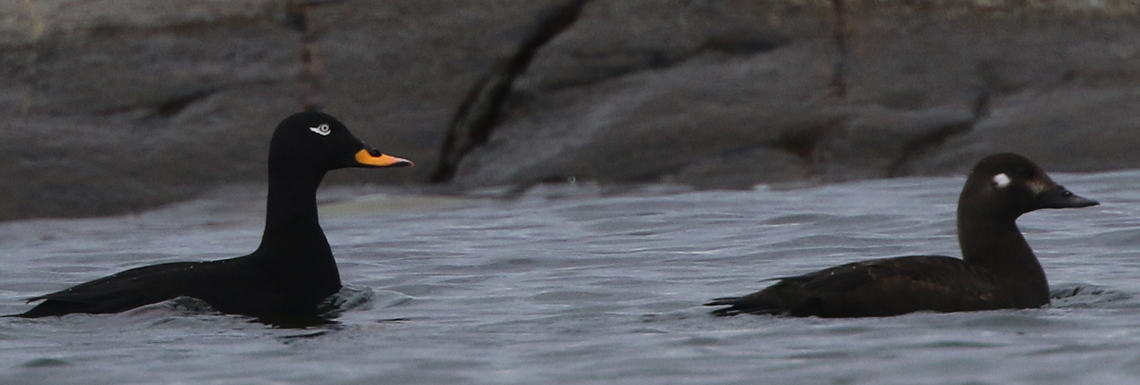
Infauna eaters – shallow divers (5-10 m)
Velvet Scooter (svärta) Melanitta fusca (IUCN, Globally vulnerable, VU)
Decrease, but maybe sabilization in the last years? Threats: Mink, oil spill, tourism.
Nest near small bush, breeding near Gull colonies probably favourable. Feed on mussels and invertebrates.
Notes:
The Velvet scooter (svärta) shows a general decrease in the Swedish central Baltic coast of about 50–60 % the last 10–25 years. Threats are predation (American Mink), oil spill, turbid water, disturbance (boat-tourism). Needs small bushes or high grass as nest shelter. Breeding in colonies of Gulls favorable. Dives for mussels (musslor) and invertebrates. PHOTO: Ulrik Lötberg.

Slide 11
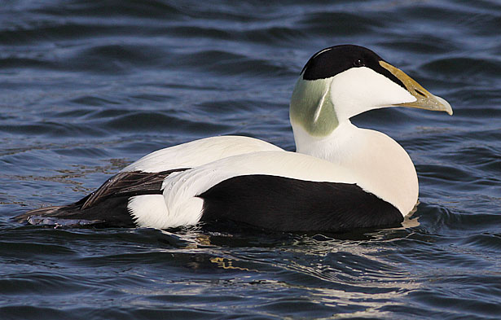
Bluemussel eaters – shallow divers (5-15 m)
Eider (ejder) Somateria molissima (IUCN, Globally near threatened, VU in Europe)
Very strong decrease in the latest years. Extremely few clutches seen in water in june.
Threats: predation, bias in sex-ratio (less females), lack of Thiamine, less yeld per musslel
Notes:
Eider (ejder) shows a very strong decrease in the latest years. We see extremely few clutches in the water in recent years. Preferrably hide its nests in grass or under a bush. Feed on Blue mussels of about 17-18 mm in size. Blue mussels have increased in numbers in late 1900 century. In winter they need to eat mussels in quantities equal to their body mass per day…
Threats: predation (Mink and Sea Eagle) , bias in sex-ratio 40-60 % (less females), eutrophication, climate changes, lack of thiamine, less yeld per musslel, mussel-fishing in winter quarters, eg. DK) and maybe access of food (mainly Crustaceans) for the youngs. We shal though remember that the Eider was not so common in the early 1900s. So the Eider has increased and then decrased. In general over the last 50 years the curves of the Eiderpoulation and eutrophication shows consitency…PHOTO: Lars Gezelius.

Slide 12
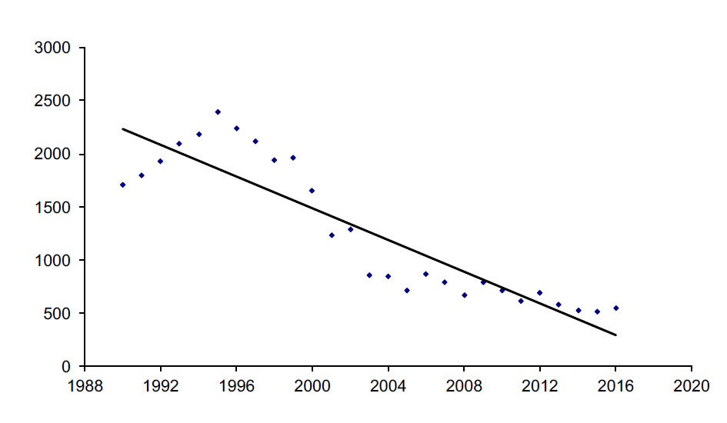
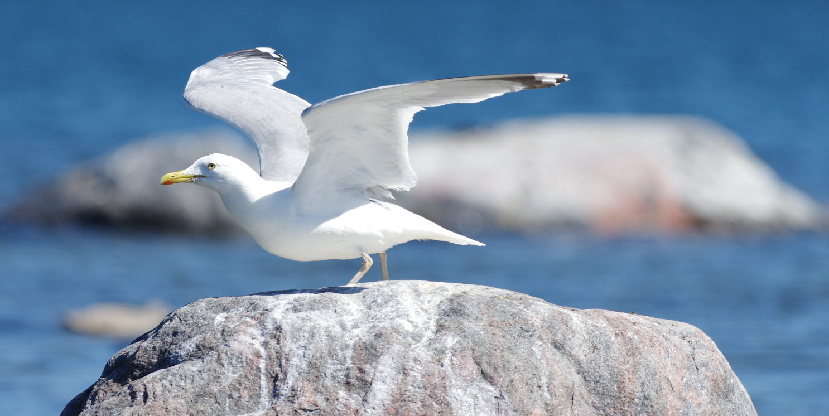
Herring Gull - decreasing key species
(Omnivourus)
Number of pairs of Herring Gulls (VU) Larus argentatus at Kalmar coast 1990-2016.
Threats: less waste available, lack of thiamine (B1). Needs tree-free skerries.
Important species as their colonies attracts other breeding seabirds.
Notes:
The Herring Gull (gråtrut) Larus argentatus NT, shows a strong decline along Swedish central Baltic coast. Breeds generally in colonies often associated with other species, often on rocky and tree-free skerries. Omnivourus – e.g. fish, dumped fish and fishwaste, rodents, birds and eggs, human waste, frogs, worms, mussels, seeds. 30-years ago human waste and waste from comercial fishing was important food source. Threats: less waste available, lack of thiamine (B1). The species is important as their colonies attracts other breeding seabirds. PHOTO: Lars Gezelius.

Slide 13
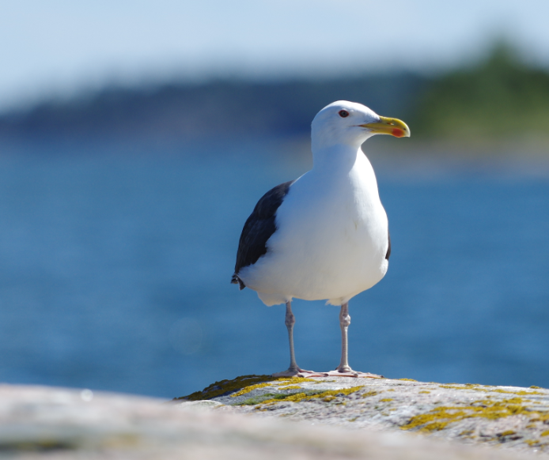
General decline in the Gulls
Great Black-backed Gull (havstrut) Larus marinus & Lesser Black-backed Gull (silltrut) Larus fuscus fuscus (NT)
Notes:
We see a general decline in the three species of Gulls in Östergötland. Great Black-backed Gull (havstrut), Lesser Black-backed Gull (silltrut) and Herring Gull (gråtrut). Great Black-backed Gull has decreased 50 % in 20 years. We have only a few pairs left of the Lesser Black-backed Gull although it is a fish-eater…. Threats are predation, toxins, less available fish-waste, hunting and changes in winter quarters (Africa). Typical species in the habitats 1260 & 1620. The Great Black-backed Gull breeds mostly solitary. It is omnivourus. PHOTO: Lars Gezelius.

Slide 14
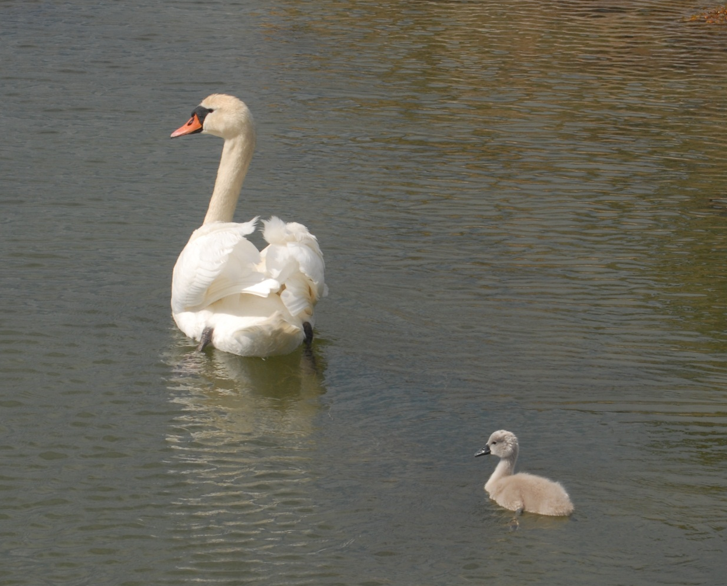
Increase in some freshwater widfowl
(vegetarians)
Mute Swan (knölsvan) Cygnus olor. More than a fourfold increase.
Notes:
The Mute Swan (knölsvan) Cygnus olor is an example of an increasing waterbird along the Baltic coast feeding on plants and traditionally being a freshwater species. PHOTO: Lars Gezelius.

Slide 15
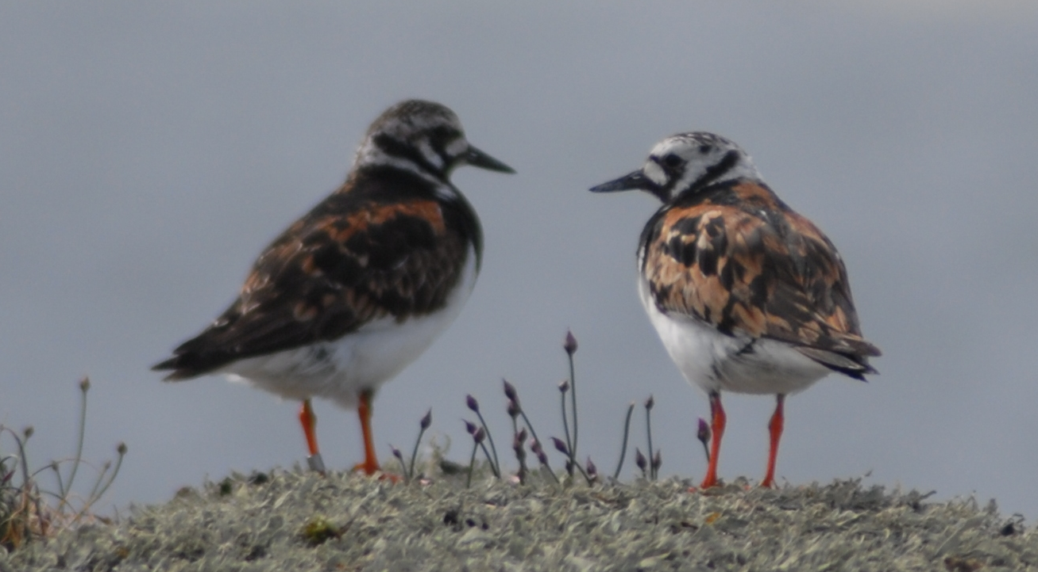
Vaders – feeds on the shore
Turnstone (roskarl) Arenaria interpres. (VU) Sparse breeder in colony-skerries. Generally declining. Adversebly affected by overgrowing, probably aslo Mink negative as well as declining of Gull colonies.
Notes:
Turnstone (roskarl) Arenaria interpres. Is a sparse breeder, mostly in skerries with a colony of Gulls or terns. We see a 50 % decline the last decades. Probably negatively affected by lack of grazing and overgrowing. Probably also suffer from predation by American Mink and the declining of the Herring Gull (gråtrut) Larus argentatus. PHOTO: Lars Gezelius.

Slide 16
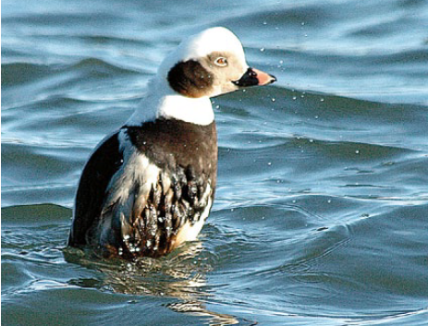
Antropogenic threats
Exploitation
Hunting
Oil Spill
By-catching
Notes:
Some direct human caused impact on many coastal birds are different kinds of exploitation, hunting, oil spill and by-catching. PHOTOS: Kjell Larsson.

Slide 17
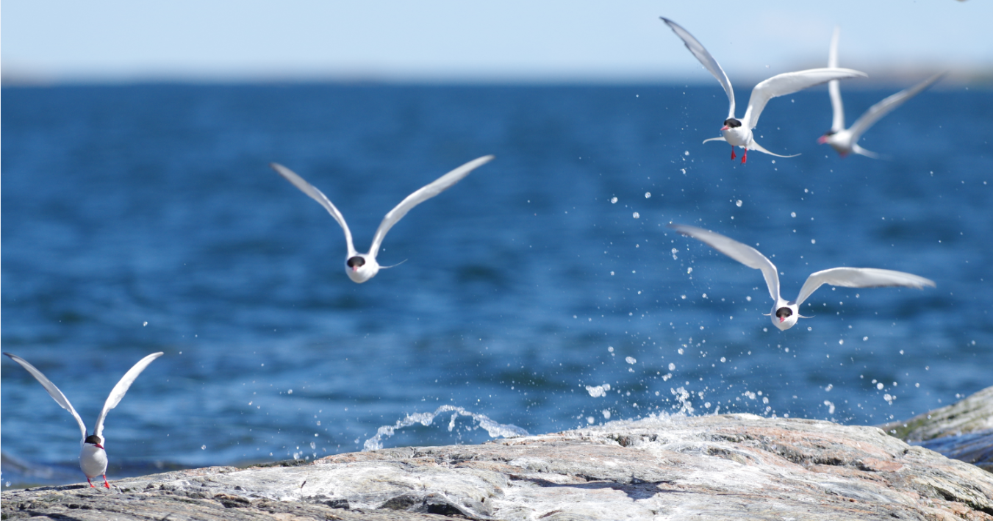
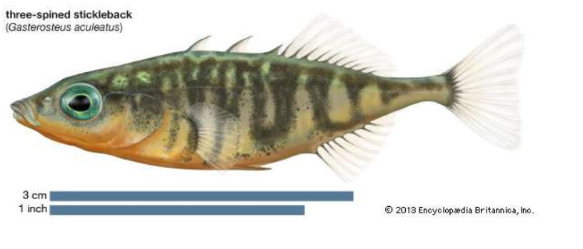
Ecosystem pressures
Many factors affecting:
Climate changes
Eutrophication
Overfishing
Trophic shifts
Changes in breeding grounds
Changes in food web
Lack of Thiamine
Notes:
The marine ecosystem in central Baltic has changed quite dramatically the last 50 years as has the coastal bird fauna in response. Human induced changes in waterquality and throphic levels has lead to different cascade effects that have changed the food abundance and/or quality for many of the coastal birds where some are winners and others loosers. PHOTO: Lars Gezelius.

Slide 18
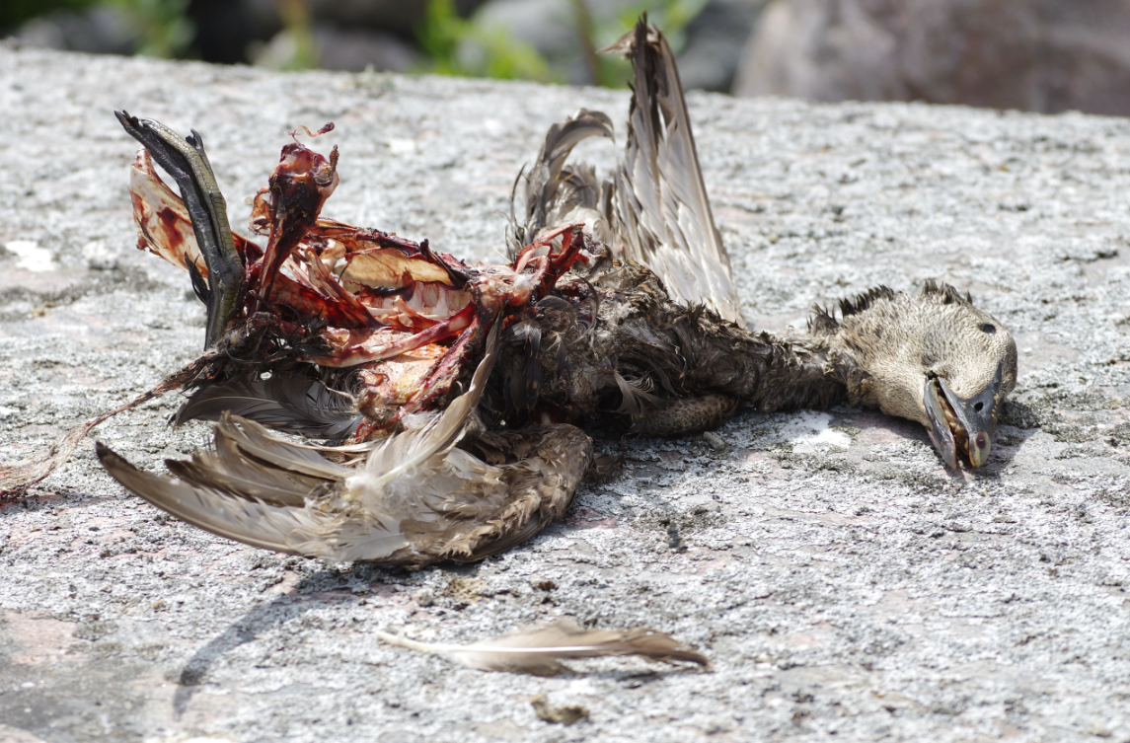
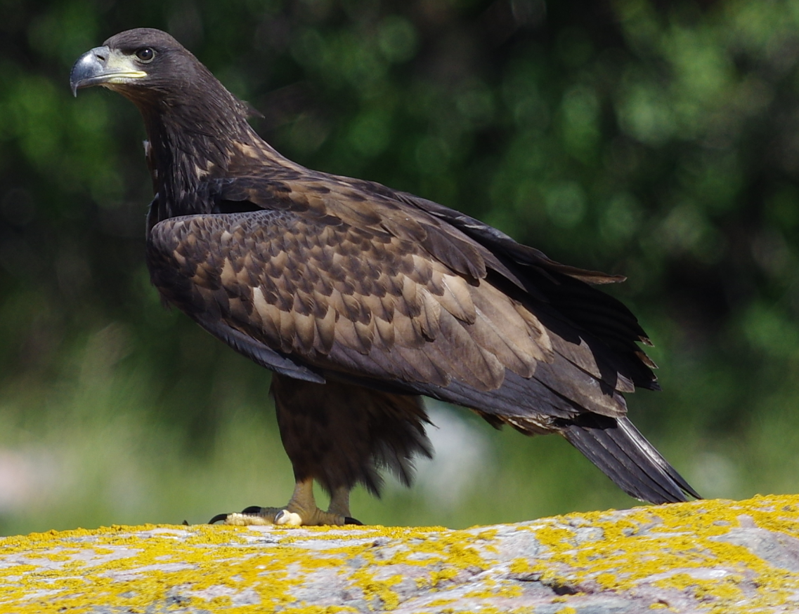
Interspecific threats
Predation – Sea Eagle, American Mink, Herring Gull, Crow and others.
White-tailed Sea-eagle (havsörn)
Notes:
We have seen an increase in predation from White-tailed Sea-eagle (Havsörn) Haliaeetus albicilla. Most obvious on Caspian Tern (skräntärna). PHOTOS: Lars Gezelius.

Slide 19
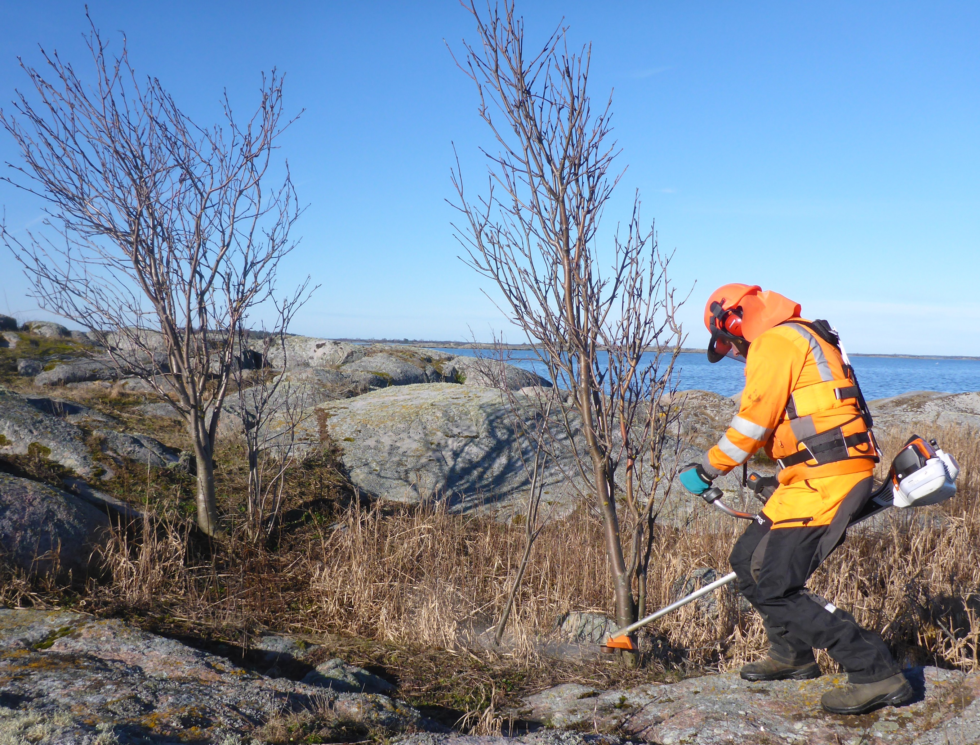
Improvment for birds
Actions in this project are:
Reducing predator pressure from American Mink
Restoration of overgrowed breeding sites
Species that can benefit are:
Gulls and terns – direct
Waders – direct and/or indirect
Ducks – mainly indirect
The clearing will make the sites more attractive for colony breeders and reduce risk of predation from e.g. Crows, using the small trees as outlook posts.
Notes:
Owergrowing of skerries is an effect of natural sucession, to some extent speeded by atmospheric deposits of nutrients, but also reduced grazing pressure and reduced human wood harvest in the last say 50 years. PHOTO: Martin Larsson.

Slide 20
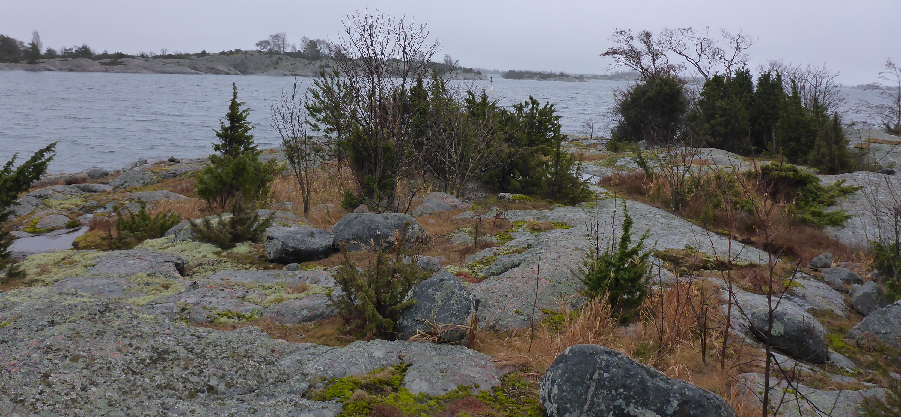
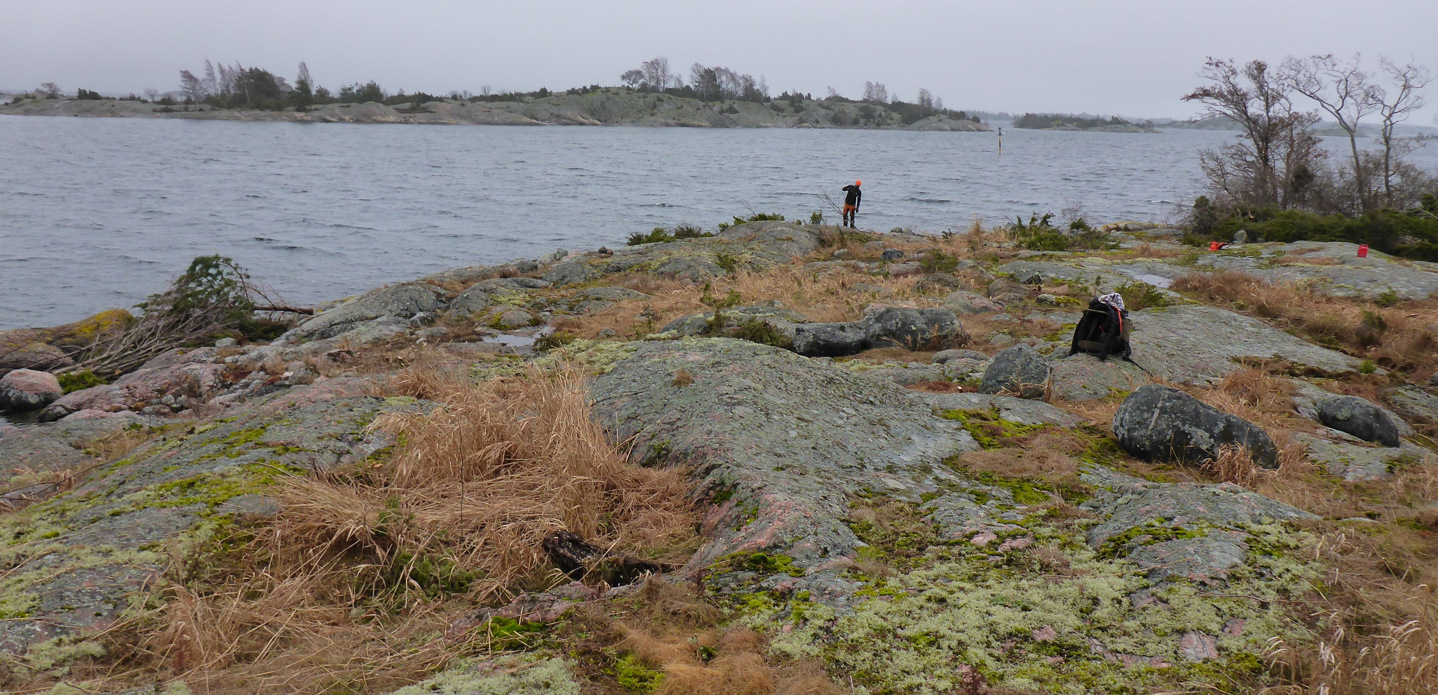
Ådklabb - before and after
Around 130 ha was cleared in the three Countys in 2016-2018.
Before-after monitoring of the breeding birds is ongoing. The clearing has focused on skerries in middle and outer archipelago. The goal were to clear most of the islands from higher vegetation or sometimes parts of the islands. A report with results will be published.
Notes:
The CAB:s accomplish monitoring of the breeding bird populations before and after the clearing of the skerries. Evaluation is now ongoing with some data to be collected in the upcoming breeding season 2019. A report over the restoration actions on the bird-skerries and the monitoring of the response of the breeding birds will be published in ths project (autumn 2019).

Slide 21
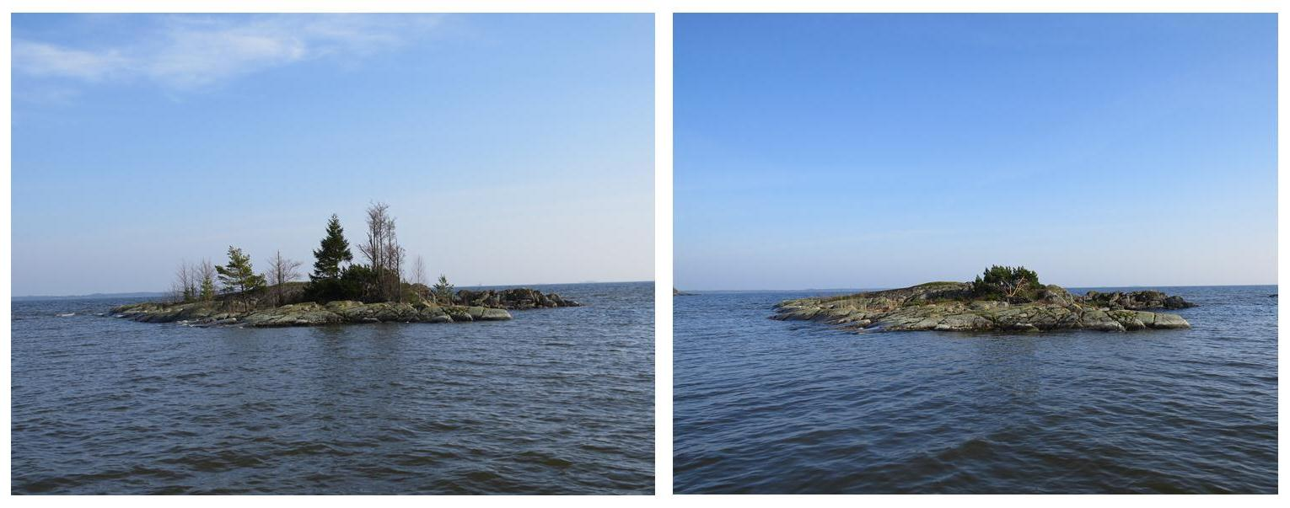
LIFE Vänern – clearing of skerries
200 skerries cleared. No immediate positive response found yet.
Notes:
In an evaluation of a similar projekt in Lake Vänern, Sweden, (LIFE Vänern) there were few sign of immediate positiv response to clearing actions at 200 skerries in the years 2014-2018. Lund University suggest though that the actions has contributed to stabilaze the population levels. The objectives for the clearings was to restore important breeding sites for colony nesting birds such as terns, gulls and other species connected to the bird colonies. PHOTOS: Gunnar Lagerkvist/LIFE Vänern.

Slide 22
LIFE Vänern
- some positive examples
Branta leucopsis Croicocephalus ridibundus Sterna hirundo
Few signs of short term increasing breeding pop. after clearing.
Maybe there is an historic ”dept” - i.e. ”there are no birds waiting to invade”
Notes:
After restoration (years 1 and 2) of 200 skerries in Lake Vänern, Sweden, there were some species showing increase in number of breeding pairs compared to the years before the actions (years -5 to -1) – e.g. Barnacle Goose (vitkindad gås) Branta leucopsis, Black-headed Gull (skrattmås) Croicocephalus ridibundus and Common tern (silvertärna) Sterna hirundo. Data from LIFE Vänern and Lund University, Martin Green.

